Slide 1
AACP History of Pharmacy SIG Webinar When Pharmacy Goes to the Rescue: The Impact of Pharmacy and WWII Japanese American Internment Camps
Speaker:
Megan Undeberg, PharmD, BCACP
University of Minnesota College of Pharmacy
Moderator:
Ettie Rosenberg, PharmD, JD
West Coast University School of Pharmacy

Slide 2
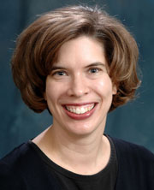
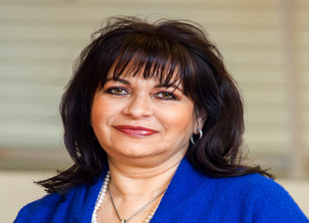
Meet the Webinar Panel
Speaker:
Megan Undeberg, PharmD, BCACP
University of Minnesota
College of Pharmacy
Moderator:
Ettie Rosenberg, PharmD, JD
West Coast University
School of Pharmacy
Notes:
This webinar aims to take us back in time to WWII to witness through historic video clips, photographs, and correspondence →
The mass removal of approximately 120,000 Japanese Americans (living in western US) to concentration camps in the country’s interior, and
To learn how pharmacists acted in public interest during that indelible period of US history

Slide 3
Learning Objectives: Examine and Reflect
Examine impact of WWII and Executive Order 9066 on:
Relocation/imprisonment of Japanese Americans
Role of the pharmacist and the drug distribution system.
Reflect on intertwined roles of the pharmacist, the drug industry, and Oath of the Pharmacist with patient care.

Slide 4
Learning Objectives: Review
Delivery of pharmacy-based services in context of the WWII era
Disparity of care available to the Japanese and Japanese Americans within the WWII internment camps

Slide 5
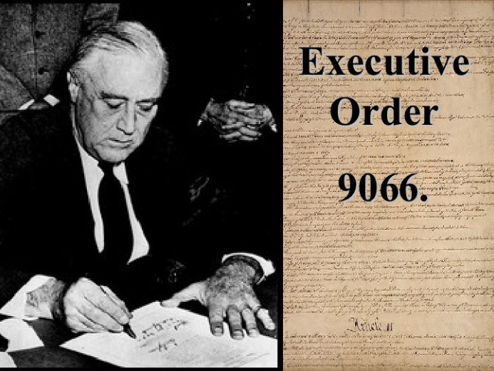
February 19, 1942: FDR and Signing of Executive Order 9066

Slide 6
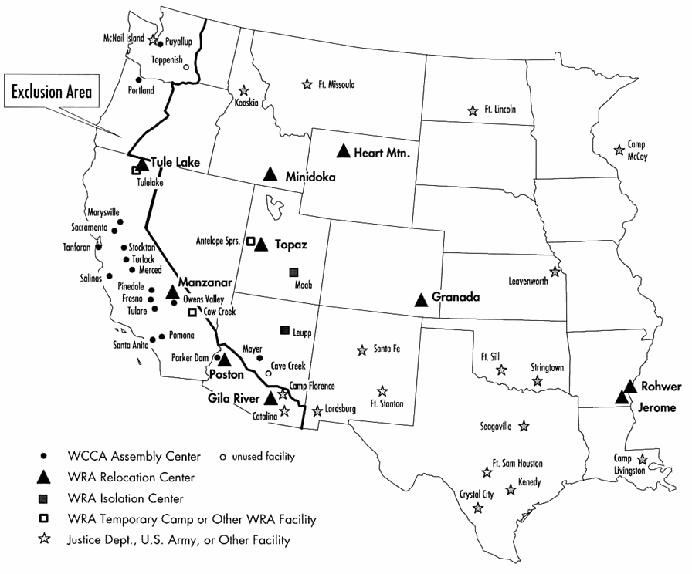
Map of Internment Camps

Slide 7
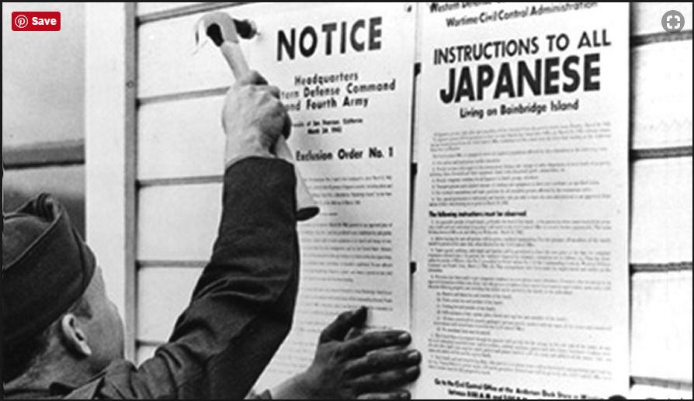
Notes:
Reference: https://www.pacificcitizen.org/executive-order-9066-at-75-will-the-japanese-american-experience-trump-a-repeat-of-history/

Slide 8
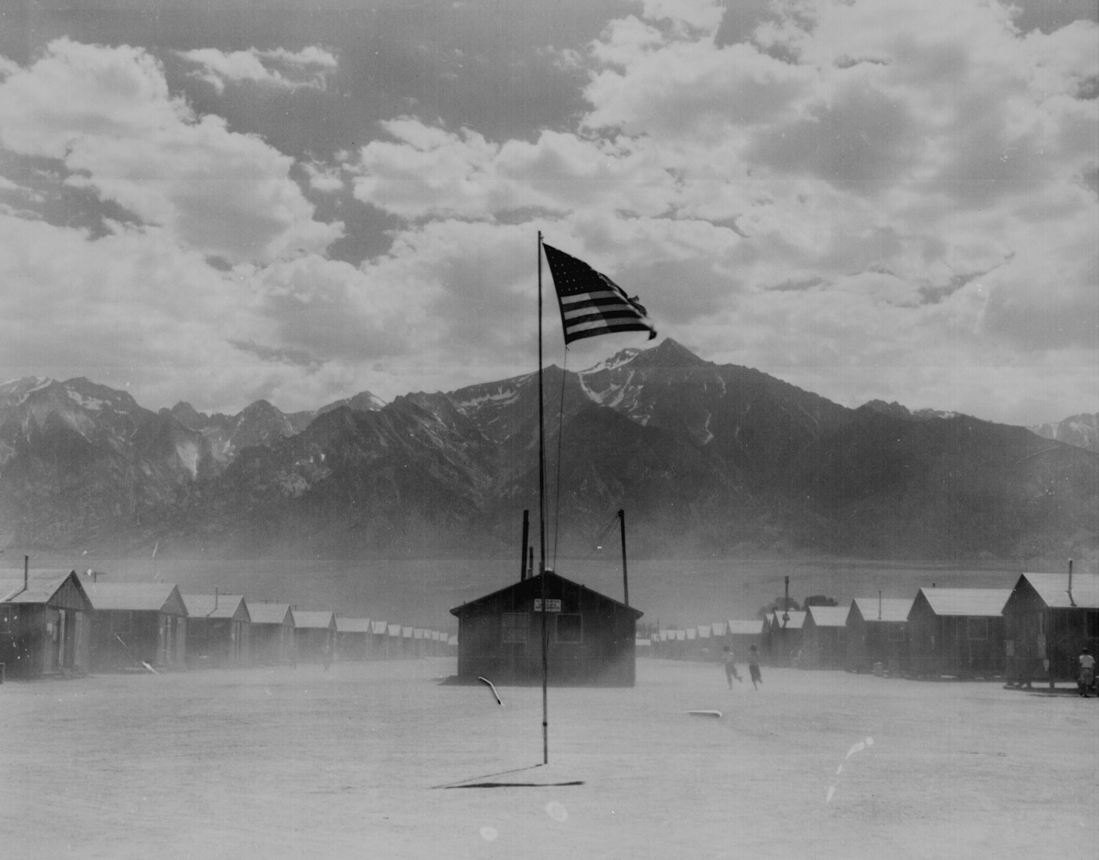
Dirt and Desolation
“This country is very bleak & if you really want to know—
as the residents around here call it:
The country where God took his rest
after making the rest of the US ,
And forgot to work on it afterward.”…..
-- “Match” Frank Masakatsu Kumamoto
Excerpt from letter dated October 11, 1942
Notes:
KEEP IN SLIDE PRESENTATION

Slide 9
But What Are Their Stories???
Some unique insights into the stories of these Japanese Americans and pharmacists are provided by correspondences from that era recently discovered …

Slide 10

Correspondence Discovered
John Bonomi of Los Angeles, CA
Yutaka “Tak” Terasaki of
TK Pharmacy, Denver, CO.
Notes:
Take with me now a step back in time, to a time that is largely forgotten

Slide 11
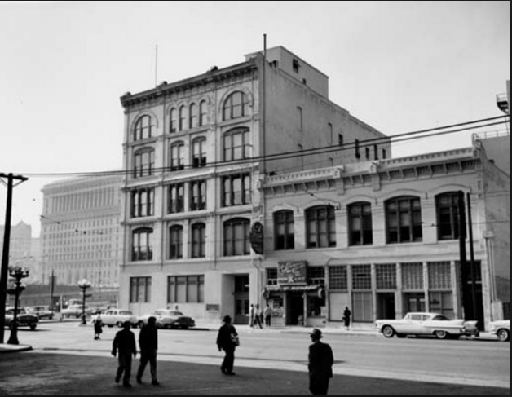
The Brunswig Building Los Angeles, CA
John Bonomi reported to work each day at Brunswig.
He was a popular rep with the pharmacists
Notes:
Reference: http://bigorangelandmarks.blogspot.com/2007/09/no-64-plaza-park.html

Slide 12
“Dear Johnny Niku-Bone,”
John Bonomi was a salesman for Brunswig, and his area included the Little Tokyo area in Los Angeles, CA
He enjoyed not only a great business relationship with the pharmacists he served, but also one on a personal level
Correspondence that follows from Japanese American pharmacists to John Bonomi and wife, Lillian, opened researchers’ eyes about the situation unfolding in 1942…→
Notes:
“”niku” most often refers to a big chunk of meat, or a meaty bone. Based on other references from other letters, I think this is a joke on Bonomi related to his hefty girth and size

Slide 13

“Dear Johnny Niku-Bone,”
Seven pharmacists from the Little Toyko area of Los Angeles corresponded with John Bonomi in 1942 onward. These letters were authored by
Mutsumi “Muts” Nobe
Masaru “Masy” Masuoka
Johnny Toshiyuki
David S. Miyamoto
Fred Sakuda
Frank “Match” Kumamoto
Ryo Komae
.
From their letters, we visualize the hardships and creativity by which these pharmacists performed the duties of their profession.
Notes:
“”niku” most often refers to a big chunk of meat, or a meaty bone. Based on other references from other letters, I think this is a joke on Bonomi related to his hefty girth and size

Slide 14
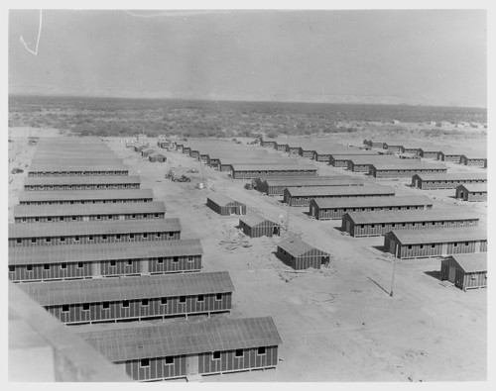
“Well, here we are, in one of the best U.S. concentration camps as of Anno Domini, 1942…”
Muts Nobe 17 May 1942
Notes:
Dialogue: Muts Nobe arrived with his wife, Catherine, from ________________________, California on Saturday, May 9, 1942 at 4:30 in the afternoon. As he wrote to John Bonomi on May 17, 1942,Well, here we are in one of the best U.S. concentration camps as of Anno Domini, 1942. I tried to get in touch with you before leaving, but [you] were out. You see, we had to leave on a 48 hour notice. Boy, oh boy, but it was hectic. Shopping, rushing around, etc.
https://calisphere.org/item/ark:/13030/ft2c6003jt/
UC Berkeley, Bancroft Library > War Relocation Authority Photographs of Japanese-American Evacuation and Resettlement > Poston, Ariz., (Site No. 2)--Living quarters of evacuees of Japanese ancestry at this War Relocation Authority center as seen from water tower. Photographer: Clark, Fred Poston, Arizona
Title: Poston, Ariz., (Site No. 2)--Living quarters of evacuees of Japanese ancestry at this War Relocation Authority center as seen from water tower. Photographer: Clark, Fred Poston, Arizona
Date: 1942-06-01
Collection: War Relocation Authority Photographs of Japanese-American Evacuation and Resettlement
Owning Institution: UC Berkeley, Bancroft Library
Source: Calisphere
Date of access: April 25 2018 20:52
Permalink: https://calisphere.org/item/ark:/13030/ft2c6003jt/
Item Information. View source record on the Online Archive of California.
Title
Poston, Ariz., (Site No. 2)--Living quarters of evacuees of Japanese ancestry at this War Relocation Authority center as seen from water tower. Photographer: Clark, Fred Poston, Arizona
Date Created and/or Issued
1942-06-01
Publication Information
The Bancroft Library;;University of California, Berkeley, Berkeley, CA 94720-6000, Phone: (510) 642-6481, Fax: (510) 642-7589, Email: bancref@library.berkeley.edu;;, URL: http://bancroft.berkeley.edu/
Contributing Institution
UC Berkeley, Bancroft Library
Collection
War Relocation Authority Photographs of Japanese-American Evacuation and Resettlement
Rights Information
Some materials in these collections may be protected by the U.S. Copyright Law (Title 17, U.S.C.). In addition, the reproduction of some materials may be restricted by terms of University of California gift or purchase agreements, donor restrictions, privacy and publicity rights, licensing and trademarks. Transmission or reproduction of materials protected by copyright beyond that allowed by fair use requires the written permission of the copyright owners. Works not in the public domain cannot be commercially exploited without permission of the copyright owner. Responsibility for any use rests exclusively with the user.
All requests to reproduce, publish, quote from, or otherwise use collection materials must be submitted in writing to the Head of Public Services, The Bancroft Library, University of California, Berkeley 94720-6000. See: http://bancroft.berkeley.edu/reference/permissions.html
Type
image
Identifier
http://ark.cdlib.org/ark:/13030/ft2c6003jt
WRA no. A-191
Subject
Japanese Americans--Evacuation and relocation, 1942-1945--Photographs

Slide 15
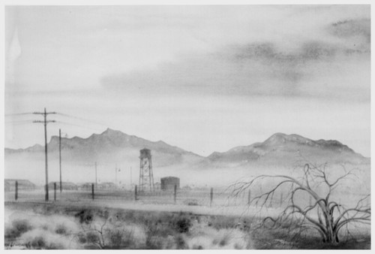
“....a vile westerly wind starts winding up around 5 every P.M. & whoops hell-bent-for-leather lifting all of Arizona’s dust into our mouth, ears, nose, throat, rear end, etc, all at one time.”
-Muts Nobe’s description of Poston’s environment
Notes:
Dialogue: As Muts continued on, “This place isn’t so bad--not so good either. It’s typical Ariz desert land, desert heat, bugs, sand and a vile westerly wind that starts winding up around 5 every P.M. & whoops hell-bent-for-leather lifting all of Arizona’s dust into our mouth, ears, nose, throat, rear end, etc, all at one time…”
https://calisphere.org/item/ark:/13030/ft0d5n98v4/
UC Berkeley, Bancroft Library > War Relocation Authority Photographs of Japanese-American Evacuation and Resettlement > Poston After Sundown. A special award, first in camp scenes, was received on this entry in an art exhibit recently held at Cambridge, Massachusetts, under the sponsorship of the Friends Meeting. ($20) ARTIST: Kakunen Tsuruoka, Colorado River Relocation Center, Poston, Arizona. Cambridge, Massachusetts
Title: Poston After Sundown. A special award, first in camp scenes, was received on this entry in an art exhibit recently held at Cambridge, Massachusetts, under the sponsorship of the Friends Meeting. ($20) ARTIST: Kakunen Tsuruoka, Colorado River Relocation Center, Poston, Arizona. Cambridge, Massachusetts
Date: 1943
Collection: War Relocation Authority Photographs of Japanese-American Evacuation and Resettlement
Owning Institution: UC Berkeley, Bancroft Library
Source: Calisphere
Date of access: April 25 2018 21:22
Permalink: https://calisphere.org/item/ark:/13030/ft0d5n98v4/
Item Information. View source record on the Online Archive of California.
Title
Poston After Sundown. A special award, first in camp scenes, was received on this entry in an art exhibit recently held at Cambridge, Massachusetts, under the sponsorship of the Friends Meeting. ($20) ARTIST: Kakunen Tsuruoka, Colorado River Relocation Center, Poston, Arizona. Cambridge, Massachusetts
Date Created and/or Issued
1943
Publication Information
The Bancroft Library;;University of California, Berkeley, Berkeley, CA 94720-6000, Phone: (510) 642-6481, Fax: (510) 642-7589, Email: bancref@library.berkeley.edu;;, URL: http://bancroft.berkeley.edu/
Contributing Institution
UC Berkeley, Bancroft Library
Collection
War Relocation Authority Photographs of Japanese-American Evacuation and Resettlement
Rights Information
Some materials in these collections may be protected by the U.S. Copyright Law (Title 17, U.S.C.). In addition, the reproduction of some materials may be restricted by terms of University of California gift or purchase agreements, donor restrictions, privacy and publicity rights, licensing and trademarks. Transmission or reproduction of materials protected by copyright beyond that allowed by fair use requires the written permission of the copyright owners. Works not in the public domain cannot be commercially exploited without permission of the copyright owner. Responsibility for any use rests exclusively with the user.
All requests to reproduce, publish, quote from, or otherwise use collection materials must be submitted in writing to the Head of Public Services, The Bancroft Library, University of California, Berkeley 94720-6000. See: http://bancroft.berkeley.edu/reference/permissions.html
Type
image
Identifier
http://ark.cdlib.org/ark:/13030/ft0d5n98v4
WRA no. B-653
Subject
Japanese Americans--Evacuation and relocation, 1942-1945--Photographs

Slide 16
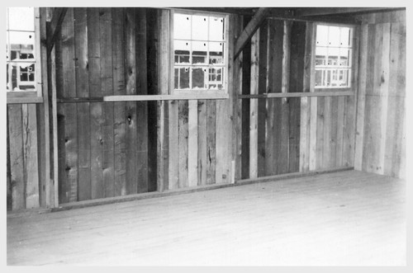
“...partitioned off into 4 rooms for 1 barrack building. Five windows in ours & plenty of space between the partition board so our neighbors’ secrets are also ours.” -Muts Nobe, 17 May 1942 on conditions of barracks at Poston
Notes:
NOTE: ½ of today’s average garage size Dialogue: As Muts continued on, “This place isn
https://calisphere.org/item/ark:/13030/ft0h4n990b/
Title: Poston, Ariz.--Site No. 1. Interior view of barrack construction at this War Relocation Authority center for evacuees of Japanese ancestry. Photographer: Clark, Fred Poston, Arizona
Date: 1942-05-08
Collection: War Relocation Authority Photographs of Japanese-American Evacuation and Resettlement
Owning Institution: UC Berkeley, Bancroft Library
Source: Calisphere
Date of access: April 25 2018 20:45
Permalink: https://calisphere.org/item/ark:/13030/ft0h4n990b/
UC Berkeley, Bancroft Library > War Relocation Authority Photographs of Japanese-American Evacuation and Resettlement > Poston, Ariz.--Site No. 1. Interior view of barrack construction at this War Relocation Authority center for evacuees of Japanese ancestry. Photographer: Clark, Fred Poston, Arizona
Item Information. View source record on the Online Archive of California.
Title
Poston, Ariz.--Site No. 1. Interior view of barrack construction at this War Relocation Authority center for evacuees of Japanese ancestry. Photographer: Clark, Fred Poston, Arizona
Date Created and/or Issued
1942-05-08
Publication Information
The Bancroft Library;;University of California, Berkeley, Berkeley, CA 94720-6000, Phone: (510) 642-6481, Fax: (510) 642-7589, Email: bancref@library.berkeley.edu;;, URL: http://bancroft.berkeley.edu/
Contributing Institution
UC Berkeley, Bancroft Library
Collection
War Relocation Authority Photographs of Japanese-American Evacuation and Resettlement
Rights Information
Some materials in these collections may be protected by the U.S. Copyright Law (Title 17, U.S.C.). In addition, the reproduction of some materials may be restricted by terms of University of California gift or purchase agreements, donor restrictions, privacy and publicity rights, licensing and trademarks. Transmission or reproduction of materials protected by copyright beyond that allowed by fair use requires the written permission of the copyright owners. Works not in the public domain cannot be commercially exploited without permission of the copyright owner. Responsibility for any use rests exclusively with the user.
All requests to reproduce, publish, quote from, or otherwise use collection materials must be submitted in writing to the Head of Public Services, The Bancroft Library, University of California, Berkeley 94720-6000. See: http://bancroft.berkeley.edu/reference/permissions.html
Type
image
Identifier
http://ark.cdlib.org/ark:/13030/ft0h4n990b
WRA no. A-171
Subject
Japanese Americans--Evacuation and relocation, 1942-1945--Photographs

Slide 17
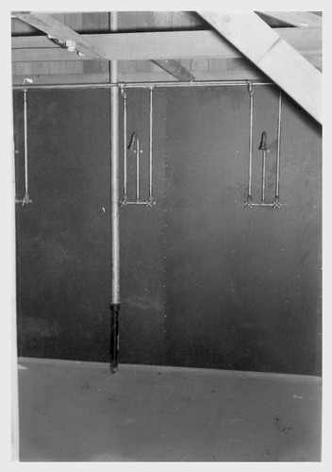
“... men’s latrines and showers (no hot water yet--BRRR!)”
-Muts Nobe, 17 May 1942
Notes:
Dialogue: end of 2nd paragraph and into description
https://calisphere.org/item/ark:/13030/ft658006cm/
UC Berkeley, Bancroft Library > War Relocation Authority Photographs of Japanese-American Evacuation and Resettlement > Poston, Ariz.--Site #1--Typical shower facilities at this War Relocation Authority center for evacuees of Japanese ancestry. Photographer: Clark, Fred Poston, Arizona
Title: Poston, Ariz.--Site #1--Typical shower facilities at this War Relocation Authority center for evacuees of Japanese ancestry. Photographer: Clark, Fred Poston, Arizona
Date: 1942-05-03
Collection: War Relocation Authority Photographs of Japanese-American Evacuation and Resettlement
Owning Institution: UC Berkeley, Bancroft Library
Source: Calisphere
Date of access: April 25 2018 21:26
Permalink: https://calisphere.org/item/ark:/13030/ft658006cm/
Item Information. View source record on the Online Archive of California.
Title
Poston, Ariz.--Site #1--Typical shower facilities at this War Relocation Authority center for evacuees of Japanese ancestry. Photographer: Clark, Fred Poston, Arizona
Date Created and/or Issued
1942-05-03
Publication Information
The Bancroft Library;;University of California, Berkeley, Berkeley, CA 94720-6000, Phone: (510) 642-6481, Fax: (510) 642-7589, Email: bancref@library.berkeley.edu;;, URL: http://bancroft.berkeley.edu/
Contributing Institution
UC Berkeley, Bancroft Library
Collection
War Relocation Authority Photographs of Japanese-American Evacuation and Resettlement
Rights Information
Some materials in these collections may be protected by the U.S. Copyright Law (Title 17, U.S.C.). In addition, the reproduction of some materials may be restricted by terms of University of California gift or purchase agreements, donor restrictions, privacy and publicity rights, licensing and trademarks. Transmission or reproduction of materials protected by copyright beyond that allowed by fair use requires the written permission of the copyright owners. Works not in the public domain cannot be commercially exploited without permission of the copyright owner. Responsibility for any use rests exclusively with the user.
All requests to reproduce, publish, quote from, or otherwise use collection materials must be submitted in writing to the Head of Public Services, The Bancroft Library, University of California, Berkeley 94720-6000. See: http://bancroft.berkeley.edu/reference/permissions.html
Type
image
Identifier
http://ark.cdlib.org/ark:/13030/ft658006cm
WRA no. A-412
Subject
Japanese Americans--Evacuation and relocation, 1942-1945--Photographs

Slide 18
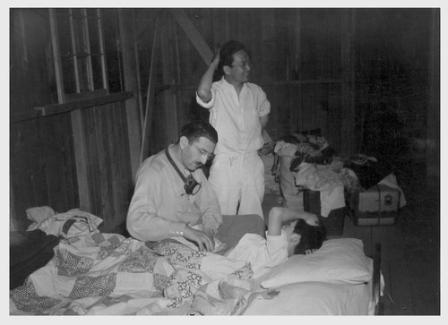
“... after a little Nobe bull throwing I landed a permanent position as a hospital pharmacist.”
--Muts Nobe to John Bonomi, 17 May 1942
Notes:
Dialogue: Muts wrote “We registered & she (wife, Catherine) was assigned immediately as a lab technician. I couldn’t even get a regular work card as I was not registered in the San Francisco office. I saw the head doctor immediately & after a little Nobe bull throwing I landed a permanent position as a hospital pharmacist. …………. The #1 man expects me to be top sergeant around here. Must be my fluent profanity. Oh well, every sin must have its compensations. “
Towards the end of the letter, Muts wrote with less joviality: “So far we are doing the best we can under trying circumstances. It isn’t easy & it isn’t comfortable. A great many here are bedridden thru fever an ddiarrhea. Due to changing conditions, climate, water, dust, etc. The doctors we came with are busy as the dickens and I’m running crazy--cafaxed--you might say. No sooner do I get drugs in the dispensary--it’s out for treatment. Well, life is too short & eternity too long to worry. Hell! I eat regular. What more do I want…. only the opportunity to be a good American & serve my country. Maybe--someday.
https://calisphere.org/item/ark:/13030/ft0199n4tr/
UC Berkeley, Bancroft Library > War Relocation Authority Photographs of Japanese-American Evacuation and Resettlement > Poston, Ariz.--First sick man at this War Relocation Authority center for evacuees of Japanese ancestry. (L to R) Head doctor, Leo Schnur, and evacuee doctor, Dr. S. Watoke. Photographer: Clark, Fred Poston, Arizona
Title: Poston, Ariz.--First sick man at this War Relocation Authority center for evacuees of Japanese ancestry. (L to R) Head doctor, Leo Schnur, and evacuee doctor, Dr. S. Watoke. Photographer: Clark, Fred Poston, Arizona
Date: 1942-05-10
Collection: War Relocation Authority Photographs of Japanese-American Evacuation and Resettlement
Owning Institution: UC Berkeley, Bancroft Library
Source: Calisphere
Date of access: April 25 2018 21:24
Permalink: https://calisphere.org/item/ark:/13030/ft0199n4tr/
Item Information. View source record on the Online Archive of California.
Title
Poston, Ariz.--First sick man at this War Relocation Authority center for evacuees of Japanese ancestry. (L to R) Head doctor, Leo Schnur, and evacuee doctor, Dr. S. Watoke. Photographer: Clark, Fred Poston, Arizona
Date Created and/or Issued
1942-05-10
Publication Information
The Bancroft Library;;University of California, Berkeley, Berkeley, CA 94720-6000, Phone: (510) 642-6481, Fax: (510) 642-7589, Email: bancref@library.berkeley.edu;;, URL: http://bancroft.berkeley.edu/
Contributing Institution
UC Berkeley, Bancroft Library
Collection
War Relocation Authority Photographs of Japanese-American Evacuation and Resettlement
Rights Information
Some materials in these collections may be protected by the U.S. Copyright Law (Title 17, U.S.C.). In addition, the reproduction of some materials may be restricted by terms of University of California gift or purchase agreements, donor restrictions, privacy and publicity rights, licensing and trademarks. Transmission or reproduction of materials protected by copyright beyond that allowed by fair use requires the written permission of the copyright owners. Works not in the public domain cannot be commercially exploited without permission of the copyright owner. Responsibility for any use rests exclusively with the user.
All requests to reproduce, publish, quote from, or otherwise use collection materials must be submitted in writing to the Head of Public Services, The Bancroft Library, University of California, Berkeley 94720-6000. See: http://bancroft.berkeley.edu/reference/permissions.html
Type
image
Identifier
http://ark.cdlib.org/ark:/13030/ft0199n4tr
WRA no. A-401
Subject
Japanese Americans--Evacuation and relocation, 1942-1945--Photographs

Slide 19
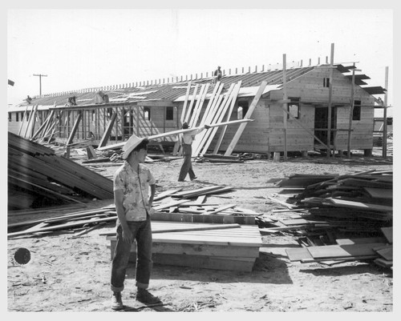
“So far all I’ve done is direct a squad of husky guys in cleaning up the hospital--it’s only a temp, a 250 bed one in the making.” --Muts Nobe to John Bonomi, 17 May 1942
Notes:
Dialogue: from Muts Nobe’s May 17th letter: “So far all I’ve done is direct a squad of husky guys in cleaning up the hospital--it’s only a temp, a 250 bed one in the making.”
Later paragraph: So fare we are doing the best we can under trying circumstances. . . . . A great many here are bedridden thru fever and diarrhea. Due to changing conditions, climate, water, dust, etc. The doctors we came with are busy as the dickens and I’m running crazy . . . . No sooner do I get drugs in the dispensary--it’s out for treatment. . . . “
https://calisphere.org/item/ark:/13030/ft467nb1rk/
UC Berkeley, Bancroft Library > War Relocation Authority Photographs of Japanese-American Evacuation and Resettlement > Site No. 1. Larry Orida at the hospital being constructed at this War Relocation Authority center for evacuees of Japanese ancestry. Photographer: Clark, Fred Poston, Arizona
Title: Site No. 1. Larry Orida at the hospital being constructed at this War Relocation Authority center for evacuees of Japanese ancestry. Photographer: Clark, Fred Poston, Arizona
Date: 1942-05-12
Collection: War Relocation Authority Photographs of Japanese-American Evacuation and Resettlement
Owning Institution: UC Berkeley, Bancroft Library
Source: Calisphere
Date of access: April 25 2018 21:17
Permalink: https://calisphere.org/item/ark:/13030/ft467nb1rk/
Item Information. View source record on the Online Archive of California.
Title
Site No. 1. Larry Orida at the hospital being constructed at this War Relocation Authority center for evacuees of Japanese ancestry. Photographer: Clark, Fred Poston, Arizona
Date Created and/or Issued
1942-05-12
Publication Information
The Bancroft Library;;University of California, Berkeley, Berkeley, CA 94720-6000, Phone: (510) 642-6481, Fax: (510) 642-7589, Email: bancref@library.berkeley.edu;;, URL: http://bancroft.berkeley.edu/
Contributing Institution
UC Berkeley, Bancroft Library
Collection
War Relocation Authority Photographs of Japanese-American Evacuation and Resettlement
Rights Information
Some materials in these collections may be protected by the U.S. Copyright Law (Title 17, U.S.C.). In addition, the reproduction of some materials may be restricted by terms of University of California gift or purchase agreements, donor restrictions, privacy and publicity rights, licensing and trademarks. Transmission or reproduction of materials protected by copyright beyond that allowed by fair use requires the written permission of the copyright owners. Works not in the public domain cannot be commercially exploited without permission of the copyright owner. Responsibility for any use rests exclusively with the user.
All requests to reproduce, publish, quote from, or otherwise use collection materials must be submitted in writing to the Head of Public Services, The Bancroft Library, University of California, Berkeley 94720-6000. See: http://bancroft.berkeley.edu/reference/permissions.html
Type
image
Identifier
http://ark.cdlib.org/ark:/13030/ft467nb1rk
WRA no. A-107
Subject
Japanese Americans--Evacuation and relocation, 1942-1945--Photographs

Slide 20

“Hi ‘Niku-Bone,’ what’s cooking?”
“…We in Poston are literally becoming well done. Old “Sol” is really starting his summer jamboree and between the heat, the wind (it blows like hell) and the dust (I eat it, now), and the food (it’s lousy—all starches—no protein, a live cow would be consumed before it fell dead in this camp).
Me, myself, am very sad “niku bone”…
Muts Nobe
Block 11, Bldg. 7-C
June 7, 1942

Slide 21
“I am putting in 8 hours every day at the hospital drug room and ½ day Saturday. We are short of almost every medicinal. It’s terrible. Finally put through an order & am waiting for it to come. There are no catalogues whatsoever.
“People are suffering a great deal from a form of diarrhea that lays them out. Cramps and high fever. Lasts from 5-10 days. We are controlling it with paregoric and Bis subnitrate mixture. All out of cremo car, pepto bismol (never had any) & everything else. ASA tabs all gone.”
Muts Nobe to John Bonomi, June 7, 1942, Poston, AZ

Slide 22
“in connection with this, Johnny, I might build up a pretty good account here for you if you can get me credit for the usual time. . . . . You know there are individuals that are willing to pay for medication and since the hospital is unable to get it now & want me to order it for them.
“I took this up with my doctor friend who is chairman of the medical staff and he asked me to contact you immediately. All profits to go into the camp medical fund.
“Also we need very much all the catalogues you can get for me. Lilly (I’ll cover cost for this), PD Co, Lederle, Roche. We shall be only too glad to defray all expenses.”
Muts Nobe to John Bonomi, June 7, 1942

Slide 23
Conditions in the Poston Camp Hospital, June 7, 1942
“The doctors are overworked & fed up and I am too. Can’t fill prescriptions with only air and water to work with.
“So far the camp has 8500 people & 3 have died and many are seriously ill.
“We are in sore straits, and therefore must strive mightily to exist—for the future may turn brighter—I hope.
“Anyway—thanks to you & the rest of my American friends I’ll get along. Get me the catalogues & stuff if you can.”
Muts Nobe to John Bonomi

Slide 24
Continuation of the saga in Poston: July 15, 1942
“The hospital is sadly understaffed with doctors and nurses. I have plenty of pharmacists (20 in camp #1) (5 in camps #2) but we lack equipment and, above all, drugs. The administration here is so damn slow in gathering us medicinals—stuff ordered 2 months ago still hasn’t come. I haven’t a prescription scale in the drug dept. yet.
“Oh well. Lots of guys are dying off, especially the newborn. Many young people are seriously undernourished. I’m afraid that a great many are doomed to die here. These are actual conditions in the camp. I know that you, for one, wouldn’t stand for the type of treatment we receive here if your family had to take it.”
Notes:
Letter to John Bonomi from Muts Nobe, July 15, 1942. Poston, AZ

Slide 25
Muts Nobe Continues to Write: August 13, 1942 from Poston
“As far as the pharmacy goes, our equipment is still zero—no scales, no spatulas, slab, mortar or anything really essential.
I get by through using volume measure but that’s not so accurate. Also supplies are short. We lacked normal saline, O.B. pituitary, Ertotrate, Coramine, etc until only a week ago. I’m going nuts trying to organize something out of this now.
“Lots of heat rash, heat prostration, diarrhea, etc. Some nut cases are cropping up now. Several have been taken to the LA psycho. A lot of it is due to shock—nervous strain, etc. Poor devils. We have also had several cases of attempted suicide.

Slide 26
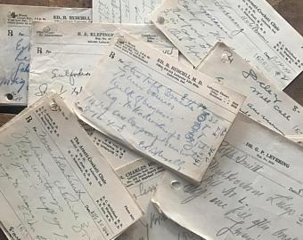
Notes:
Citation: https://www.google.com/search?q=prescription+order+from+1940s&tbm=isch&tbo=u&source=univ&sa=X&ved=0ahUKEwib-M_bitjaAhWm3oMKHXDtDlAQsAQITQ&biw=1344&bih=755#imgrc=R0LucoGJOMcRfM:
Accessed 26 April 2018

Slide 27
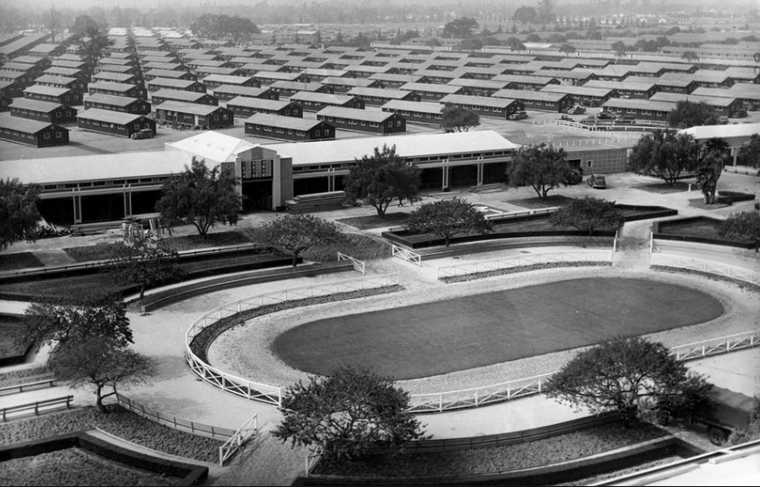
Santa Anita Assembly Center

Slide 28
Santa Anita Assembly Center
June 7, 1942
We have at present one hospital with a staff of 6 doctors, 6 registered nurses, 3 lab technicians, 3 pharmacists. Masy alone fills about 100 prescriptions in just 2 hours, as the clinic hours is 2 pm to 4 pm.
--letter from Kiku Masuoka, wife of Masy Masuoka to John Bonomi

Slide 29
Santa Anita Assembly Center
Kiku noted next:
“You have to realize that 1 hospital and 1 drug store is servicing a good sized city of 19,000. Masy’s hours are from 1-10 pm or sometimes 7:30-4:30 pm and 44 hours a week.”
June 7, 1942
Notes:
From Kiku’s June 7, 1942 letter to the Bonomis from Santa Anita Racetrack assembly center

Slide 30
What Happened to Pharmacists?
Masy writes to John Bonomi on July 1, 1942
“Shig (brother) has been transferred to Camp Harrison in Indiana. He tried to get into the Hospital pharmacy, but was informed no Japanese were accepted into the hospital so he is working now as a boiler tender.”
Notes:
From 1940 to 1950, Fort Harrison served as a military induction and reception center, the Army Finance School, the Army Chaplain School, School for Bakers and Cooks, and then housed first Italian POWs from the African campaign, and later German POWs. Towards the end of WWII, it served as the location for the U.S. Army Disciplinary Barracks, for those in the US military who received punishment of varying degrees.”
(Reference: https://archive.org/stream/historyoffortben00fort/historyoffortben00fort_djvu.txt, access 5-11-18)
Reference: http://www.indianamilitary.org/FtHarrison/SoThinkMenu/FtHarrisonSTART.htm Access 5-11-18
During WW II nearly 425,000 prisoners of war (POW s) were sent to detention camps in the U. S. They were moved far from the front lines where there would be no threat of escape, in the same ships that had taken American soldiers to fight in Europe.
The prisoners of war proved to be a great benefit in the U. S., where manpower was in short supply. Prisoners took the place of farm hands and factory workers who had gone to fight. They harvested crops, maintained roads and buildings, and helped businesses stay open, which in turn strengthened local economy.
The 1929 Geneva Convention was in effect at the time, requiring that prisoners receive the same housing, food, pay and work hours as provided to soldiers of the capturing nation. Enlisted men could do the same jobs as our own soldiers, as long as they were not directly engaged in military activities. Non-commissioned officers could supervise enlisted men, but officers were not required to work. In general, the prisoners were treated very well in the U. s. They had good food and decent living conditions, and records indicate there were very few discipline problems or escape attempts. Many prisoners did not want to leave when the war was over.
The first WW II POWs in Indiana arrived in May of 1943. They were Italians captured in the African Campaign. The majority stayed at Camp Atterbury, although smaller numbers of prisoners were sent to other locations. As a test, some groups were sent to military reservations, where they had an immediate impact on the war effort. Prisoners put to work at military installations, working in the laundry or quartermaster or motor pool, could free-up U. S. soldiers for active military duty.
In January of 1944, 250 Italians from Camp Atterbury moved to Fort Harrison. The Camp Edwin F. Glenn site, used for the Citizens' Military Training Camp in the 1930's, was fenced off and converted into a compound for POW s. originally, two of the three mess halls were turned into living quarters for the prisoners, and the third became their mess hall. After September of 1943, the Italians had switched sides and became our allies, so by the time they came to Fort Harrison; Italian soldiers were already reclassified as "co-belligerents." This made their internment somewhat paradoxical, since they were enemies when captured, but remained prisoners even after these circumstances changed.
The Italians performed Post maintenance, clean-up, and made improvements to the prison compound. They were at Fort Harrison only four months when they were transferred to Fort Hays, Ohio.
In May of 1944, 300 German prisoners, from Rommel's elite "Afrika Korps" moved into the camp. The Germans were extremely proud and patriotic. They arrived still wearing their worn and faded German military uniforms. They left a lasting impression with people who witnessed them goose-stepping in formation to their work site.
One story tells of the Germans assigned to put a new roof on the canteen. They carefully divided two shades of shingles and placed them to form a large swastika on the roof. The staff did not discover their handiwork for several days, after which time the job had to be re-done.
German prisoners were responsible for much of the work on the new Officers Club, now the Garrison Restaurant. They also maintained and repaired other post buildings, performed road work and assisted the quartermaster with laundry, equipment and motor pool duties. Some even waited tables at the Officers Club.
Fort Harrison later became a site for an Army Disciplinary Barracks, a prison compound for American servicemen convicted of offenses by the military court system. Because Army regulations did not allow POW camps in the same military installation that housed disciplinary barracks, Fort Harrison’s POW camp was closed in February of 1945 and the German prisoners moved to Fort Knox, Kentucky.
If you or someone you know has information to share about the history of Fort Harrison, please contact the webmaster. Email
Produced by Indiana Department Of Natural Resources Division of State Parks & Reservoirs Interpretive Naturalist Service.
This publication was made possible by an Indiana Heritage Research Grant from the Indiana Historical Society, the Indiana Humanities Council and the National Endowment for the Humanities.
The Fort Benjamin Harrison Historical Society especially thanks Larry Helkema who did the research and Jeannine Montgomery for their input to this important historical information.

Slide 31
Departure ensues….
Dear Folks,
Whispers of “relocation” are in the air now and we are concerned as to where we will be sent. We certainly want to see you folks again before we are shipped out further east. We are sending you a souvenir of our barracks in the form of a pin that I carved with a knife. Hope you like it.
Johnny--will you send me an order C.O.D. plus the taxes? We wanted ViPenta Perles 600. Please send it as soon as possible. Thank you for the last order; everything came fine.
(from Masy Masuoka, August 16, 1942, addressed from hospital at Santa Anita Racetrack Assembly Center)

Slide 32
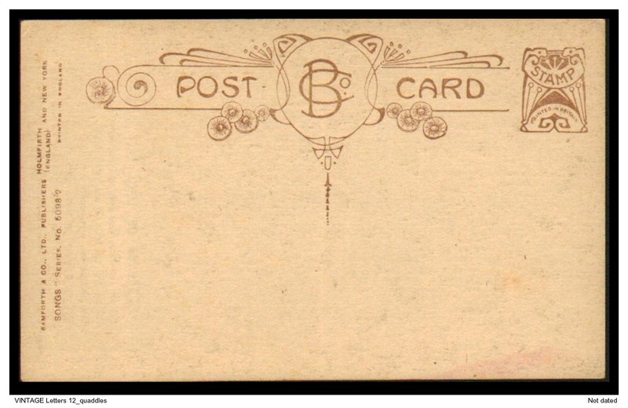
Postcard, October 15, 1942,8:00 AM
Dear Johnny and Lillian!
WELL--this is it...Arkansas bound….
we left the race track yesterday morning at 9:00 AM……
The hospital staff and families “occupy” this car….#10...the roomiest….cleanest….bestest...of all...the rest are quite crowded and dingy.
Sent order to Brunswig special delivery but no reply…????
Had to disappoint the doc. Will write from the land O’ the Arkies….soon….
Kiku and Masy

Slide 33
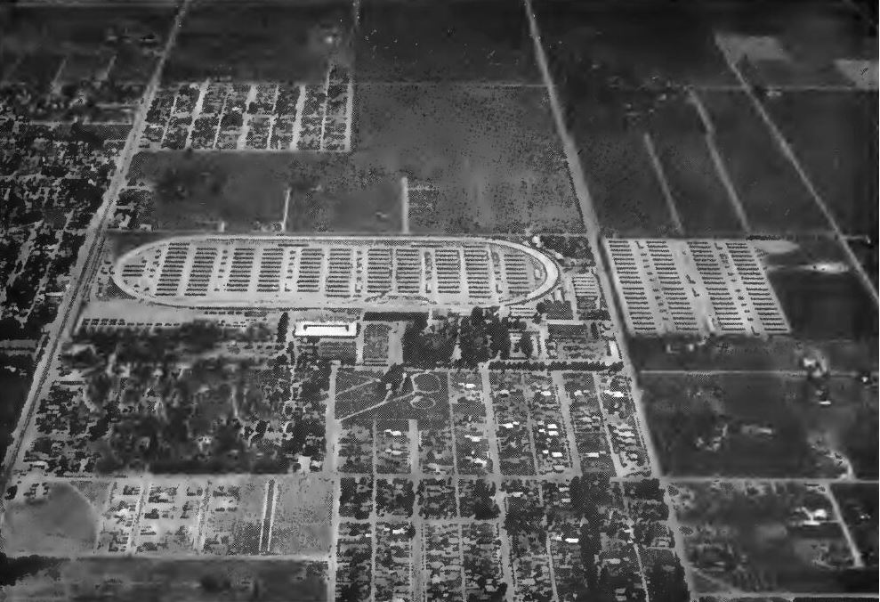
Fresno Assembly Center
Notes:
Resource: http://www.militarymuseum.org/FresnoAssyCtr.html
Fresno Assemby Center for Ethnic Japanese The Fresno Assembly Center was located at the Fresno County Fairgrounds. Occupied from May 6 to October 30, 1942, it was the last assembly center to close. It held a total of 5,344 evacuees (with a maximum of 5,120 at a time) from the central San Joaquin Valley and Amador County. Over 100 barracks served by six sets of communal buildings were located within the infield of the fairgrounds racetrack, and four contiguous blocks with 20 barracks each were located adjacent to the fairgrounds At this center accommodations were crude tar paper barracks with cots, out houses and overhead water pipes with holes drilled in them to serve as showers. There are no assembly center remains or any historical marker at the site. Most of the fairgrounds has been changed so extensively from its 1942 appearance that it is difficult to determine whether any fair buildings present during the assembly center use still remain Most of those processed at the Fresno center went to the Relocation Center at Jerome, Arkansas. The Fresno Assembly Center ceased operations on October 30, 1942 when the last group of ethnic Japanese departed. The center was then turned over to the 4th Air Force which converted it into non-flying training facility called the Fresno Ground Training Center. Signalmen, camouflage specialists, chemical warfare specialists, ordnance technicians, clerks, truck drivers and cooks trained here. The 1945 Army Inventory of Installations lists this activity as the Fresno Army Air Forces Training Center. There is an historical marker with information on the site located near the Chance Avenue gate of the fairgrounds.

Slide 34
Notes from Fresno Assembly Center
August 7, 1942
I wish now that I was in Santa Anita so you can come visit me and bring me 1 case of Coca Cola and a big watermelon and also hear you throw the bull.
Really, I am very lonesome here as there isn’t hardly a soul here that I know. I really miss the L.A. crowd.”
Johnny Toshiyuki

Slide 35
News from and about pharmacists
“...Did you know that Freddie Koyama, my ex-pharmacist, is here in this same camp. ….now he is here working in one of the hospitals as staff pharmacist earning $16.00 a month pay. (This is the top pay for workers in camp.) Right now he is also conducting a First-Aid course as he is a registered First-Aid Instructor. I am just loafing and so I have no income, so don’t be surprised if some day I will write to you to borrow some “diners.”
from Johnny Toshiyuki, August 7, 1942

Slide 36
Prejudice here in US as well...
“So the ex-Japanese town is dead.
It’s really too bad. I wonder what the city is planning to do over there. I sure hate like hell to see a bunch of Jews get in there and make those stores into a second-hand junk and clothing stores.”
Johnny Toshiyuki, August 7, 1942
letter to John Bonomi

Slide 37
Relocation from Fresno Assembly Center
“Everything is fine over here and we are all in good health so far. I think this place will be moving to relocation center in Arkansas around Oct 5 or 15th. No definite date has been announced as yet but we are pretty sure unless something turns up in the meantime.”
“I understand Santa Anita people are moving out now. I wonder where Masy Masuoka will go. My brother who was in Santa Anita is leaving tomorrow (13th) for Heart Mountain, Wyoming.”
From Johnny Toshiyuki, September 12, 1942

Slide 38

May 7, 1942: Manzanar and David S. Miyamoto
“I landed the pharmacy job so at the time I’m doing okay. The situation isn’t any too good on the job as I’m not exactly the best pharmacist. I’m alright running a drug store but a hospital pharmacy is a little different. All I can hope for is that the situations come up gradually so I can have plenty of time to meet it. If this & that come up all at once, I’m sunk.”
David S. Miyamoto

Slide 39
June 3, 1942: Updates from David S. Miyamoto
“As it is now, I’ll receive $16.00 a month, $192 a year. I’ll really be a rich man when we get out—(wait) we still have to receive our first pay check or scripts.
Say, I owe you money for the Digitalis. How much for postage & all? I’m going to pay you so please let me know. You don’t know how handy it was that you sent it. There’s so much red tape that it takes about 2 weeks before we get out things. As it was, I was sort of in the hole, I forgot all about ordering it.”

Slide 40
June 3, 1942 from Manzanar: Pharmacy Connections as related to John Bonomi…
“You know Fred Sakuda, don’t you? He used to work at Iwaki on First and San Pedro Sts. Well, he’s working under me at the hospital. So all in all, there’s two of us. Eventually there’ll be 3 or 4 altogether in the pharmacy. It’s big business—stocking up for 10,000 people. When we get a run on medicine, they go like water.”
“Good news I heard today—the new hospital (250 beds) will be ready on the 15th of June. We now have a 10 bed hospital with annex all filled up—total measles, chicken pox and all—over 100 patients.”

Slide 41

August 7, 1942: David S Miyamoto to John Bonomi: “Another business letter— … but a little profit this time”
“I have a favor to ask of you. Can you pick up a package of Euseals Potassium Thiocyanate 3 mg 100’s and send it over to Mrs. Momoye Sato, Blk 35-12-3, C.O.D. I’ll guarantee you won’t lost anything on it. Regardless of what it cost you, I want to make at least 25% profit. This is a favor one of the doctors want done, so I’ll appreciate it if you can help me out.” David S Miyamoto
1940 marked the introduction
of potassium thiocyanate as
a treatment for hypertension

Slide 42

August 10, 1942: “Please send one bottle of Lilly’s Multicebrin 100’s (C.O.D.) to Mr. Frank Murata, Blk 12-11-2, Manzanar Relocation Center”

Slide 43
August 27, 1942: David S. Miyamoto to John Bonomi
Thanks for all the favors and putting me on your account. Everything so far has been swell. We’re at the new hospital now and do we work. They practically throw Rx’s at us—over 100 Rx a day.
We’ve received everything so far and so if possible, I wonder if you’ll send us a few more items.
1-250 Sels B complex caps
1 pkg Squibbs (Hi potency) Vit. ABDG caps 100’s
½ doz Charms “All Purpose” Cream 6/- (large size)
I heard that Muts Nobe left Poston, Arizona for someplace out east. If you hear from him, let me know and also his address.

Slide 44
September 18, 1942: David S. Miyamoto to John Bonomi
Boy, the wind’s terrific—been blowing since 9 pm and hasn’t stopped yet. And it’s not just plain wind—it must be those 60 miles an hour kind. It practically picks up the whole desert upon one side and takes it to the other side.
Well, I have a couple more items to order—you can mail it direct to the hospital as it doesn’t make any difference.
2 pkg Gelseal Hepicebrin 100’s
2 pkg Benzedrine Inhaler 60 c
Also add 2 pkg Vacagen Tabs (Sharp & Dohme) 100’s
2 pkg Meads Viosterol in Halibut Liver Oil 50 cc
1 pkg “Oreton” Schering 5 mgm 6’s
1 pkg Lilly’s Multicebrin 30’s

Slide 45
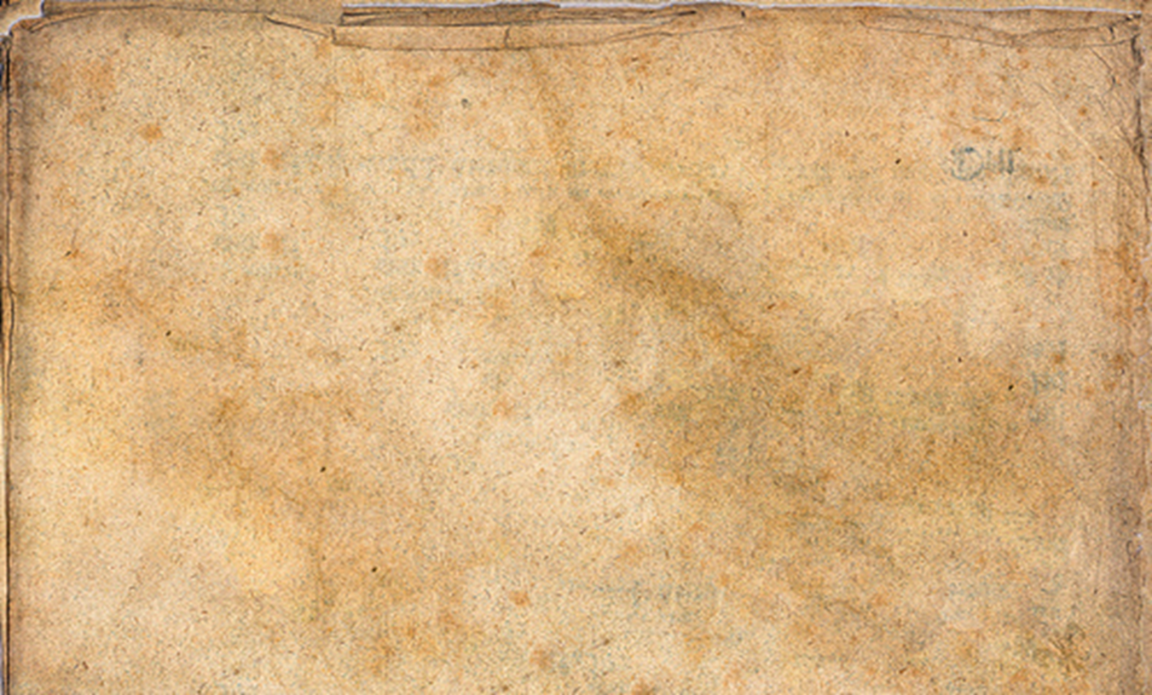
October 5, 1942: “Well, here’s a few more items…”
1 pkg Lilly “Lextron” Pulvules 500’s #55
3 pkg Lilly #238 Pulvules Theamin & Amytal RxB 40’s
2 pkg Lilly #1592 Tab. Trisomin 100’s
1 pt Upjohn Caripeptic Liq.
1/6 doz Denticators
¼ doz Clean-b-tween Tooth Brushed Red pref (Xtra hard)
¼ doz Clean-b-tween Refills 3’s –Xtra-hard
1 pkg Sharpe & Dohme Vacagen 100’s
1 pkg “Meads” Oleum Percomorphum 50 cc
A roll B&B Adhesive 12” (one piece width-not in strips)
1 jar emo Special Night Cream or Tissue Cream (lg size)
1 case Colgate Soap (any perfume) 3 doz to case
1 oz. Milford’s Digitol (or Mulford’s Digitol)

Slide 46
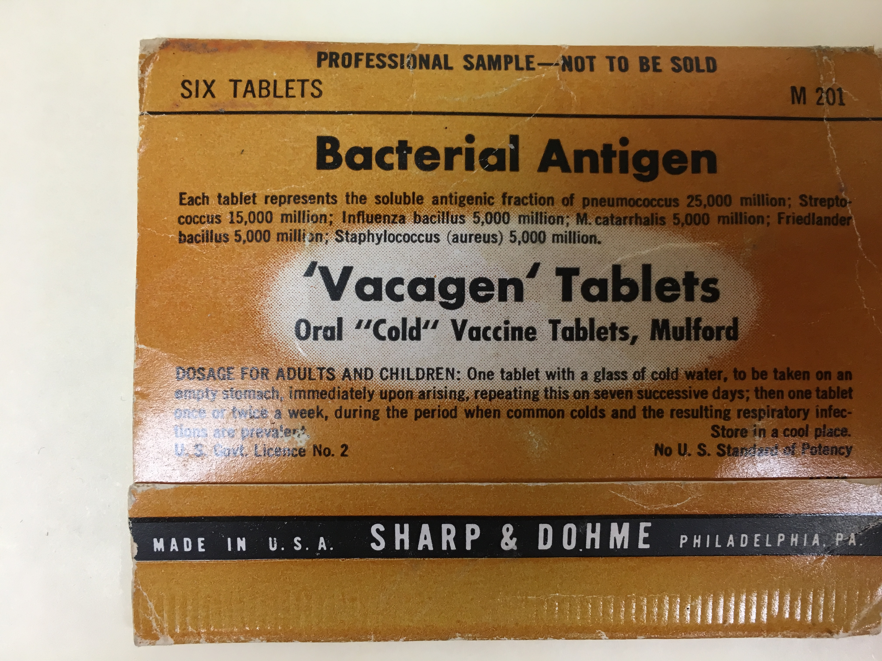
Vacagen Tablets

Slide 47
Dear John: I’ll bet you’re surprised to hear from me….
“…I thought I’d better let you know that I’m going to be settled here for the next six months or so.
Gosh, what a difference to be out of camp. We never realized how free you can be regardless of prejudices and rationing. Oh yes, I think I mentioned it but I’m out here by myself. My wife and babies will stay in camp until June when I plan to go and pick them up.”
David S. Miyamoto, February 9, 1944
117 So. Church St, Zeeland, Mich

Slide 48
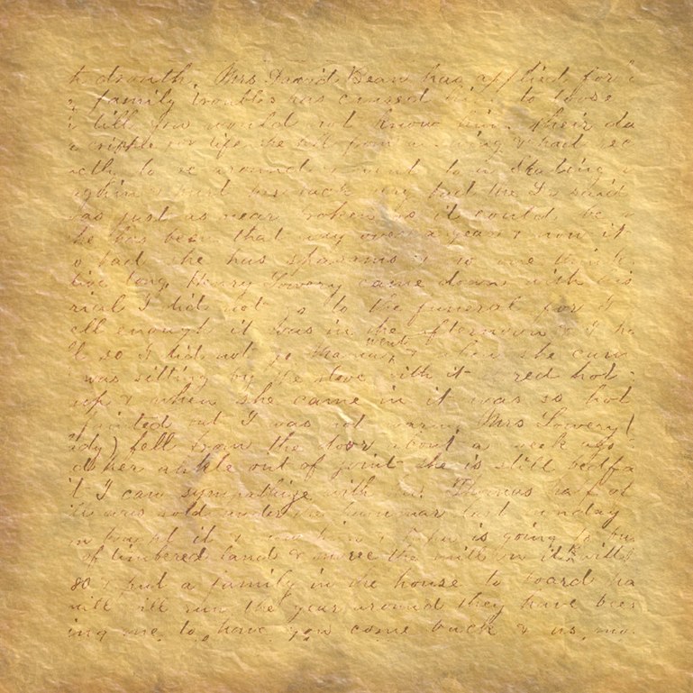
March 11, 1944: Reply to John Bonomi’s letter
“Thanks a million for your letter. I was certainly surprised to hear from you so soon.
Well, I’ve started to work now and so it’s no time to loaf except on Saturdays. We work every day but then. One good thing about our job—the more we work the more we make. We’re on a sort of piece work basis.
Thanks again for helping us out at camp with drug orders. I’ll bet Fred (Sakuda) and the boys appreciate all you’re doing for them too.”

Slide 49
Zeeland, Michigan: WWII Role and Japanese Americans
Zeeland, MI was the home of the Herman Miller Furniture Company, which, during the war years, was known as the Michigan Star Furniture Company
The company had military contracts which utilized their specialty molded plywood to design lightweight splits and stretchers for use in the field instead of their previous manufacturing of lightweight furniture
To meet war demands, they hired additional workers

Slide 50
One letter from Fred Sakuda, after David S. Miyamoto’s departure from Manzanar …
Dear Mr. Bonomi:
Will you please send the following by Parcel Post and please address care of Pharmacy
1 only Vitamin B Complex with Iron
1/100 Trisomin Tab
3 only A.R.T. Tablet 8/-
1 only Ponds Vanishing Cream $1.50
1 only Vitamin B Complex Syrup 12 fl oz (Squibb)
Please Rush and Thank You John. Enclosed find $16.00 in money order. If short, I will send money next time.

Slide 51
Frank “Match” Kumamoto and John Bonomi
Match Kumamoto started writing to John Bonomi July 1, 1942 when he was relocated to the Santa Anita Assembly Center.
There—or nearby—he worked on a National Project by the WPA making camouflage nets for the Army
He was paid $12 a month
By October 11, 1942, he wrote from Wyoming—home of the Heart Mountain Relocation Center

Slide 52
October 11, 1942: Match Kumamoto to John Bonomi
“Sorry I didn’t write right away but ever since I came to Wyoming I’ve been pretty busy. I started working in the Hospital the day after I came here & since every thing were unsettled it kept me pretty busy. Most of the stocks & drugs supplies which are furnished by the St. Louis Army Medical Depot are not here so we’re having one heck of a time trying to fill the prescriptions of the Doctors. We’re getting some of the needed stocks on an emergency purchase from a drug store in Cody, Wyo, so it helps a lot. Pretty soon we’ll have all we need in the hospital.”

Slide 53
Match Kumamoto continues to John Bonomi— October 11, 1942
“Tom Saskehara is working in the pharmacy along with 10 others & with myself included, we have 12 at present. We have a 24 hr. service and right now at this moment, I’m on the 12:00 AM to 8:00 AM shift. It’s only once every Sat., so I don’t mind. Dr. Hauaoka who use to come to Kyosai Drug is the head man among the Japanese MD’s so thru his efforts I got the job right away.
This country is very bleak & if you really want to know—as the residents around here calls it: The country where God took his rest, after making the rest of the U.S. & forgot to work on it afterward.”

Slide 54
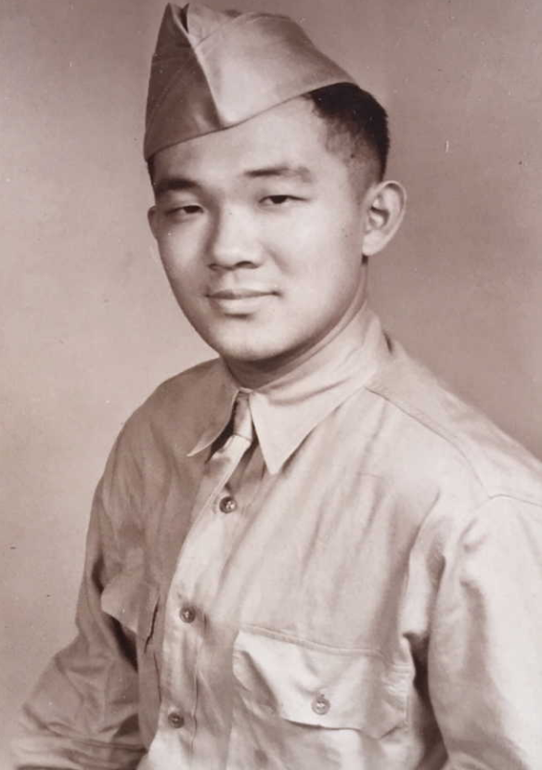
Single letter to John Bonomi from Ryo Komae:
Ryo Komae
Born 1918
Enlisted February 3, 1942 at Fort MacArthur, San Pedro, CA as a private.
His term of enlistment was the duration of the war plus 6 months.
He was already a pharmacist when he enlisted.
Notes:
Found on Ancestry.com (add the genealogy link)

Slide 55

Ryo’s letter to John Bonomi:
Well, you asked for it to here I go---
About the middle of Nov. I visited John Toshiyuki at Jerome & we had a talk about old times. Naturally I asked about the store and during the course of our conversation John T. told me how liberally you aided him in disposing of his mdse. He had naught but praises for you & Brunswig & regretted very much that he had traded on such a larger scale with McKesson.
About the middle of April, about 80 of us Niseis were shipped here where we became attached to the headquarter detachment. Upon arrival I asked for a transfer to the medics but my efforts were in vain. So for four months I worked as a cashier & bookkeeper for the officers club.

Slide 56
Ryo’s continuation and conclusion of letter:
I became acquainted with a captain in the medics & he arranged to have me transferred to the medical detach. This was the first week in Sept. so I came to work as a laboratory technician. They had some queer idea about not being able to trust me in pharmacy. Yet I am satisfied as my work is interesting & I am gaining new knowledge every day. At present, I am working as a bacteriologist.
And how about a little news of L.A. Tell me about the former “Lil’ Tokio.” So long & drop me a line soon.
Your pal, Ryo Komae

Slide 57
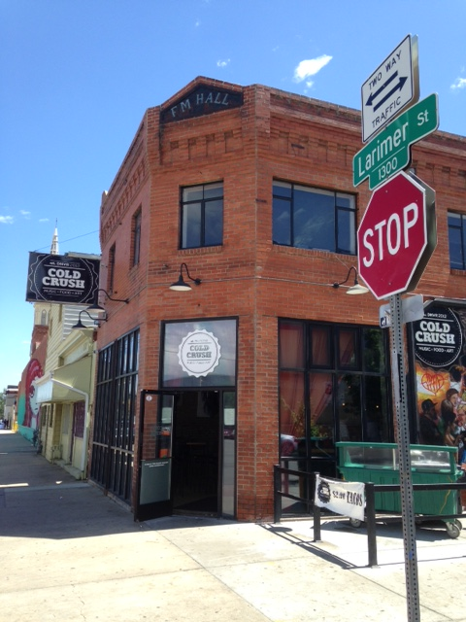
T.K. Pharmacy Denver, Colorado (2015)
Notes:
Presenter’s collection; taken June 2015, Denver, CO.

Slide 58
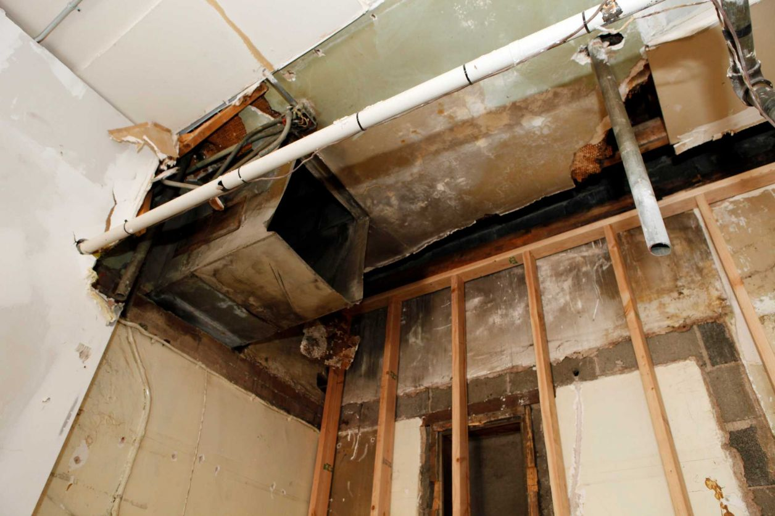
…When walls talk…
Notes:
Reference: http://www.thehistoryblog.com/archives/21692
Accessed 3 May 2018

Slide 59
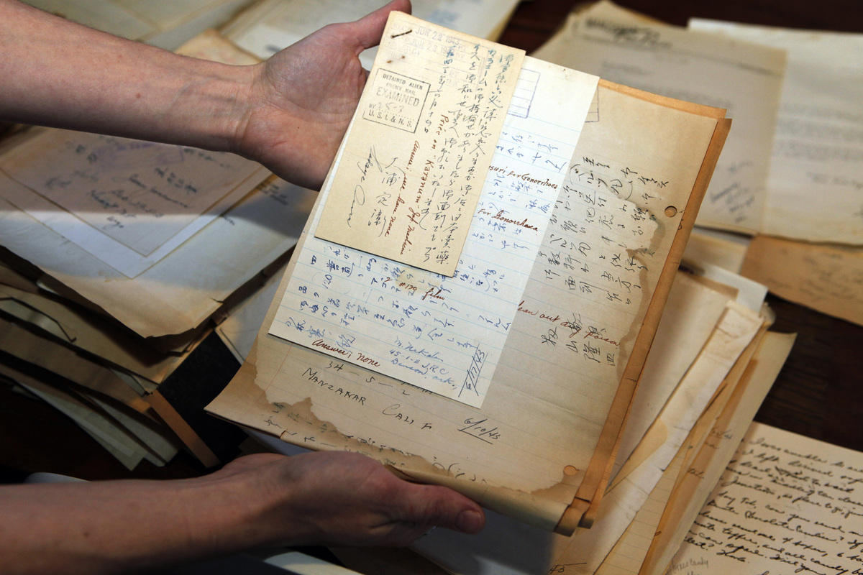
…unforgettable stories emerge...
Notes:
Reference: http://www.thehistoryblog.com/archives/21692
Accessed 3 May 2018

Slide 60

Pharmacy’s Long-Standing Presence in Denver, CO
From the 1905
“Bulletin of
Pharmacy”.
Frank M. Hall was
one of Denver’s
original
pharmacists.
Notes:
Picture from : https://books.google.com/books?id=74hNAAAAMAAJ&pg=PA252&lpg=PA252&dq=Frank+M+hall+pharmacist+denver+colorado&source=bl&ots=StURx5Z_tM&sig=uqv5QKFas-vsiFI4Fr27XEbuCmk&hl=en&sa=X&ved=0ahUKEwi8r5_jhOraAhWLnoMKHXjsBiYQ6AEIMTAF#v=onepage&q=Frank%20M%20hall%20pharmacist%20denver%20colorado&f=false
“The Bulletin of Pharmacy, A concise and Comprehensive Monthly Review of Pharmaceutical Literature, Progress, and News, Vol XIX, January to December 1905. Detroit, EG Swift, Medical Publisher, 1905
p. 252
From: “The Pacific Pharmacist, An Independent Journal….Devoted to scientific pharmacy and the interests of the drug trade.”
(volume 2, 1908-09)
p. 548
from: Pacific Pharmacist - Volume 2 - Page 548 - Google Books Result
https://books.google.com/books?id=5fkzAQAAMAAJ
https://books.google.com/books?id=5fkzAQAAMAAJ&pg=PA548&lpg=PA548&dq=frank+m+hall+building+denver+co&source=bl&ots=lRA1cAkNhj&sig=VYV92swx4mf9q-E9GED9N6_LDWM&hl=en&sa=X&ved=0ahUKEwjQwojz-unaAhXG64MKHbrXDV0Q6AEIOTAD#v=onepage&q=frank%20m%20hall%20building%20denver%20co&f=false
Accessed May 3, 2018
“Mr Frank M Hall of Denver, Colorado, is at the present time building a two-story block at the corner of Twenty-seventh and Larimer streets directly opposite his present location, and expects to occupy the corner room in the block. He has purchased a new Walrus Eitherway Soda Fountain and will install fixtures to match. Mr. Hall is one of the first druggists in the State of Colorado, being financially interested in several other stores in the city of Denver. He is what we might call a pioneer druggist, having been in this same location for a quarter of a century.

Slide 61
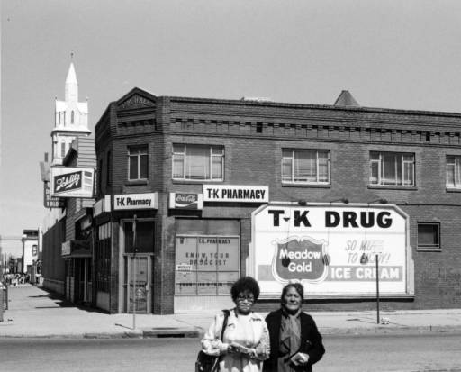
T.K. Pharmacy
F.M. Hall Building
Notes:
Reference:
Call Number
X-24858
Title
F. M. Hall Building
Creator
Noel, Thomas J. (Thomas Jacob)
Date
1979
Summary
View of the Frank M. Hall Building at 27th (Twenty-seventh) and Larimer Streets in the Five Points neighborhood of Denver, Colorado. The two-story brick building has decorative trim. Women walk across the street nearby. Signs read: "Schlitz" "T-K Pharmacy" "Coca-Cola" "Know Your Pharmacist" "and "T-K Drug Meadow Gold Ice Cream So Much to Enjoy!"
Description
1 photoprint ; 13 x 18 cm. (5 x 7 in.)
Subject
Denver (Colo.); Five Points (Denver, Colo.); Drugstores--Colorado--Denver; Women--Colorado--Denver
Geographic Area
Denver (Colo.)
Format-Medium
Photograph
Source
T. J. Noel.
Rights Contact Information
Copyright restrictions applying to use or reproduction of this image available from the Western History and Genealogy Dept., Denver Public Library, at photosales@denverlibrary.org.
Reproduction Available for Purchase
Yes (digital reproduction)
Related Material
Image File: ZZR710024858
Notes
Handwritten on back of print: "2700 Larimer Street" and "Frank M. Hall built this structure to house his drug store in 1896 at 2700 Larimer, a few doors down from Sacred Heart Church."; Title supplied.; R7100248586
We Invite Your Comments
See an error or omission? Spot a person or place that's unidentified? Send an email to whgclerks using the domain denverlibrary.org. Be sure to include as much detail as possible, including the source of your information so we can respond properly. Thanks!
CONTENTdm number
37390

Slide 62
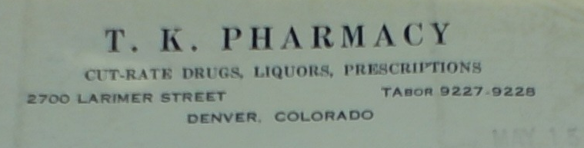
Why and How did Yutaka “Tak” Terasaki Provide Pharmacy Services to Japanese Americans in the Camps?

Slide 63
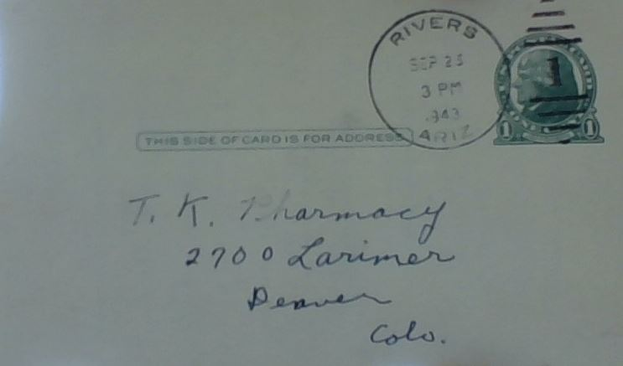
Letters and Postcards arrived near and far, from Japanese Americans scattered in the camps across the nation
9/23/1943
postmark

Slide 64

Common Postmark on Correspondence Tak Terasaki Received

Slide 65
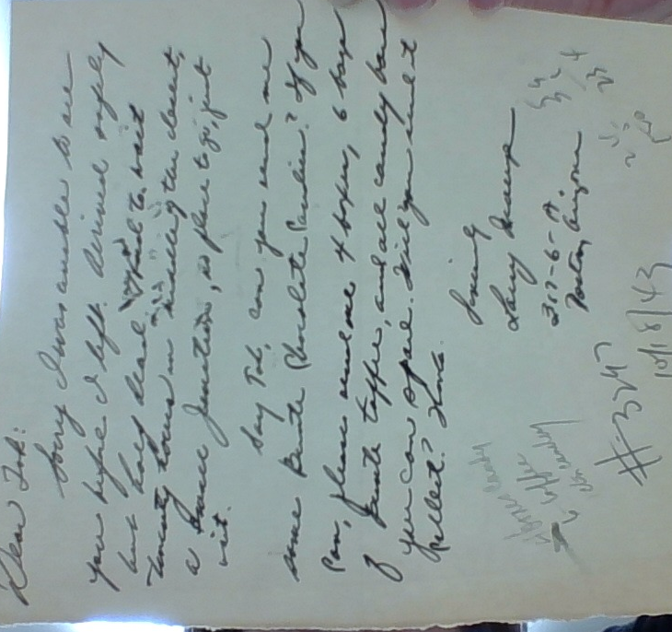
The Letters Began the Same: “Dear Tak…”
10/18/1943
Notes:
“Dear Tak:
Sorry I was unable to see you before I left. Arrived safely but half dead. Made to wait twenty hours in middle of the desert, a small junction, no place to go, just sit.
Say Tak, can you send me some Bente Chocolate Candies? If you can, please send me 4 boxes, 6 boxes of Bente Toffee, and all candy bars you can spare. Will you send it >>>>
Thanks
Sincerely,
Larry Inouye
317-6-A
Poston, Arizona

Slide 66
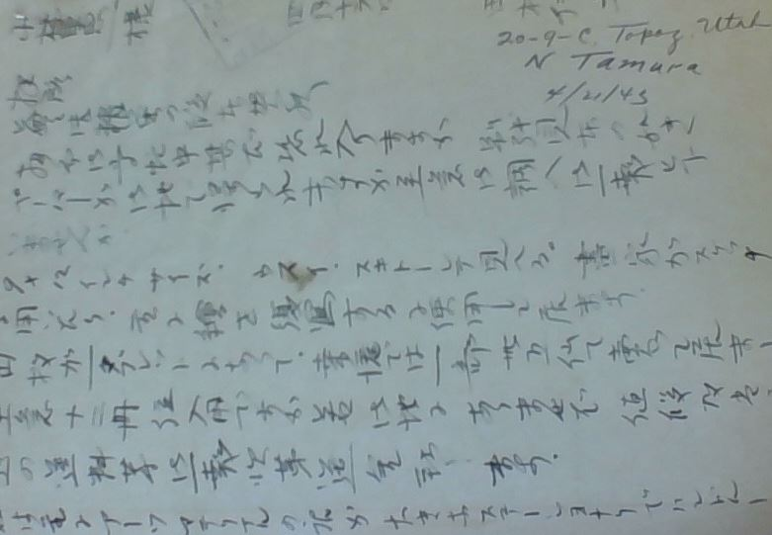
Note handwritten in Japanese 4/21/1943

Slide 67
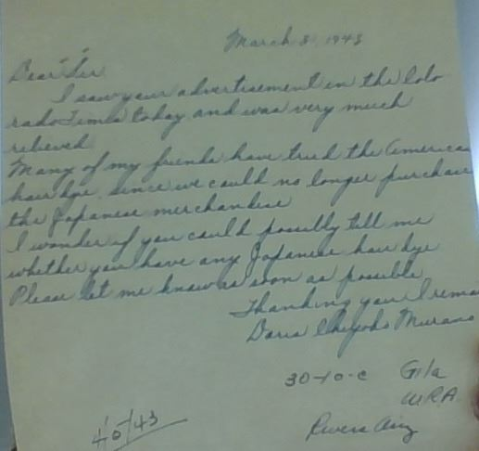
“I saw your advertisement in the Colorado Times today and I was very much relieved.”
“I saw your advertisement in the Colorado Times
today and was very much relieved….”
From Gila W.R.A. (War Relocation Authority)

Slide 68
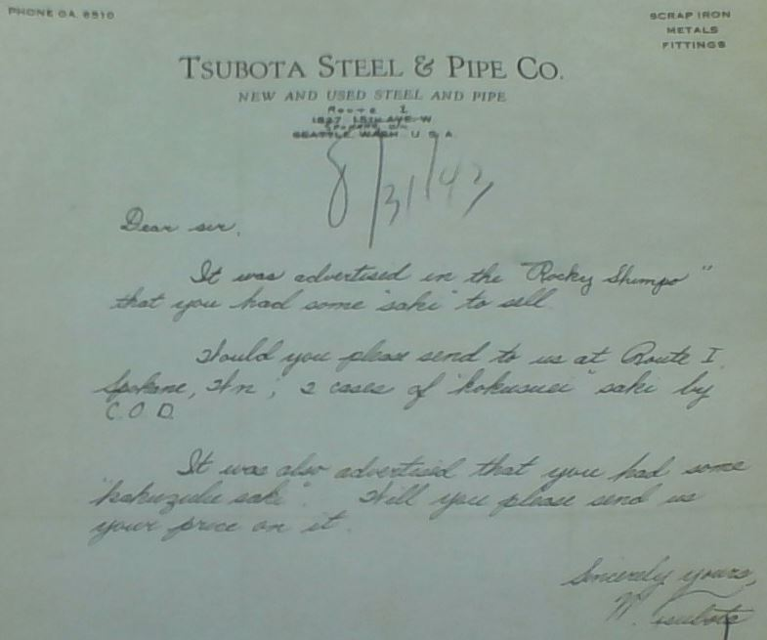
“Rocky Shimpo”

Slide 69
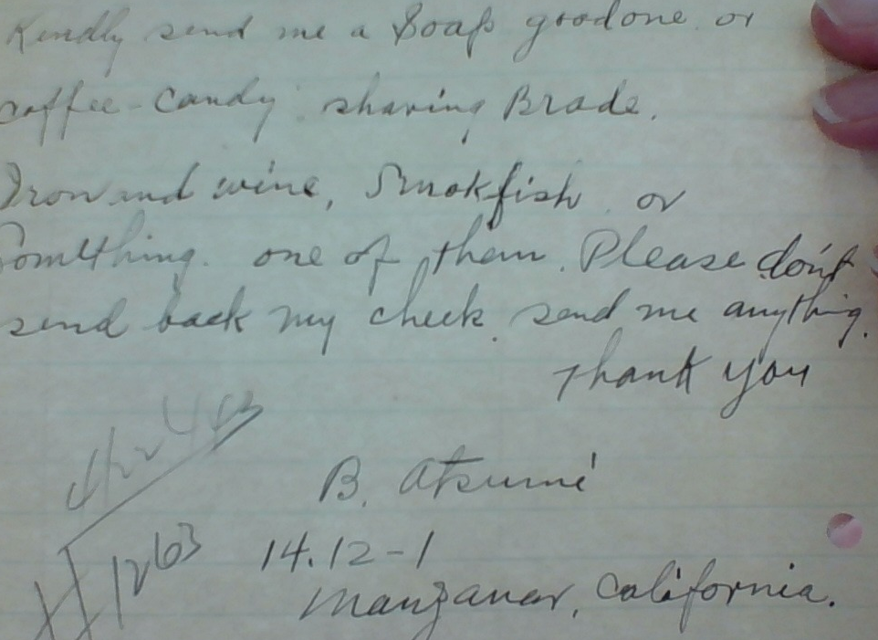
1943
Notes:
Manzanar, 4/19/1943

Slide 70
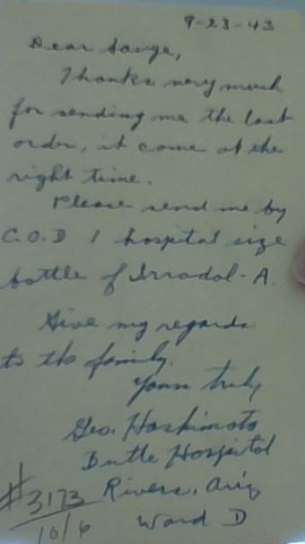
From George Hashimoto, addressed from Butte Hospital, Rivers, Arizona, Ward D (Gila River Internment Camp)
Irradol A:
“A molasses- flavored syrup of water miscible forms of vitamins A, E, D, and K, as well as vitamin C, B complex vitamins, and other vitamins plus zinc”
Handwritten Note dated 9-23-1943
Notes:
Irradol-A generic. Price of irradol-a. Uses, Indications and Description
https://www.ndrugs.com/?s=irradol-a
ADEKs uses water- miscible forms of the fat-soluble vitamins to improve absorption in these individuals.It also provides vitamin C, B complex vitamins, and other vitamins plus zinc to supplement dietary intake. ... Multiminerals/Multivitamins in Australia.

Slide 71
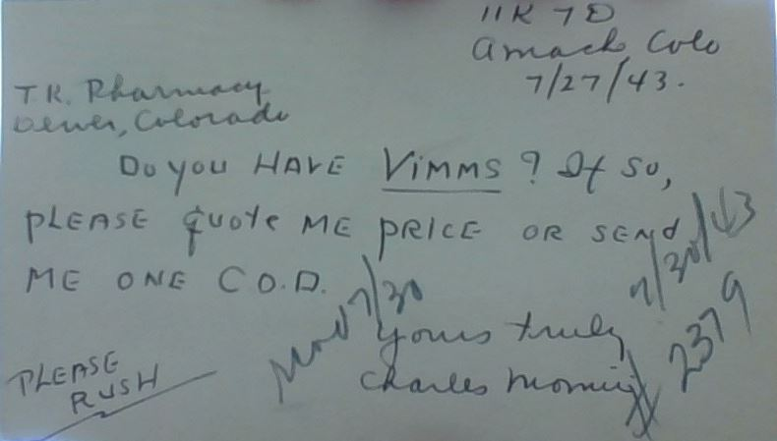
“do you have VIMMS? If so, quote me or send me one COD...PLEASE RUSH” July 27, 1943
Notes:
Vimm’s were vitamins in the 1940s

Slide 72
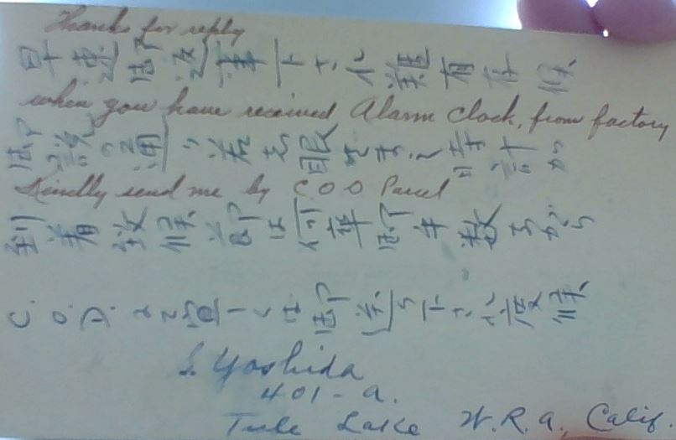
“Thanks for reply… when you have received alarm clock from factory, kindly send me by COD parcel” (translated from Japanese)

Slide 73
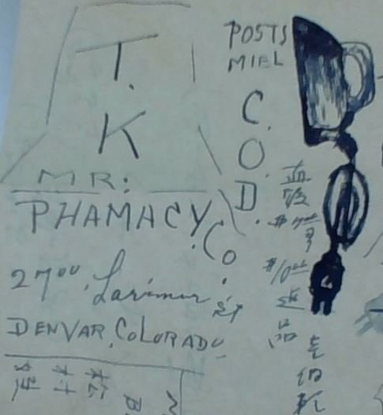
Mixed English, Japanese notations and doodles

Slide 74
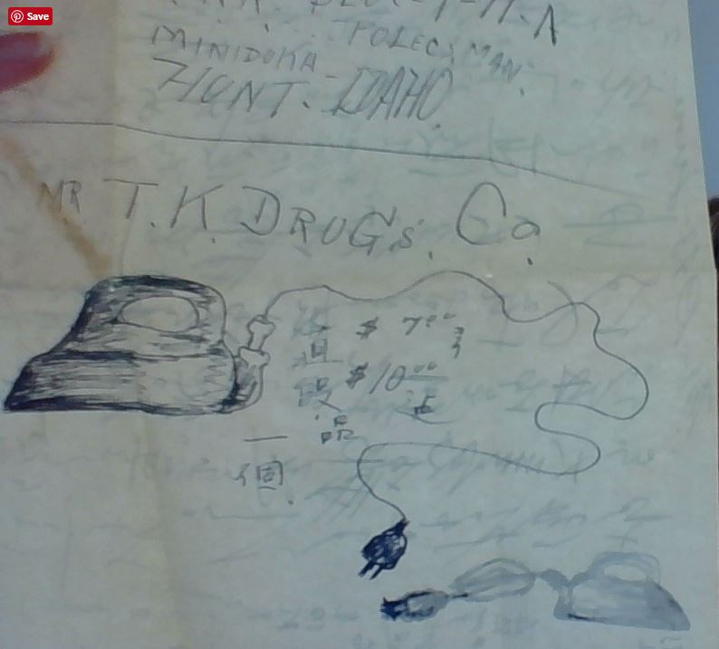
Minidoka
Electric Iron
Electric Iron

Slide 75
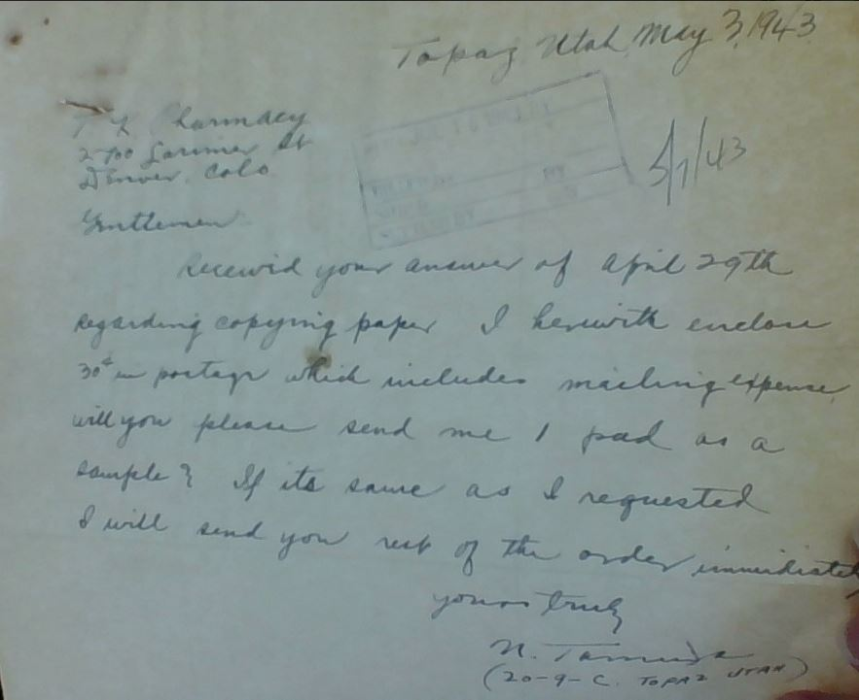
“received your answer of April 29th (1943)…”
Notes:
Just wanted paper (pad of paper for writing, drawing)

Slide 76
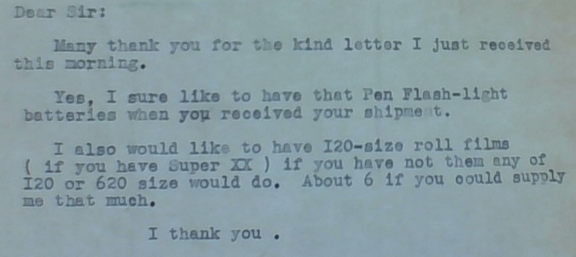
The Simple Things: “Batteries” and “Film” were both on allocation by government restrictions and the war effort
-- From Heart Mountain Internment Camp,
James Yonemura, July 30, 1943

Slide 77
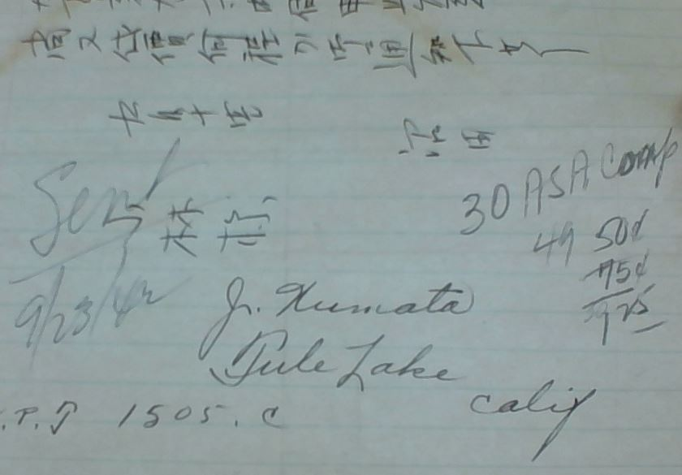
Mixed English, Japanese writing Order for #30 ASA Compound
30 ASA Comp

Slide 78
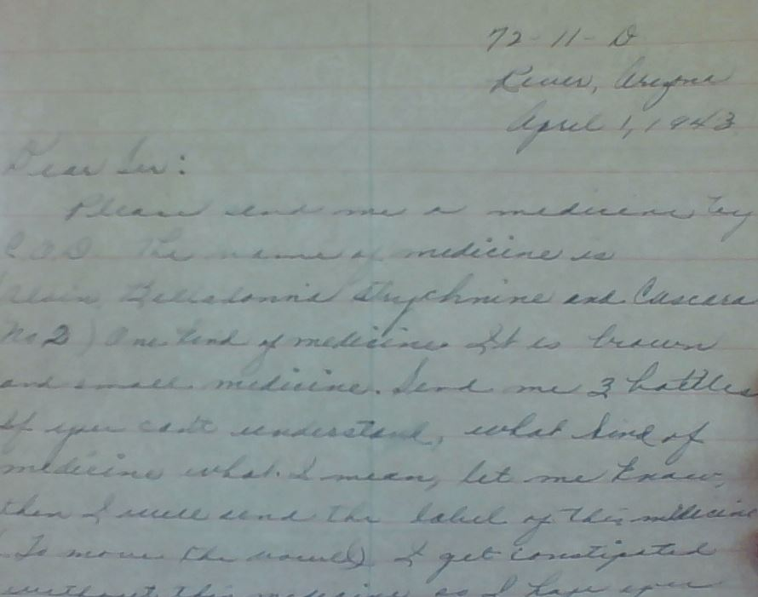
April 1, 1943
“Belladonna, strychnine and cascara no 2”
Notes:
Put an arrow in 4th line down in letter—belladonna, strychnine and cascara no 2

Slide 79
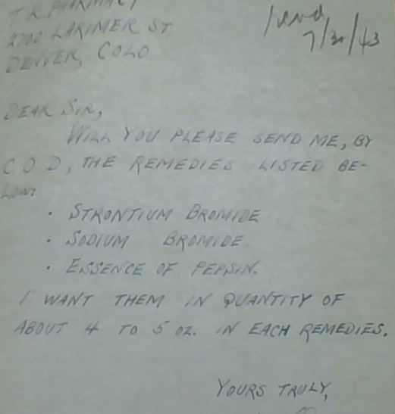
Prevalence of many stomach ailments…
7/30/1943
Strontium Bromide,
Sodium Bromide,
Essence of Pepsin

Slide 80
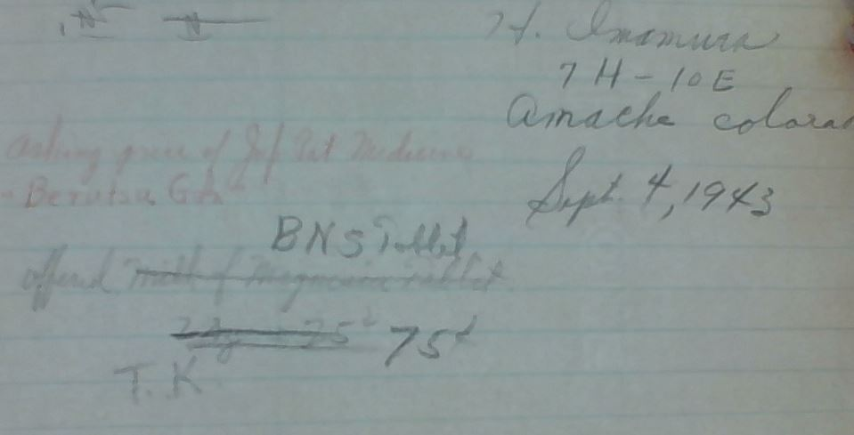
September 4, 1943
BNS tablets
Notes:
Berutsu is glycerin-based product
Not able to translate gita
Initial offering was for milk of mag tablets, then changed to BNS tablets. Digestive ailment?

Slide 81
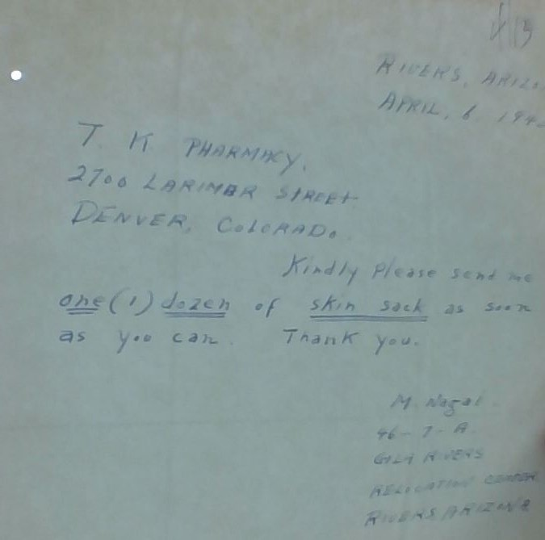
April 1, 1943 “Kindly send my one (1) dozen skin sack as soon as you can. Thank you. M. Nagal”

Slide 82
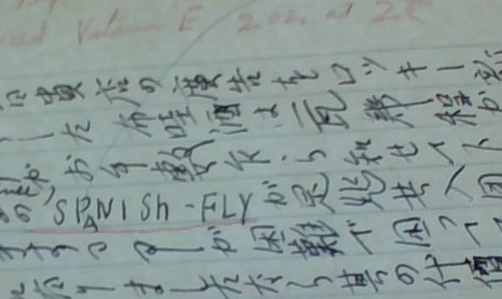
Spanish Fly Aphrodisiac
Notes:
Active ingredient is cantharidin—a severe irritant when ingested. As it is metabolized and excreted, it’s irritative effects continue, including the testes, urethra, and penis, resulting in a lot of swelling resembling a long-lasting erection. Tak noted on bottom of this card: “no”

Slide 83
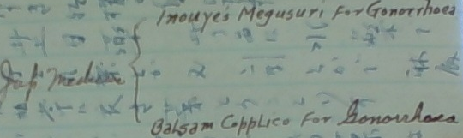
Treatment for Gonorrhea

Slide 84
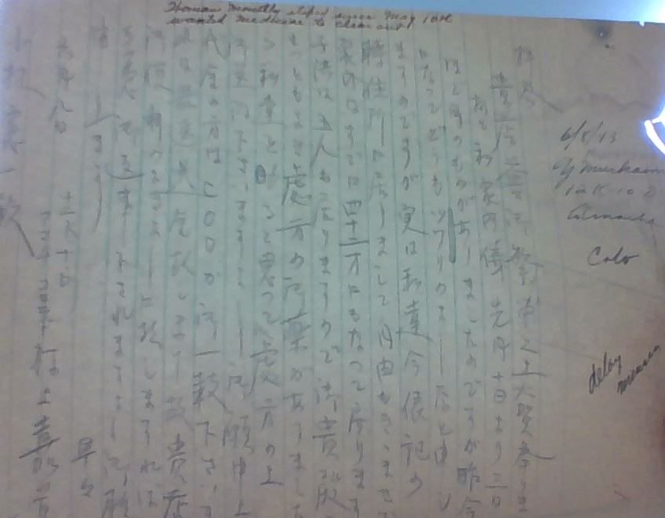
abortifacient
Granada WRA
Amache, Colorado
June 6, 1943
Notes:
Asking for abortifacient

Slide 85
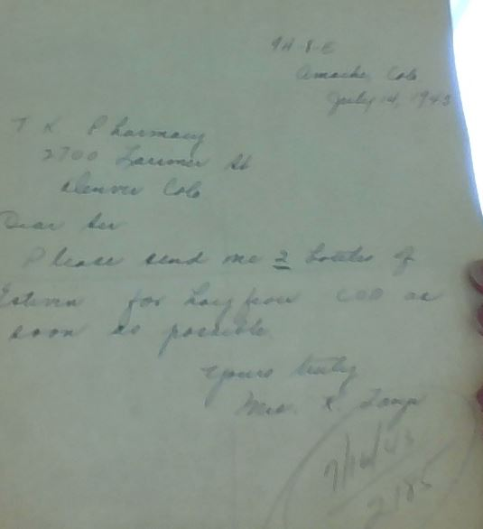
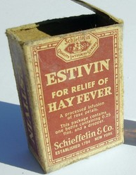
July 14, 1943: “Please send me 2 bottles of Estivin for hay fever as soon as possible.” Mas K
2 bottles of Estivin
for hay fever
“A processed infusion of
rose petals”
Notes:
Estivin is for allergies/hay fever

Slide 86
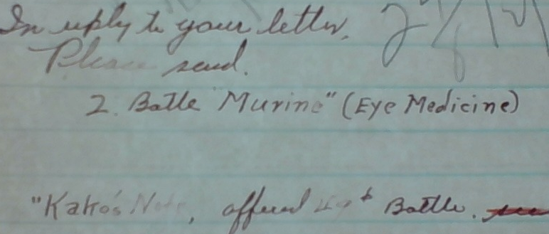

Kako’s Note: Offered 49c bottle

Slide 87





Slide 88

1 dozen quinine requested
Frequent request from Poston camp…
Records show high incidence of malaria

Slide 89

Ascaris treatment from afar
“Ask Tak: 5 year old and baby
Feels itchy on rectum.
Finds worms in AM”

Slide 90

Bookkeeping receipts to support those requesting orders…

Slide 91

TK Pharmacy and Sake Distribution

Slide 92

The “Granada Fish Market” and Sake Request

Slide 93

Notes:
To highlight use of Western Union cables/telegrams

Slide 94

Popular product request:
“Godefroy’s Larieuse hair dye”
Jet Black coloring (dye) was a common request of Japanese Americans in all camps.

Slide 95

11/9/1943
“Larieuse (Black)
Godefroy’s Coloring”

Slide 96

Larieuse product insert

Slide 97
June 1943 Tak purchased for $5.43
“I brought just a few of the more expensive drugs with me from San Francisco with hopes of selling it somehow. You will note the prices are approximately half the wholesale so I’m sure they represent quite a substantial saving to you.”
“Following are the quantity and prices. Let me know what you could take and I shall be glad to send them to you at once.”
1-500 Lilly, Pulv. Sod. Amytal 3 gr 8.00 ($5.40)
1-500 Abbott, Cap. Nembu-Fedrin 5.00 (3.60)
(Nembutal ¾ gr)
(Ephredrine ⅜ gr)
5 bot P.D. Sol. Adrenalin Chl. 1-1000
(Cork stoppered) 1 oz .45 each
3 vials P.D> Sol. Adrenalin Chl. 1-1000
(Rubbered stoppered) 1 oz .45 each
-- Pharmacist S. Okamoto, formerly of San Francisco,
writing from Rivers, AZ, location of Gila River W.R.A.

Slide 98
What happened to these pharmacists?
Continued
Journeys…
Notes:
Create list of names discussed in this presentation and describe what happened to each then animated(as in movie credits) – next to last slide

Slide 99
What did the future hold for Muts Nobe (1)?
August 13, 1942 letter to John Bonomi:
“Catherine & I have applied for school at last. I am to get into med school if possible. Times “a-wasting” and I don’t intend to let too much slip by.”
POSTSCRIPT:
Muts Nobe did indeed leave the camp and attended medical school.
Mutsumi Nobe was born in Los Angeles, CA in 1908
He received his MD license in 1949 in Illinois.
His death notice was posted in JAMA for October 3, 1963, Chicago, IL.

Slide 100

From University of Illinois, 1944-45 Directory
Mutsumi Nobe

Slide 101

Who was Masy Masuoka (2)?
“Masaru Aurelius Masuoka was born
20 August 1914 in
Los Angeles CA and died 15 Nov 1998.
He was the son of Naoichi Masuoka and Oryo Chikamori.”
… a surprise finding
from Masy’s obituary

Slide 102

Masy Masuoka’s next journey:
From Ancestry.com, discovered the Jerome camp records
Masy and Kiku departed Jerome on June 16, 1944 for Chicago, IL
Masy later attended college in Chicago and became an optometrist for nearly 40 years
Kiku passed away in 1965

Slide 103
Details Regarding John Toshiyuki (3)
John Yoshiaki Toshiyuki was registered by the California State Board of Pharmacy, Certificate No. 14889 by exam, on 25 July 1936.
John Yoshiaki Toshiyuki was born 12 November 1913 and died 4 January 2004 in Venice, CA.

Slide 104

David S. Miyamoto (4)
David Shoichi
Miyamoto
registered
for the draft
in 1940
Notes:
Reference:
Draft Registration Cards for California, 10/16/1940 - 03/31/1947. 2013 boxes. NAI: 7644723. Records of the Selective Service System, 1926–1975, Record Group 147. National Archives and Records Administration, St Louis, Missouri.

Slide 105








Details about David S. Miyamoto
From “Final Accountability Roster of Evacuees at Relocation Centers”
Notes:
Reference:
https://www.ancestry.com/interactive/2982/40915_294010-00131?pid=32459&backurl=https://search.ancestry.com/cgi-bin/sse.dll?db%3DEvacueeRostersRelocationCenters%26h%3D32459%26indiv%3Dtry%26o_vc%3DRecord:OtherRecord%26rhSource%3D8918&treeid=&personid=&hintid=&usePUB=true&usePUBJs=true&lang=en-US
Logs from Manzanar official government records: “Final Accountability Roster of Evacuees at Relocation Centers”

Slide 106

David S. Miyamoto’s Journey … out of Manzanar
Notes:
Note how this confirms David did leave Manzanar 12/3/43 for first Scotts Bluff, Neb. We know from his correspondence to John Bonomi that he then traveled to Zeeland, MI and worked in an industry, presumptively the furniture store.
He wrote John Bonomi that he was going to send for his family, and indeed, they left Manzanar 4/18/44 for Zeeland, MI.

Slide 107


David S. Miyamoto University of Southern California, Class of 1934
Notes:
Reference:
https://www.ancestry.com/interactive/1265/32724_241375-00056?pid=127801044&treeid=&personid=&rc=&usePUB=true&_phsrc=ceB3&_phstart=successSource

Slide 108
Two more pharmacists…
Fred Sakuda (5)
Frank “Match” Kumamoto (6)
No additional details found at this time
The search continues…

Slide 109

Ryo Komae’s Future (7)
He survived WWII
Returned and opened the
Gardena Pharmacy, active from
1949 to 1971.
He and his wife, Jean, were
strong supporters of pharmacy
and student-pharmacist
education
He passed away in 2016

Slide 110
Dirt and Desolation
“This country is very bleak & if you really want to know—
as the residents around here call it:
The country where God took his rest
after making the rest of the US ,
And forgot to work on it afterward.”…..
-- “Match” Frank Masakatsu Kumamoto
Excerpt from letter dated October 11, 1942
Notes:
KEEP IN SLIDE PRESENTATION

Slide 111
Special Thanks and Recognition
Sam Terasaki, Denver, CO
Alissa and Mitch Williams, Snohomish, WA
Dennis Worthen, PhD
Steve Bingo, Project Archivist, Manuscripts, Archives, and Special Collections, Washington State University, Pullman, WA
Deb Hollis, Department of Special Collections & Preservation, University of Colorado Boulder Libraries, Boulder, CO
Jamie Henricks, Archivist, Japanese American National Museum, Los Angeles, CA
Kelly Mikiko Gates, Collections Assistant, Japanese American National Museum, Los Angeles, CA
Caitlin Oiye Coon, Densho, Seattle, WA
Tom Ikeda, Executive Director, Densho, Seattle, WA
Densho Museum, Seattle, WA
Japanese American National Museum, Los Angeles, CA

Slide 112
Contact Information
Speaker: Megan R. Undeberg
Phone: 218.726.6039
Email: undeberg@d.umn.edu
After July 1, 2018:
Phone: 509.358.7737
Email: meganru@wsu.edu
Moderator: Ettie Rosenberg
Phone: 323. 454. 5024
Email: erosenberg@westcoastuniversity.edu

Slide 113
References
As there are too many references to fit on a single slide or two, references will be available upon request from Dr. Undeberg, whose contact information is provided on the previous slide

