Slide 1
Teaching History of Pharmacy According to the AIHP Guidelines:
A. Introduction to the Study of Pharmacy History
Created by: Terri M. Wensel,
PharmD, BCPS, TTS
Samford University McWhorter School of Pharmacy
Reviewed by: Patricia Jusczak,
BS Pharm
University of Hawai'i at Hilo, The
Daniel K. Inouye College of Pharmacy
Developed by the Teaching History of Pharmacy Committee of the History of Pharmacy SIG, 2017-18
Picture: Pharmacist at People’s Drug Store No. 5, Washington, DC, c. 1920. Library of Congress Prints and Photographs, LC-USZ62-129891

Slide 2
Lecture Objectives
Explain the evolution of diagnosis and treatment of disease in early civilizations
Discuss the role of fossils in discovering disease in early man
Describe techniques used by early Native Americans to diagnose and treat disease
Describe the significance of artifacts left by early civilizations to medicine, treatment and society
Explain the importance of the shaman healer in the prehistoric era and connection to modern healthcare

Slide 3
Lecture Objectives
Identify contributions made by Greek and Roman Empires, especially how they influenced the standards for Western pharmacy and medicine
Explain how the Romans built upon Greek medical and pharmacy achievements
Recall individuals from Greek and Roman Empires who advanced pharmacy and medicine
Describe methods used by the Greeks and Romans to diagnose and treat disease

Slide 4
Learning Objectives
Describe key features of Arabian pharmacy
Discuss the contributions of Arabian pharmacy to expanding pharmacy literature
Discuss key elements of Ancient Chinese Medicine
Discuss how Chinese Medicine evolved the use of the needle as a means to deliver treatment
Describe the doctrine and different disciplines of Ayurveda Medicine

Slide 5
Why study history?
1. To learn the past and past practices.
2. To gain knowledge and avoid the mistakes of the past.
3. To know where we may be headed, based on where we’ve been.
4. To discover the “eternal truths” - what worked in the past and may work now - human nature hasn’t changed.
Notes:
NOT ON SLIDE:
1. To learn the past and past practices.
2. To gain knowledge and avoid the mistakes of the past.
3. To know where we may be headed, based on where we’ve been.
4. To discover the “eternal truths” - what worked in the past and may work now - human nature hasn’t changed.

Slide 6
How long has pharmacy existed?
As long as man has been in existence.
Early man/woman learned by trial & error what effects different plants, animals and minerals had.
Prehistoric humans believed events &/or occurrences were due to magic or spirits, and their “pharmacy” practice was a mix of mysticism and crude products.

Slide 7
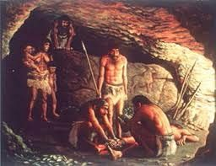
Prehistoric Era
2.6 million years ago to ~15,000 B.C.
Cave people
Small tribes, sparsely wooded areas
Gatherers & Hunters
Nomadic
Primary cause of death: disease & injury
  Short lifespan
  High infant mortality
Notes:
This time era includes the Paleolithic Era and Old Stone Age
People had to be nomadic to ensure survival

Slide 8
Prehistoric Diseases
Arthritis
Sinusitis
Tumors
Musculoskeletal injuries
Tuberculosis
Rickets
Cavities
Notes:
Paleopathology: study of disease of ancient man using fossilized bone, art, teeth, and later, mummies.
Poor nutrition thought to have contributed to various diseases.
Soft tissue diseases difficult to study due to decay.

Slide 9
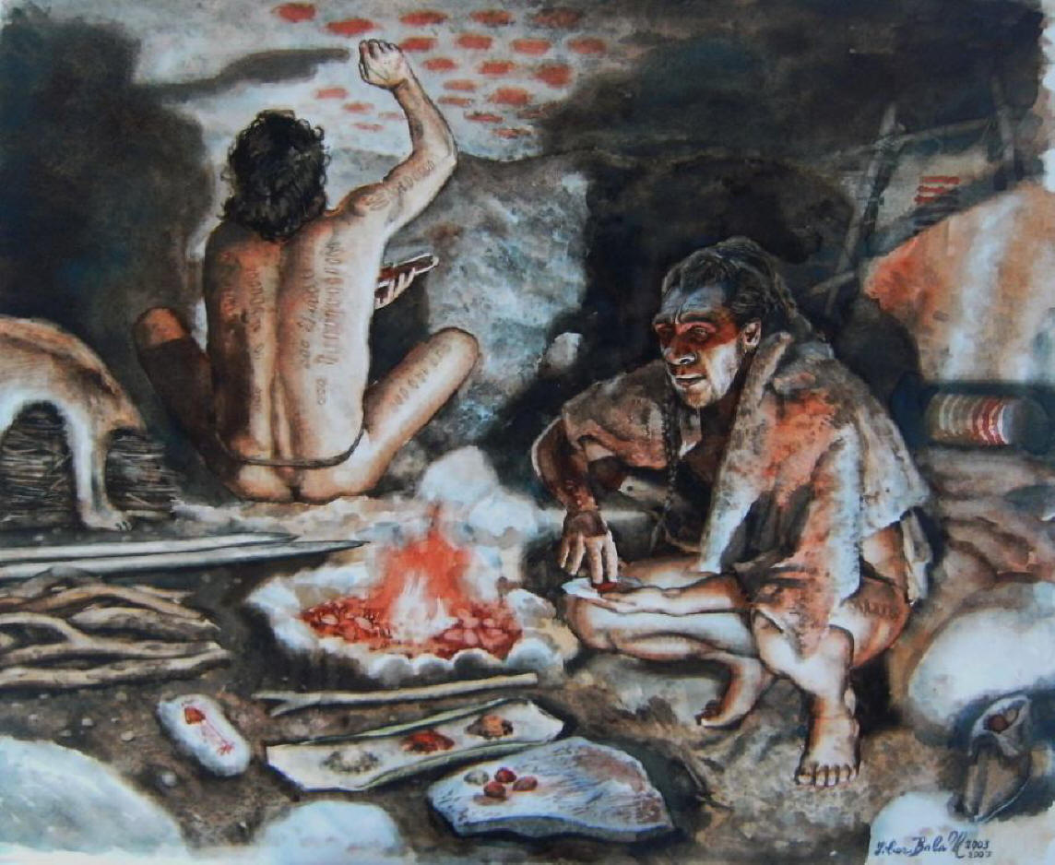
Habits of the Paleolithic Man
Leaves, mud, and clay
Instinct
Trial & error
Learned by watching animals, neighbors
Created gods / idols
Emergence of tribal healers
How does this compare to practices we use today?
Notes:
What were animals eating that helped them to heal? What did not work?
Animals immobilized fractured limb. Physical therapy, massaging, applying heat or cold for pain.
Those with special talents for healing emerged-
Shaman, witch doctors, medicine men
Shaman derived from Siberian language meaning “one who knows”
Role of learned & trusted healer evolved over time into modern physician, pharmacist, nurse & other health care professionals.
Shamans developed
Over time, individuals in a tribe emerged who had special talents for healing others…shamans, witch doctors, medicine men
People explained the world around them in supernatural or religious terms. This extended through to the Renaissance Era with cultures and civilizations explaining illness in sacred or religious language. Not until well into the Early Modern Era that pharmacy and medicine are framed in secular or scientific language
Leaves, mud & clay for bee sting: -> cool and grainy brings relief from pain and potential to remove source of pain…the stinger.
Minor bleeding stopped by applying leaves (astringent), clay or mud (pressure)
Leaves, mud and clay….more for comparison….
Origin of Nystatin:
Like many other antifungals and antibiotics, nystatin is of bacterial origin. It was isolated from Streptomyces noursei in 1950 by Elizabeth Lee Hazen and Rachel Fuller Brown, who were doing research for the Division of Laboratories and Research of the New York State Department of Health. Hazen found a promising micro-organism in the soil of a friend's dairy farm. She named it Streptomyces noursei, after William Nourse, the farm's owner. Hazen and Brown named nystatin after the New York State Health Department Laboratory (now known as the Wadsworth Center) in 1954.
Origin of lincomycin
The first lincosamide to be discovered was lincomycin, isolated from Streptomyces lincolnensis in a soil sample from Lincoln, Nebraska (hence the bacterial name).
Origin of Aureomycin
Aureomycin, the first of the tetracyclines, was discovered in 1948 by American botanist Benjamin Minge Duggar (1872-1956). Duggar was 76 years old at the time of his discovery. He had graduated from the Mississippi Agricultural and Mechanical College (Mississippi State College) and studied at Alabama's Polytechnic Institute and Harvard University. Duggar later became a professor of botany at the University of Missouri, Washington University, and the Missouri Botanical Garden. He did pioneering research on the tobacco mosaic virus and became widely known for his work with molds and fungi (a group of organisms, such as mushrooms, that lack chlorophyll, roots, stems, or leaves, and reproduce by spores).
Later, as a consultant to the Lederle Division of the American Cyanamid Company, Duggar turned to research on new antibacterial drugs. Although penicillin and streptomycin were being widely used to treat bacterial infections, a number of diseases and strains of bacteria were resistant to the treatments. Duggar focused his research on groups of molds found in soil. He tested more than 3,500 strains of molds before he had a success. In 1945 he tested a sample taken from soil at the University of Missouri campus. A golden-hued (colored) substance produced by the mold exhibited antibiotic properties. After extensive testing, he found it to be active against bacilli, staphylococci, and streptococci (all forms of bacteria). Duggar named the substance aureomycin, from the Latin word "aureus," meaning gold, and the Greek word "mykes," meaning fungus.
Continued testing revealed that aureomycin was effective against 90 percent of bacteria-caused infections. In human trials, the medication was found to be effective against a wide range of infections with minimal side effects. Unlike penicillin and streptomycin, which had to be injected, aureomycin could be taken orally (by mouth). Aureomycin was also effective in treating diseases that did not respond to other antibiotics, such as trachoma, parrot fever, typhus, chlamydia, and mycoplasmas. It was also active against Rocky Mountain spotted fever, an infection which had spread throughout the United States. Caused by a microorganism called rickettsia and transmitted by a tick, the disease was fatal in one out of every five patients. For a time, aureomycin was added to livestock feed to prevent diseases in animals. This practice has been largely discontinued, however, because it breeds bacteria which are immune to the drugs.

Slide 10
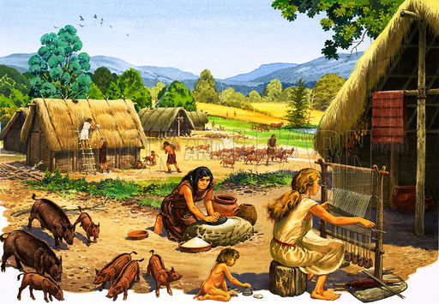
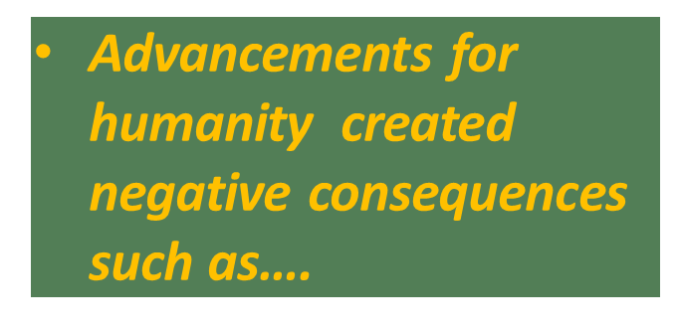
Neolithic Period
~10,000 to 12,000 B.C.
  New Stone Age
Higher density populations
Permanent dwellings
Agriculture
Pottery allows for food / water storage
Irrigation
Farming, animal breeding
Cloth weaving
Art, trade
Notes:
Trading was with excess crops, weaved clothing, etc.
Pair & share activity…or 4 corners….
Negative consequences:
Higher density populations: -> incr. spread of infection; political hierarchy, division of labor, competition for fixed territorial resources
High density human & animal populations:
Higher levels of animal fecal waste in water supplies, harbored diseases: (polio, typhoid, viral hepatitis, whooping cough, diphtheria.
Cross-species transmission of infectious disease
Relationship to animals
Small pox & mad cow disease (Humans association w/cattle)
Humans brought TB to cattle.
Pigs & fowl: threatened humans with influenzas of various types & degrees
Dogs: brought us measles.
Dogs, cat, chickens, mice, rats, & reptiles: brought us salmonella

Slide 11
Neolithic Period
More gods / idols
Expanded knowledge of materia medica
‘Cast out’ evil
Plants began to be used as drugs
Surgery
Minor bleeding stopped with leaves, clay, or mud
Splinting
Massage
Materia medica – anything that can be used to heal a patient: plant, animal or mineral
Notes:
More gods / idols created to explain what was not understood
materia medica (mat. med.)
1 the study of the origins, preparation, uses, and effects of drugs and other substances used in medicine.
2 a substance or a drug used in medical treatment.
Mosby's Medical Dictionary, 9th edition. © 2009, Elsevier.
= pharmacology
Cast out evil by chanting, sucking poison out of wound, draining
Plants as drugs (i.e.. herbs: topical, smell, swallow)
Surgery to remove arrows
Minor bleeding stopped by applying leaves (astringent); clay or mud (pressure)
Splinting to immobilize fractured limbs
Massage, apply heat, cold for pain

Slide 12
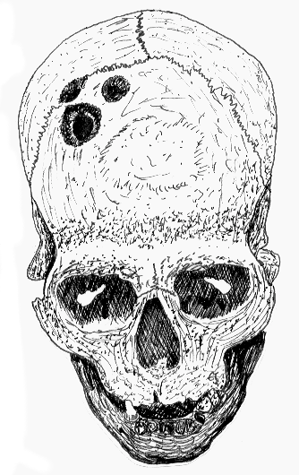
A Trephined Skull, 8,000 B.C.
Link between man and primitive societies
Notes:
Trepanations = brain surgery performed by shaman. All around the world.
Sharpened stone tools used to make incision on the top of the patient’s skull to let the demons escape. “Piece of skull cut out was given to the patient to wear as an amulet to ward off future demons from attacking.”
Skulls revealed ancestors performed brain surgery using stone instruments and that patients survived more than 75% of the time.
Note multiple holes in skull.
First believed to be a religious ritual or sacrificial act – but known that patients survived as skull bone re-grew smoothly.

Slide 13
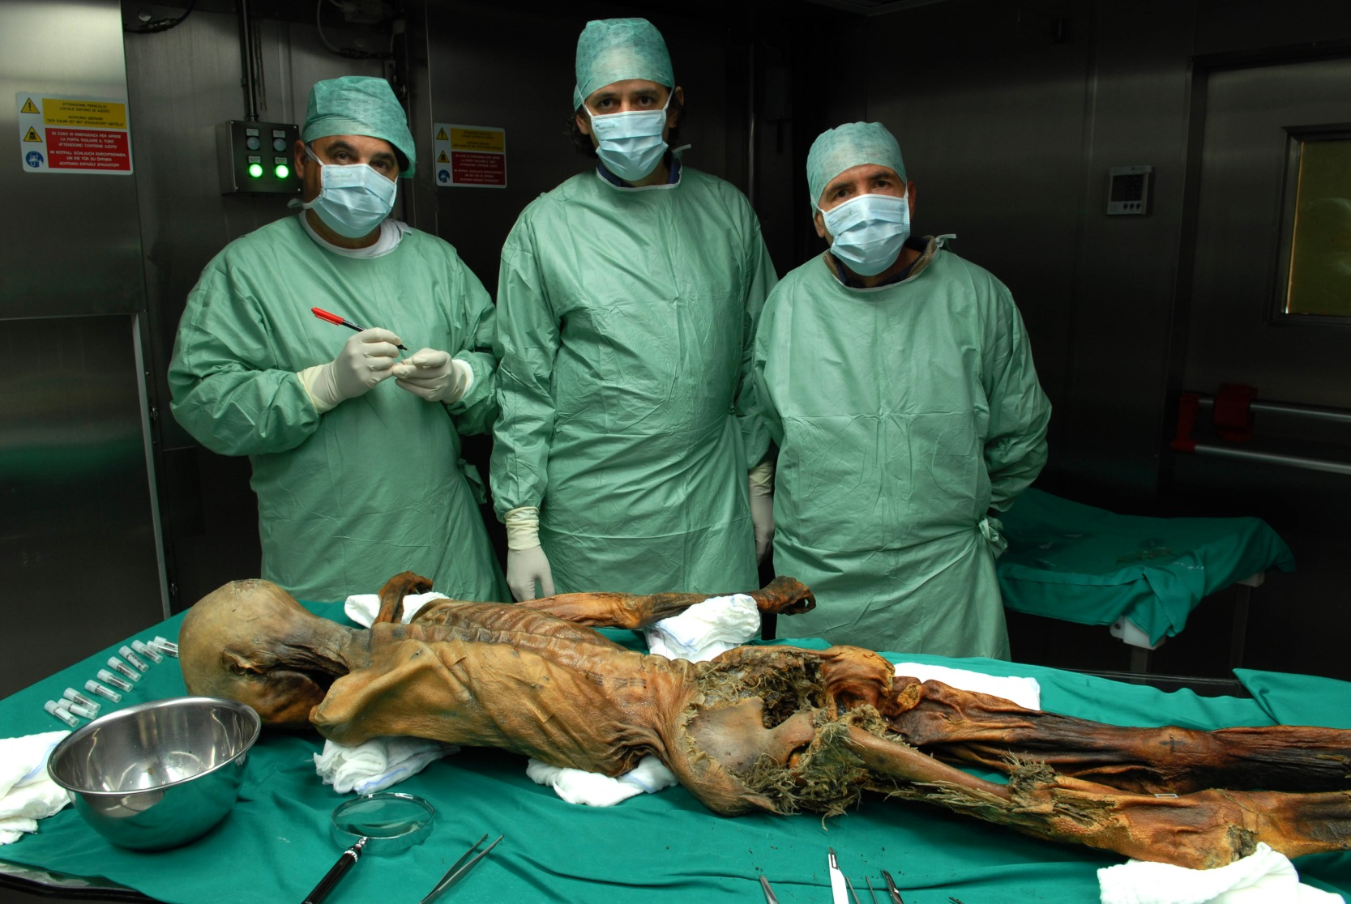
Ötzi - “Iceman” (lived around 3300 BC) - discovery yields information about prehistoric ancestors
Notes:
Discovered in Tyrolean Alps, Sept 19, 1991 (mummified in ice of glacier)
Otzi carried utility belt containing dried mushrooms and fungi that had antibacterial properties.
Tattoos on body corresponding to acupuncture points.
From this researches lead to believe Neolithic ancestors had knowledge of the body and herbs, more than previously thought.

Slide 14
Primitive Cultures / Native American Medicine
Link to the Neolithic Era
No written language
Primitive technology
Knowledge of plant drugs without application of technology
Tribal similarities
  Superstitions, curses, gods, breaking a taboo caused a curse
  Ritual chanting / dancing
  Family presence
  Shamans
  Surgical skills
Notes:
Archaeological evidence that shamans also know how to set bone fractures, perform cauterizations & amputation of limbs.
For treatment of tribal family member taken ill -> first try known practical methods such as rest, other passed down from ancestors. If no improvement, assumed disease caused by evil spirit, ghost, or a curse by a sorcerer. Medicine man or woman specialized in ailment called in and ceremony utilized to drive out evil spirit, encourage confession, etc.
American Indians treated very old ill persons with kindness.
Eskimos induced the elderly to commit suicide.

Slide 15
Illness in Primitive Societies
Rest
Remedies passed down
Ceremonial rituals
Evil spirits as a cause
  Dysentery, typhoid, malaria, bronchitis
Notes:
Ill person rested, tried remedies passed down
No improvement, could be work of evil spirit: Medicine man/woman who specialized in certain disease
Rituals were well defined and done in presence of family to present unity against the disease
Psychological value of medicine man’s treatment:
Security of established rituals, such as confession, dream interpretation, magic rituals, trances PLUS presence of entire family & tribe = great healing value.

Slide 16
Ceremonies
Organized by medicine
Trance would reveal source
Prayers
Concoctions
  Administration of purgatives
Scare away spirits with dance, regalia, drums
PURPOSE: Drive out the evil spirit
  May include confession of sins, purging, burning an effigy of the person thought to have caused the disease
Notes:
Sought to determine the cause of the disease be it spirit, angry god, curse, lost soul, ghost
Laxatives and emetics would be administered to purge
Mind, body & spirit : treated as “the whole patient”, not compartmentalized as often done in modern health care.
Compare to DO training today, versus internal medicine.

Slide 17
Native Americans
Vast knowledge of plants and agriculture
Knowledge of wound and fracture treatment
Surgical anesthetic knowledge
Psychological value of attention in medicine
Taught settlers about tobacco, witch hazel, & cascara sagrada
Notes:
Many of the drugs used by American Indians were very valuable. Therapeutic use passed on to the early settlers, many of the plant drugs were included in the 1st pharmacopeia (1820).
Bone dislocations and fractures were treated.
Removed spears and arrows, treated open wounds skillfully.

Slide 18
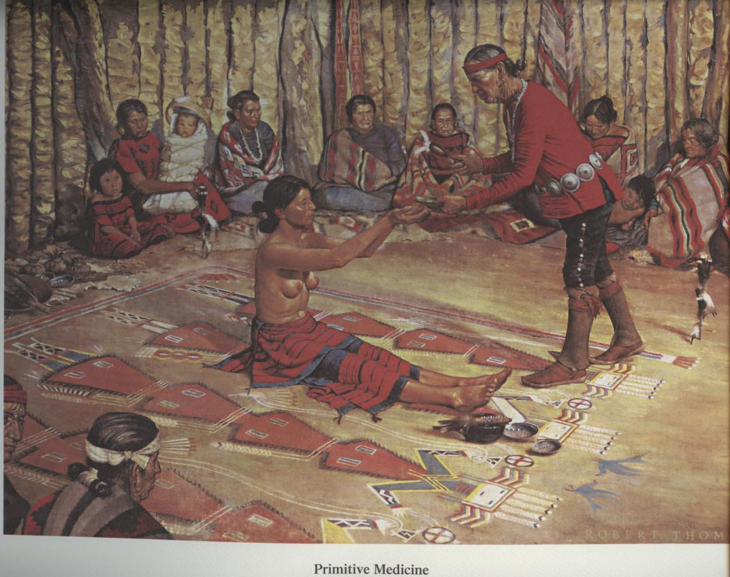
Native American Ritual Medicine

Slide 19
Navajo Sand Painting
Painted elaborate designs in the sand
Spirits could act to cure sickness
Destroyed after 24 hours so they could not be used maliciously
Over 600 documented, each with a specific disease or prevention ceremony

Slide 20
Ancient World: Growth of Civilization
Village populations grew
River civilizations grew
Mesopotamia, Sumerians 4000-2000 BC
Babylonians 2000-1350 BC
Chaldeans 612-539 BC
Assyrians 1350-612 BC
Notes:
River civilizations grew in Mesopotamia, Egypt, India, China

Slide 21
Sumerians
Pictograms
Cuneiform
Basic arithmetic
Standard system of weights and measurements
Astrology
Omens
Liver is the central organ and seat of life
Notes:
Standard weight/measurement system (sexagesimal)
Omens could be positive or negative and were a key role in priest-physician timing of treatment
Liver was seat of life where blood collected
Our system of seconds and minutes based on 60 is derived from sexagesimal measures.
Basic arithmetic, yet no evidence of being used in compounding or preparing medicine.

Slide 22
Sumerian “Pharmacy”
About 250 vegetable and 120 mineral drugs
Formulas were not quantitative
“pasisu” = remedy/cosmetic preparers - plied their trade on a particular street

Slide 23
Cuneiform Tablet, ~3000B.C.
Thousands have been discovered
Made from local clay
  Inscribed with reed stylus and baked
Among the first Western Civilization recorded language
Recorded daily activities, prescriptions, contracts, receipts
First written record of man’s medical history
  Mentions of typhus, malaria
Notes:
Sumerians wrote in pictogram, known as Cuneiform
Writing on wet clay tablets (3x4 inches), baked in kilns to make the permanent documents.
Document medical knowledge and practices of ancient Mesopotamia.

Slide 24
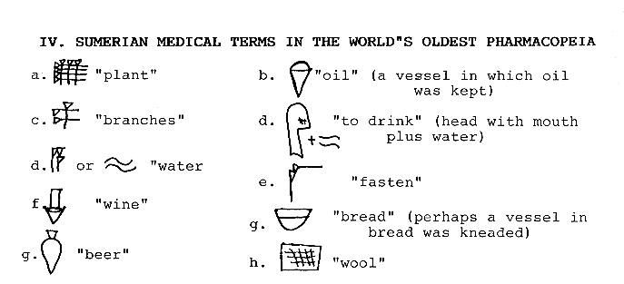
Pictograph Translations
Notes:
Written by Sumerians.

Slide 25
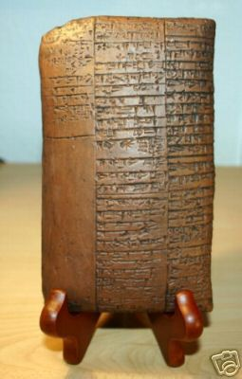
World’s Oldest prescription
Sumerian Cuneiform Prescription, 2100B.C.

Slide 26
Ancient Babylonian Inventions
Wheel
Arch
Clock dial
Metals
Weights (grain of wheat “grain”)
Astrology
Astronomy
First written legal code
Judeo-Christian-Islamic Civilizations arose
  Intense priest bureaucracy
  Believed disease was from violating moral code or engaging in a taboo activity
Notes:
Biblical Connection: Some Old Testament stories similar to Sumerian legends. Mesopotamia influenced the Christians, Hebrew, and Islamic civilizations that came later. Biblical Tower of Babel matches the temple found of Sumerian city-states.

Slide 27
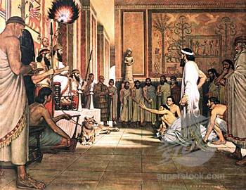
King Hammurabi, 1792-1750 B.C.
Wrote first law code, medical ethics and
justice
Innocent until proven guilty
Eye for an eye
Regulated surgery, penalties for failed
operations
Dictated physician fees
Genesis of current concepts of healthcare
Managed Care sliding fee scale services
based on social status
Notes:
Ruled city-state of Babylon
282 Laws inscribed on upright stone pillar
Failed operation by surgeon may result in having their hands cut off, or death, depending upon incident and class ranking of patient.
Found by French archeologist, 1901, in ancient city of Susa (now Iran).
“Considered the genesis of the current concepts of healthcare.”

Slide 28
Examples of plant / mineral drugs
Mesopotamian tablet library - materia medica
Mandrake
Poppy (opium)
Hellebore
Pine turpentine
Licorice root
Myrrh
Asafoetida
Cannabis
Crocus
Mentha
Mustard
Turmeric
Thymus
Honey
Cedar
Willow
Salt
Styrax
Chemical substances: Alum, Arsenic, Sulfur
Notes:
32,000 tablets of recording survived.
800 dealt with Mesopotamian materia medica
250 drugs of plant origin, 120 of mineral origin, 30 simple unmixed drugs for making compounds

Slide 29
Babylonians added:
Senna
Saffron
Coriander
Cinnamon
Garlic
Vehicles to administer drugs:
Alcohol
Beer
Wine
Oil
Fats (milk)
Wax
Distillation process discovered
Notes:
32,000 tablets of recording survived.
800 dealt with Mesopotamian materia medica
250 drugs of plant origin, 120 of mineral origin, 30 simple unmixed drugs for making compounds
Distillation process discovered- to make essence oils (ie. cedar), beer, etc.

Slide 30
Poly-pharmaceuticals / Compounding
Beer and wine used as vehicles, along with honey, milk, oils, wax, bouillon
Preparations were ground, strained and filtered
Decoctions (boil down, concentrate, extract flavor)
Electuaries (mix herbs in sugar water or honey)
Embrocations (liniments)
Examples:
Salt + beer =
Antiseptic
Glycyrrhiza (licorice root) + honey =
Sooth sore throat
Pine turpentine oil + sulfur =
Antimicrobial/analgesic for skin irritation & nerve pain

Slide 31
Dosage forms used in Ancient Babylonia
Poultices and plasters
Ointments and salves
Lotions
Tablets
Powders
Enemas
Suppositories
Pessaries
Inhalations / fumigations

Slide 32
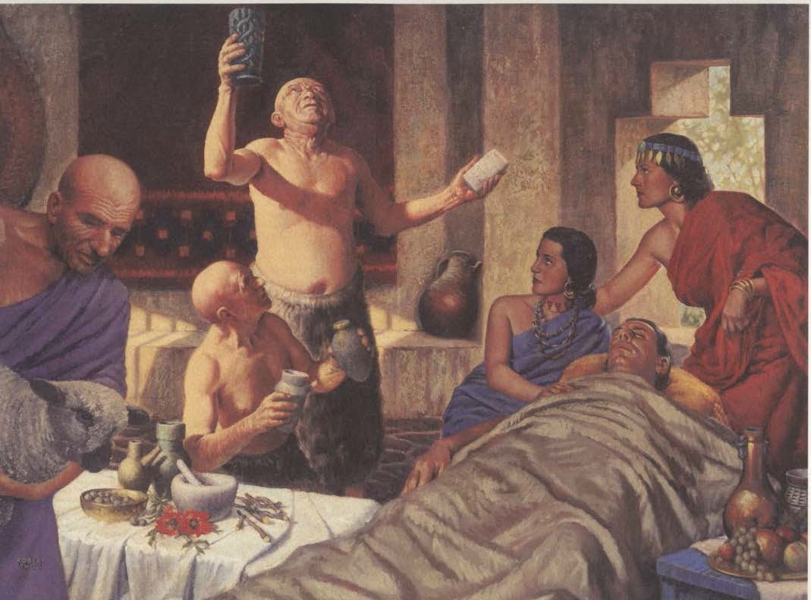
Pharmacy in Ancient Mesopotamia
Temple priests determined which god or demon caused disease
BARU diagnosis and prognosis
ASHIPU performed rites, prescribed medicine, also acted as a nurse by applying treatments
ASU prepared healing preparations (including drugs), performed surgery as physician/priest (Could be held accountable in Hammurabi’s code. BARU AND ASHIPU were exempt.)
Used incantations, amulets, prayers, sacrifice and drugs
treatments
Used incantations, amulets, prayers, sacrifice and drugs
Notes:
Mesopotamia – healers first and foremost trained as priests, specialized various areas of healing (mind, body & spirit)
Viewed their world as supernatural.
Theory of illness closely resembled pre-historic times.
Baru operated in spiritual realm. Search for omens.
Ashipu – tasked with driving out the evil demons from the patient’s body, home, & village. Used oral rites & medicines.
Asu
Above, primarily treated royal court & upper class
Barbers – treated lower class with rudimentary dentistry & surgery

Slide 33
Egyptian Civilization
1900 to 700 B.C.
Written language = hieroglyphics Translated by discovery of Rosetta Stone in 1799
Medical practices similar to Assyrians, in that continued religious connotations: Imhotep = real physician (@3000 B.C.), later deified as divine representative of medicine (@500 B.C.)
Horus = pharmacy revealed to him by his mother, Isis
Notes:
NEVER ON SLIDE:
Rosetta stone was found near the Rosetta mouth of the Nile River.

Slide 34
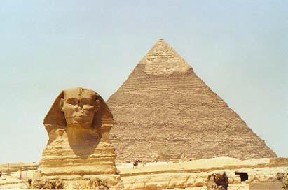
Ancient Egypt 3000BC
Egypt means “Gift of the Nile”
Wrote on papyrus reed
Life guided by mythology
Goddess Isis, knowledge of herbs
Thoth, physician/god
Priest bureaucracy controlled day to day lives, Pharaohs were considered Gods
Pharmacy separated from medicine, drugs play key role in medical system
Anubis apothecary to the gods
Notes:
“Anubis, trusted apothecary to the gods who prepared prescriptions and was in charge of the storehouse of medicines.” Pg 21 Zebroski
Mythical goddess Isis – knowledge of herbs.
Thoth = physician who later became a god. He knew which remedies drove out the evil spirits that caused disease

Slide 35
Egyptian “Pharmacy”
Evidence derived primarily from 8 medical papyri, like the Ebers Papyrus (contains 700 drugs and 800 formulas) and Edwin Smith papyrus
Tended to have more quantitative formulas than Babylonians; however, used measures (“ro”=15ml) more often than weights
Rise of polypharmacy = use of multiple drugs in a single formula
Notes:
NEVER ON SLIDE:
The Ebers Papyrus is perhaps the most famous surviving artifact relating to pharmacy. It was written about 1553-1550 BC and was discovered about 1862 in a tomb at Thebes, together with another medical text, the Edwin Smith Papyrus. It is now preserved in the University of Leipzig and is in almost perfect condition.
It is a miscellaneous collection of extracts and jottings collected from at least 40 different sources. It consists of mainly a large collection of over 800 prescriptions and more than 700 drugs mentioned for a number of named ailments; specifying the names of the drugs, the quantities of each, and the method of administration. It also contains sections dealing with diagnosis and symptoms, physiology, as well as spells and incantations.
The text:
• Is 68 feet long and 12 inches wide
• Covers 110 large columns (each averaging 22 lines long and 877 numbered sections of varying length)
• Consists of black and red writing on the papyrus (The beginning of each chapter and paragraph is enriched with red capitals.)
The prescriptions range from simple ones containing one substance to complex remedies of up to 37 ingredients; the average is from 6 to 12 ingredients.

Slide 36
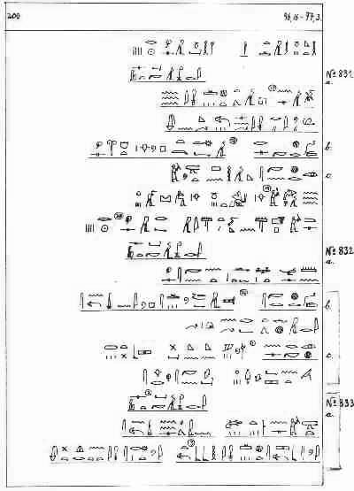
Ebers Papyrus, ca 1500 B.C.
22 yards long
800 RXs and 700 drugs, describes diseases
Very detailed, describes diseases and drugs
Directions for treating ophthalmic, dermatologic and gynecological ailments
Notes quantities, denotes poisonous or expensive drugs as well as appropriate incantations
Notes:
Most significant document from pharmaceutical standpoint.

Slide 37
Egyptian Theory of Illness
The heart = seat of life
Metu (blood vessels)
Channels of four elements flowing throughout the body: blood, air, water, wekhudu (bodily waste)
Excess wekhudu causes illness
Blocked channels can cause illness
Illness also explained in supernatural terms
Out of balance -> sickness
Treatment included restoring balance
Treatment: purge body of wekhudu (use of laxatives)
Preventative medicine (avoid excess wekhudu)
Notes:
Theory of body channels, analogous to the Nile river & tributaries
Egyptians purged themselves by vomiting and taking laxatives on a monthly basis using castor oil, colocynth, and senna to keep bodily waste materials from building up and collecting near the anus, which caused illness.

Slide 38
What the Egyptians Knew
Extensive working pharmacopeia, as early as 3700 B.C
Renowned for their learned physician/healers
Embalming and mummification, some knowledge of human anatomy
Invented paper from papyrus
Role of cleanliness and food contamination
Fevers
Eye ailments
Parasites
Small Pox, Leprosy, Arthritis, Pneumonia, Appendicitis
More details in medicine in Ancient Babylon, but still highly spiritual and superstitous
Notes:
Knowledge of human anatomy more for mummification purposes than for medical theory.

Slide 39
Egyptian “Pharmacy”
Two class system of drug preparers:
  1) Chief preparer of drugs, Conservator of drugs or priest-herbalist
  2) Collectors of drug product and laboratory aides
However, practitioners of drug collection and preparation may have been assistants to physician, and not a distinct entity. May even have been the same person.

Slide 40
Drugs and Therapeutics
Fractures easy to treat
Diseases of internal organs more difficult to treat – used supernatural methods of prayer, chants, magical incantations to expel and appease demons
Amulets of garlic, honey, fish tail, castor oil worn to drive out evil spirits that caused disease
Drugs - animal, vegetable or mineral origin, mainly alleviated symptoms
Opium well known for use in pain
Moldy bread used on wounds (penicillin?)

Slide 41
Extensive Working Pharmacopeia Typical Drug Ingredients:
Dill
Fennel
Fig
Garlic
Hemp dogbane
Henbane
Juniper
Lotus
Mandragora
Myrrh
Acacia
Almond
Aloe
Alum
Anise
Arsenic
Castor Bean
Celery
Cinnamon
Charcoal

Slide 42
Typical Drug Ingredients:
Onion
Peppermint
Saffron
Senna
Sulfur
Soot
Tamarisk
Vervain
Willow
Wormwood
Opium from poppies
Moldy bread, applied and ingested
Blood
Excrements and reptile skins
Notes:
Moldy bread…primitive penicillin?

Slide 43
Dosage Forms
Gargles
Suppositories
Enemas
Troches (lozenges)
Poultices
Pills
Lotions
Snuffs, inhalations, fumigations
Infusions
Ointments
Plasters
Eye Drops, to be added with a vulture’s feather
Beer and Wine were used as vehicles
Blood was ingested as a tonic for vitality

Slide 44
Sophisticated Tools and Methods for Compounding Preparations
Mortars and pestles
Mills
Sieves
Balances
Listed quantities of medicaments used in their formulas
Less reliance on prayers and incantations, charms and magic, still superstitious and wore amulets to ward off evil spirits (composed of garlic, honey, fish tail)
Physicians began to specialize, prayed for help in handling of patients
Notes:
Measured by volume vs. weight

Slide 45
Specialized Methods
of Drug Preparation and Storage
Division of labor, supervision, hierarchy
Priest/physician performed tasks of modern pharmacists
Second tier of specialists: drug collectors, drug preparers, drug conservers
Special rooms designated for preparation and storage
All healthcare operations publicly financed!
Notes:
Compare to physician, pharmacist, pharmacy technician hierarchy of today

Slide 46
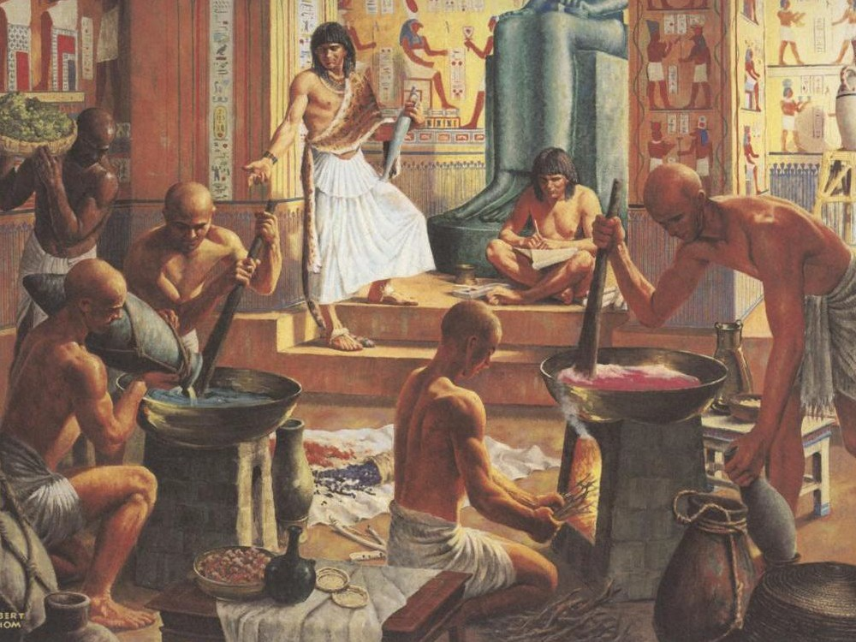

Slide 47
Egyptian “Rogaine” circa 1553 B.C.
A concoction of heel of Abyssinian greyhound, date blossoms, and asses hoofs, boiled in oil

Slide 48
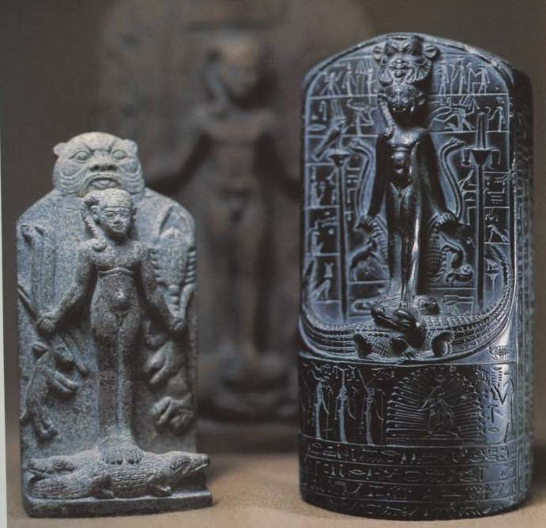
Horus, Son of Isis
Steles used against snake bites and scorpion stings
Patient would touch face and hope to be cured by the Stele’s magical powers
Epigrams covering are to guard against venemous bites

Slide 49
The Snake and the History of Medicine
A recurring theme in medicine, for centuries, the snake signifies renewal and rebirth
Sick prayed to them
Medicine men ate them, thinking they would have more healing powers

Slide 50
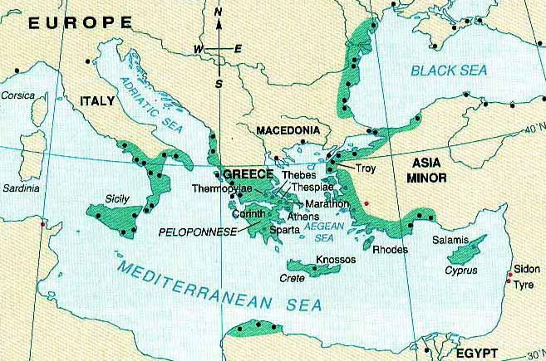
Ancient Greek Medicine 800BC – 300AD Greek Colonies, 500B.C.
Islands: navigation
and math to assist
Temperate climate, irrigation and cooperation for survival not as critical
Decentralized, priest bureaucracy was ineffective
Interacted with many other civilizations/ cultures
Notes:
Geography = peninsula, rocky hills with chalky soil so had to look outward for trade of food.
No single river system to connect hundreds of city-states and islands so allowed for independent growth. No strong centralized government or centralized priestly caste, so ancient Greeks free to generate many forms of thought and experiment with them.

Slide 51
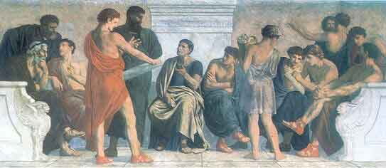
Peripatetic School founded by Aristotole
ASKED THE QUESTION WHY?
Mystic and supernatural:
rational, observational thought
Birth of free thought
Ideas presented/ defended in public forums: debated and analyzed
Individual began to be celebrated for the first time
Notes:
Peri-pa-tet-ic

Slide 52
The Ancient Greeks
Philosophy Democracy Psychology Ethics Government
Medicine as a science Mathematics
Physics Architecture Science
Greek physicians were influenced by science, led to the idea of diagnosis and prognosis – based in nature
Empedocles: 4 elements, body diseased if these elements were out of balance in the body
Notes:
We will talk more about Empedocles 4 elements….
(Em-PED-o-cleeze)

Slide 53
Ancient Greek Civilization 800 B.C.- 200 A.D.
The word “Pharmacy” derived from:
Greek “pharmakon” (drug or poison, also: a vegetable substance with magic powers that brought relief from pain)
Egyptian “pharmagia” or magic
Apothecary - Greek or Latin “apothecarius” or storekeeper
Apotheca - drug store house

Slide 54
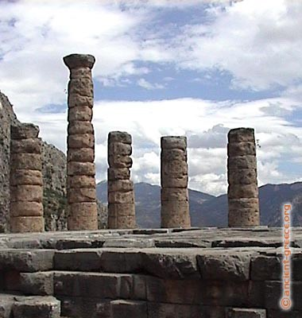
Greek Temple Medicine, Apollo – All Purpose God
God of sun, medicine, truth, and the arts- could bring and prevent disease
Greeks prayed to him for health
Mythology held a place to explain certain phenomena, morals and dilemnas
Didn’t believe that disease was a punishment for sin
Notes:
Apollo- also known as Alexikakos (the averter of ills) Alex-i- KA- kos
God of disease and healing.
Able to inflict illness on mortals by shooting poisoned arrows into them.

Slide 55
Asclepius, God of Physicians and Practitioners in the Healing Arts, 600 BC
100s of temples built to venerate Asclepius in Greek and Roman cities
  Temples - Served as a place to rest, hospital and worship
Practitioners and Schools of medicine around Greece and Settlements in his name – Asklepiads
Image became a divine ideal for physicians
Daughters:
  Hygeia (symbol of health, represented disease prevention)
  Panacea (symbol of treatment, medicine) assisted him in the temple
What is a panacea?
Notes:
Asclepius, son of Apollo, God of healing. (As-KLEP-ius)
Became the most significant healer, eventually eclipsed Apollo as the god of medicine.
Carried snake entwined staff called a caduceus. (Ka-due-see-us)
Taught by Chiron the Centaur who first mastered the art of pharmacy.
Panacea means a cure-all or a drug that will cure any disease or a variety of diseases.

Slide 56
Ancient Greek Temple Medicine &
Relationship to Current Day
Patient presents symptoms to the priest who may prescribe exercises, diets, rest, or drugs /
Part of the temple known as a kline (where patient sleeps) /
Where able patients encouraged to keep up daily activities /
Notes:
Patients directed to bathe, wear a white robe and offer gift of food or live animal to Aesclepius.

Slide 57
Ancient Greek Temple Medicine &
Relationship to Current Day
Patient presents symptoms to the priest who may prescribe exercises, diets, rest, or drugs /
Part of the temple known as a kline (where patient sleeps) /
Where able patients encouraged to keep up daily activities /
Healthcare providers do same today
“clinic” of today
occupational therapy of today
Notes:
Patients directed to bathe, wear a white robe and offer gift of food or live animal to Aesclepius.

Slide 58
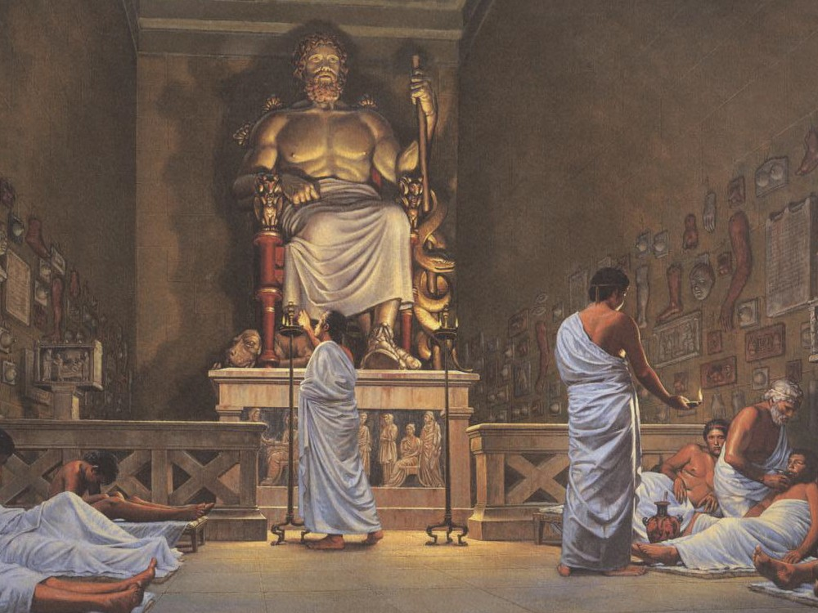
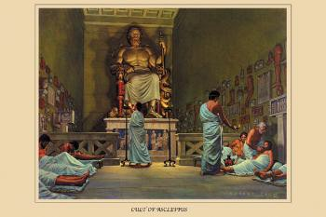
Cult of Asclepius(Asklepios)
Notes:
Asclepius with staff entwined with snake.

Slide 59
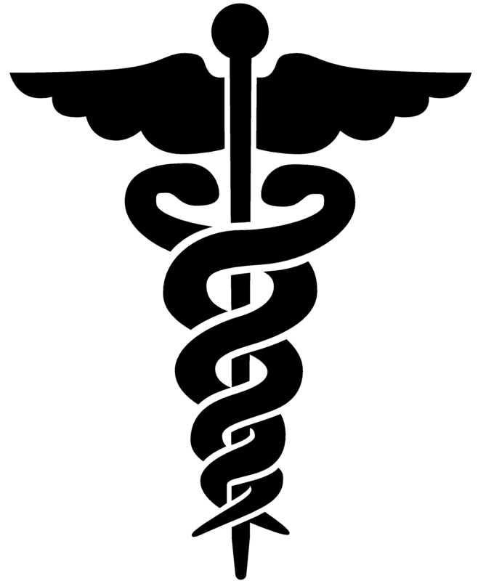
Caduceus, Mistaken Symbol of Medicine
US military adopted,1902, represents medical profession- Hermes (Mercury) staff
Staff of Asclepius , which has always represented medicine, one snake no wings
Shape familiar from biology?
Notes:
Ka-due-see-us

Slide 60
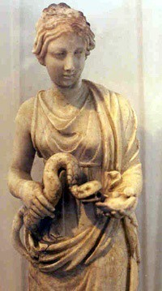
Hygeia, International
Symbol of Pharmacy
Bowl in hand: medicine and the snake, representing regeneration and health
1795 ,INTL symbol of pharmacy, French commemorated a coin with her picture
Notes:
Hygeia, daughter of Asclepius (son of Apollo)
Regeneration: snake sheds skin each year, representing healing or renewal.

Slide 61
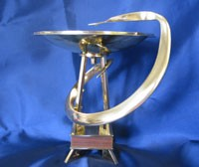
BOWL OF HYGEIA AWARD
Notes:
Awarded annually to outstanding pharmacist in each state in the USA.

Slide 62
Empedocles of Agrigentum (500-430 BC)
Developed ancient version of periodic table
Matter classified into 4 categories: earth, air, fire, water
Notes:
Em-PED-o-cleeze

Slide 63
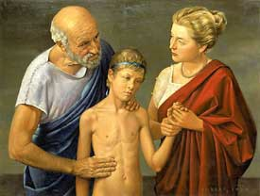
Hippocrates (460-379BC), Father of Medicine

Slide 64
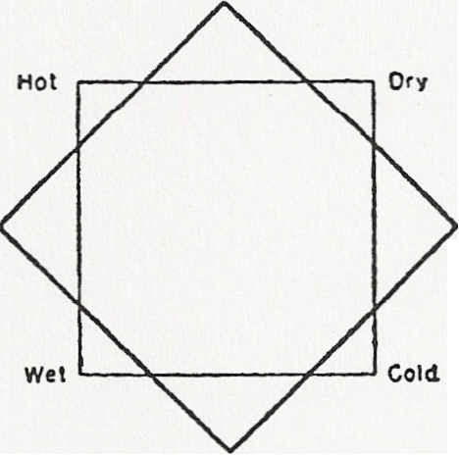
Hippocratic Humors
4 elements: water fire earth and air, replaced by “humors”
Fire YELLOW BILE
(Liver) hot and dry
Hippocrates stated body is composed of 4 humors, when healthy they are in balance (homeostasis)
Air BLOOD
(Heart) hot and moist
Earth BLACK BILE
(Spleen) cold and dry
Changed constantly due to the diet and environment
Imbalances could be compensated by drugs or bleeding
Theory lasted into the 20th century
Water PHLEGM
(Brain) cold and moist
Diagram of the Four Humors
Notes:
Humoral theory dominated for 1500 years, throughout the 19th century and remnants lasted well into the 20th century. It is said that George Washington was bled about 300 times before he died.
Change came with the discovery of germ theory in the 1870’s.

Slide 65
Hippocratic Medicine
Natural not supernatural terms to explain health and illness
Health was a state of harmonic mixtures of the 4 humors (eucrasia)
Disease a state of dyscrasia, unbalanced mix
Physician could assist nature, used DIET to correct the imbalance, followed by purging or sweating (laxative, diaphoretic), vomiting (emetic) and bloodletting
Finally stronger, compounded drugs or surgery
Notes:
Drugs or surgery were used as a last resort when diet, exercise, rest, and behavioral therapy not effective.
Step approach to treatment….how does this compare with practices today?

Slide 66
Allopathic Medicine
Treatment by Opposites
“Contraries are the cure of contraries” (Hippocrates)
Example to restore humoral balance to patient with illness
Patient suffering with a cold
Phlegmatic condition (cold and moist qualities)
Administer compounded mixture of cumin (hot quality) + hyssop (dry quality)
Notes:
“Treatment by opposites became known as allopathic medicine, which has become the dominant form of medicine practiced in the world today.
Example:
Thus, ancient Greek pharmacy, and consequently Western pharmacy, were influenced profoundly by humoral theory.” (Zebroski pg 52)

Slide 67
Characteristics of Hippocratic Medicine
DO NO HARM
The art of medicine more important than the science
Diet
Power of nature (physis) to heal on its own, physician assisted did not direct it and used very few drugs
Observation based on inspection, palpation, and succussion
First to classify disease into acute/chronic, diagnosis and prognosis
Kindness, dignity, cleanliness all stressed
Notes:
Palpation (examination with hands, feeling for organs, masses, or infiltration of a part of the body, feeling the heart or pulse beat or chest vibrations)
Succussion = action or process of shaking, such as to determine if fluid is present in a cavity, especially in the thorax.

Slide 68
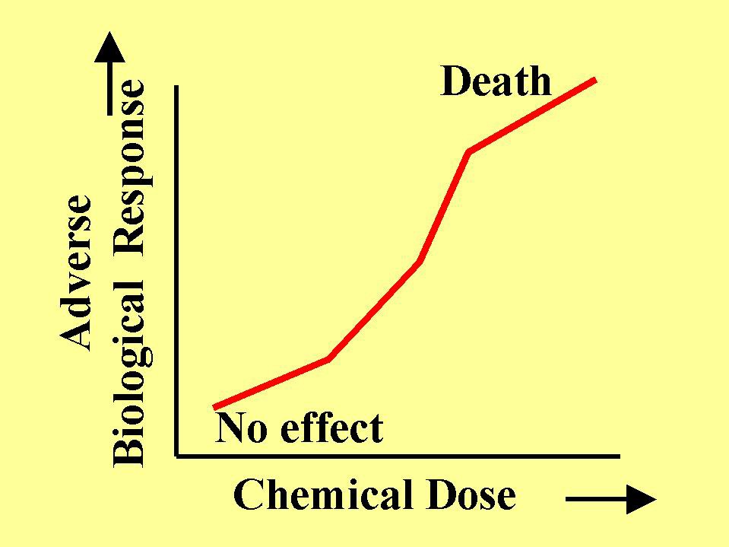
Hippocratic Drug Response
Drugs could be simple or compounded. The compounded blend had a dominant property or its quality was the sum of individual ingredients. This was their way of saying strength.
1st degree- effect produced only after repeated doses
2nd degree – effect after first dose
3rd degree – toxic after first dose
4th degree – lethal after first dose
Biological Response Graph in Pharmacology

Slide 69
Corpus Hippocraticum, 300 B.C.
Not written by Hippocrates
– Summary of various “schools” compilation of all medical knowledge known at the time, at the School of Alexandria
Naturalistic approach, not divine or supernatural
Detailed documentations of diseases, surgery and conservative treatments
Dissection was illegal
Humoral Theory
Hippocratic Oath
Ethical to refuse treatment if physician felt there could not be a positive outcome

Slide 70
CORPUS HIPPOCRATICUM
Pills
Ointments
Oils
Troches
Inhalations
Emetics
Narcotics
Cerates
Poultices
Gargles
Suppositories
Purgatives
Mention of more than 300 different herbal remedies.

Slide 71
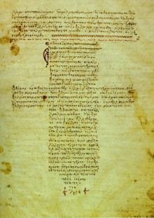
Hippocratic Oath
The oath is still taken today by physicians of some medical schools
Use dietetic measures
No deadly drugs or drugs that will assist in suicide
No pessaries for abortions
Delegate to surgeons and specialists don’t try to do it yourself
Do not seduce male or female patients
Keep consultation confidential
Pharmacy the Oath of Maimonides, Spanish
APhA Code of Ethics
Notes:
A reflection of the high ethical code of ancient Greek medical schools.
“I swear by Apollo, Aescleius….etc….to….”

Slide 72
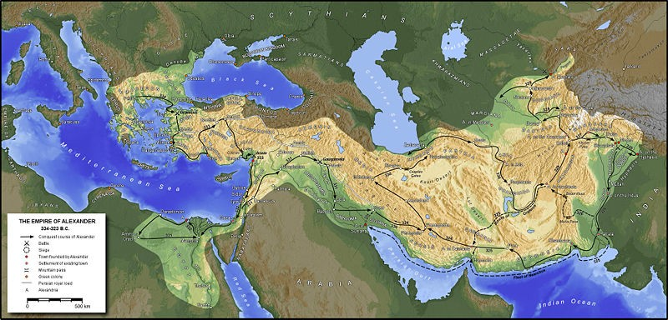
Alexander the Great and the Library at Alexandria, 330BC

Slide 73
Alexander the Great, 330 B.C.
Alexandria became the center of Greek civilization
Most sophisticated library in the known world
Science and math, experimentation, increased and flourished
Dissection was legalized briefly, descriptions of blood vessels, pathology and polypharmacy were recorded
Corpus Hippocratum was catalogued at the Library of Alexandria.

Slide 74
(1st peak of Greek Medicine)
Medical “Schools” after Hippocrates (Humoralists)
Dogmatists – still followed the Humoral theory of Hippocrates (Balance) fairly closely, and treated via purging and bleeding
Herophilus (300BC), was a dogmatist that studied anatomy and surgery, used poly- pharmacy and the humoral theory

Slide 75
(1st peak of Greek Medicine)
Medical “Schools” after Hippocrates
Rationalists
Use of reason in formulating and adopting a theory concerning structure &/or body function
Every disease has cause(s), observable or hidden
Treatment/remedies based on logical deduction & observation
Made advances by dissecting humans
Notes:
The Rationalists believed in the use of reason in formulating and adopting a theory concerning the structure and/or function of the body, and the nature of health and disease. They believed that every medical phenomenon, every disease, has a cause, or causes, and that, while many of these causes are evident, many others may be hidden from direct observation. They also believed that these rationally derived theories of bodily structure and function, and the nature of health and disease, based on observation and logical deduction, should then be applied to the treatment of disease, and finding appropriate and effective remedies for them. The Roman physician Celsus was a chief proponent of this school.

Slide 76
Schools of thought after Hippocrates
(2nd peak of Greek medicine, 300BC -100AD)
NON-HUMORALISTS
Empiricists-felt scientific experiments and speculations were irrelevant in medicine, used more drugs than Hippocrates, just do what works. Healing based on and used experience. Believed in the healing power of nature. Physician should help nature to heal. Performed surgery. Believed to have written most of the “Corpus Hippocraticum”
Heraclides – an empiricist who wrote extensively on symptoms, surgery and drug therapy .
Notes:
Empiric sect founded by Heraclides – rejected anatomy and physiology as basis of medicine, argued that curing disease is all that mattered.
Believed successful medical practice consisted of: observation, history & analogy.
Believed clinical observation & experience vs. theory.
Ultimately Empiricists won out over Rationalists: Implications: (Zebroski)
Mechanical system of restoring bodily humors
Usually through administration of poly-pharmaceuticals -> (profound ramifications on future course of Western pharmacy with emphasis on searching for poly-pharmaceutical panaceas”)
Central tenant of Western medicine until displaced by the germ theory

Slide 77
Schools of thought after Hippocrates
(2nd peak of Greek medicine, 300BC -100AD)
NON- HUMORALISTS, continued
Methodists – (Themison) Disease caused pores to constrict or relax depending on degree of fever, evacuations or secretions.
  Constricted pores, then light diet, warm bath, humidity and laxatives. Liked gymnastics and exercise.
  Open pores, cold bath, fresh air, exercise, more food, astringent or astyptic drug, to close up pores.
Opposed to blood letting and purging
Treat slaves, minimal effort

Slide 78
Schools of thought after Hippocrates
(2nd peak of Greek medicine, 300BC -100AD)
NON-HUMORALISTS, continued
Pneumatists (Athenaeus) opposed other theories. Believed air (pneuma) went to heart and reacted with atoms in the arteries.
– Disease – interference of air circulation or not in sync with climate and moisture of the body. Good living conditions and fresh water for treatment.
Eclectics – used whatever philosophy or theory worked

Slide 79
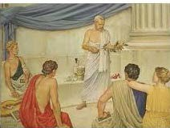
Theophrastus, Father of Pharmacognosy and Botany 370-286B.C.
Notes:
(Theo-FRAS- tuss)
Hold off…see upcoming slide….
Pharmacognosy is the study of plant drugs. It is concerned with the identification of the plant, part of the plant in which the active ingredient(s) (alkaloids, glycosides, etc) is found, locality where it grows the pharmacological action of the plant and its active constituents.

Slide 80
Theophrastus
Philosopher (student of Aristotle) and natural scientist.
Observed plants and their properties and wrote them down. Credited for creating the first taxonomy of plants.
Wrote books on the history of plants and described preparations, therapeutic uses and their pharmacology, obtained practical drug information from the rhizotomoi and pharmakopoloi.
Described peppermint, thyme, senna, juniper, hemlock.
Notes:
(Theo-FRAS- tuss)
Identified over 500 species of plants and explained their medicinal properties.

Slide 81
Plant Classification
Pharmacognosy study of active pharmacological ingredient or ingredients in plants. Identification, origin, the potency of its active ingredients (alkaloids) and the concentration in different parts of the plant.
About 70% of prescription and OTC drugs are derived in some form from original natural products.
Pharmacobotanists or the plant collectors of antiquity -Rhizotomoi, “root collectors” and the pharmakopolai – or drug sellers and apothecaries were experts on medicinal plants and their uses.

Slide 82
Rhizotomists (rhizotomoi)
Diocles 350B.C. 1st source of all medicinal plant information, upon which Theophrastus further classified.
Crateuas 100 B.C. 1st known illustrated Herbal.
Dioscorides 60 A.D. 1st materia medica survived antiquity. The first intellectual milestone in the development of pharmacy and botany.
Notes:
Dee-os-CORE-o-des
(Rye-ZOT-o-mist)
Rhizotomists were a group of pharmaco-botanists, experts on medicinal plants.
Their writings have not survived antiquity, but it is thought that most of the information about medicinal plants came from them and were distributed to the practicing physician of the time.

Slide 83
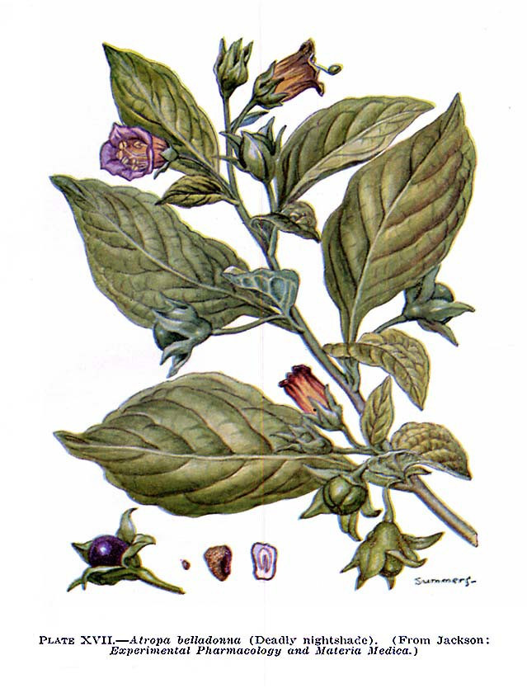
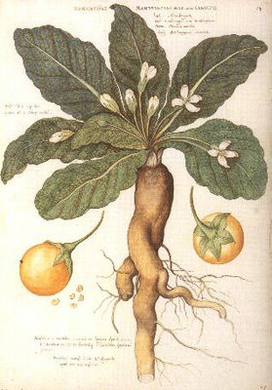
Belladonna (Atropa Belladonna) and Mandrake (Mandragora) Solanaceae
Notes:
Two plants well known in antiquity, containing alkaloid still used today – atropine (potent anticholinergic)
Both are members of the plant family Solanaceae, which includes capsicum, eggplant, tomatoes, potatoes, tobacco & jimsonweed.
Used for both treatments & poisoning.
The ancient Greeks were well aware of these poisonous qualities, and named the plant known in English as Belladonna, Atropa, after one of the 3 Greek fates that would determine how a person was to die. Atropa was used as a hallucinogen, cult worshipers of the Greek God Dionysius would add it to wine as part of their rituals (the cult promised eternal life and virility). It is said that Cleopatra used the juice of the mandrake to dilate her eyes and make her appear more attractive. Theophrastus (Theo-FRAS- tuss) records uses of mandrake for gout, sleep, wounds and as an aphrodisiac. The Romans used the wine of mandrake as an anesthetic, to be given prior to surgery or cauterization, a practice that lasted hundreds of years.

Slide 84
Belladonna and Mandrake
Mandrake, highly prized by Egyptians and Babylonians knew of its narcotic effect.
Active Ingredients: Atropine, hyoscamine, scopolamine (anti-cholinergic), highly toxic.
Used by ancient Greeks and Romans as a poison, aphrodisiac, stomach ailments, attained cult status in middle ages.
Today, found in Isopto-Homatropine, Donnatal tablets, Donnagel, Trans-Derm Scopolamine, tx of heart block and bradycardia.
Smoked, suppositories, liquid, tablets, drops, ointments
“Hot as a hare, blind as a bat, dry as a bone, red as a beet, and mad as a hatter".
Notes:
Atropine and other alkaloids in these plants are still used in a number of pharmaceuticals such as Isopto Atropine, Atropine Injection (on the WHO core list of essential medicines), as an antidote for organophosphate poisoning, stomach cramps, mydriasis and motion sickness
The classic line describing atropines’ anti-cholinergic effects: “hot as a hare, blind as a bat, dry as a bone, red as a beet, and mad as a hatter".

Slide 85
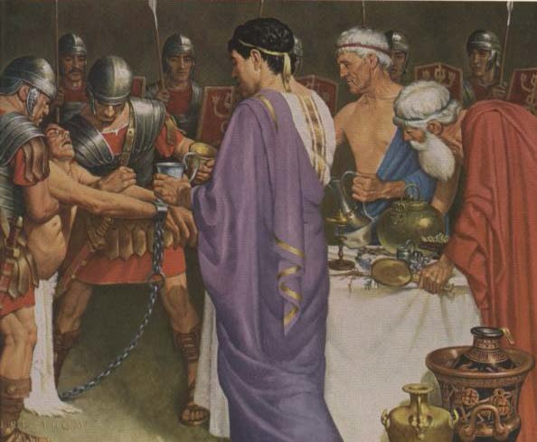
Mithridates, King of Pontus (100 B.C.), The “Royal Toxicologist”
Notes:
Mith RI date eze
Mith RI dates = antidote

Slide 86
King Mithridates VI of Pontus
“Father of Toxicology”
King ruled over Pontus about 120 – 63 BC
Interest in poisons and antidotes, experimented with them
Mithridatium, antidote to all poisons, contained > 50- 70 ingredients
(Later evolved to: treacle, galene, theriac)
Rhizotomists (root collectors) and pharmacopolists (drug sellers) in his court
Notes:
Mith RI date eze
Mith RI dates = antidote
Used poly-pharmaceuticals in antidote. If one did not help, another would.
Before the king’s palace was overrun by the Roman General Pompey, he asked to be poisoned…but none of them worked.
General Pompey captured the recipe for mithridatium.
Mithridatium used over the next millennium, became known as panacea for ailments. Produced up to 1752 CE when expunged from the pharmacopeia of the Royal College of Physicians of Edinburgh.

Slide 87
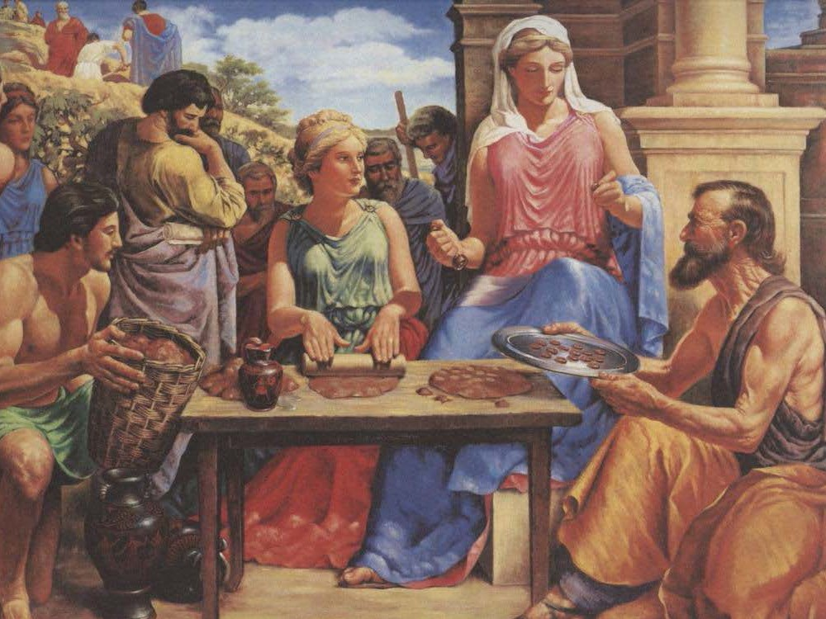
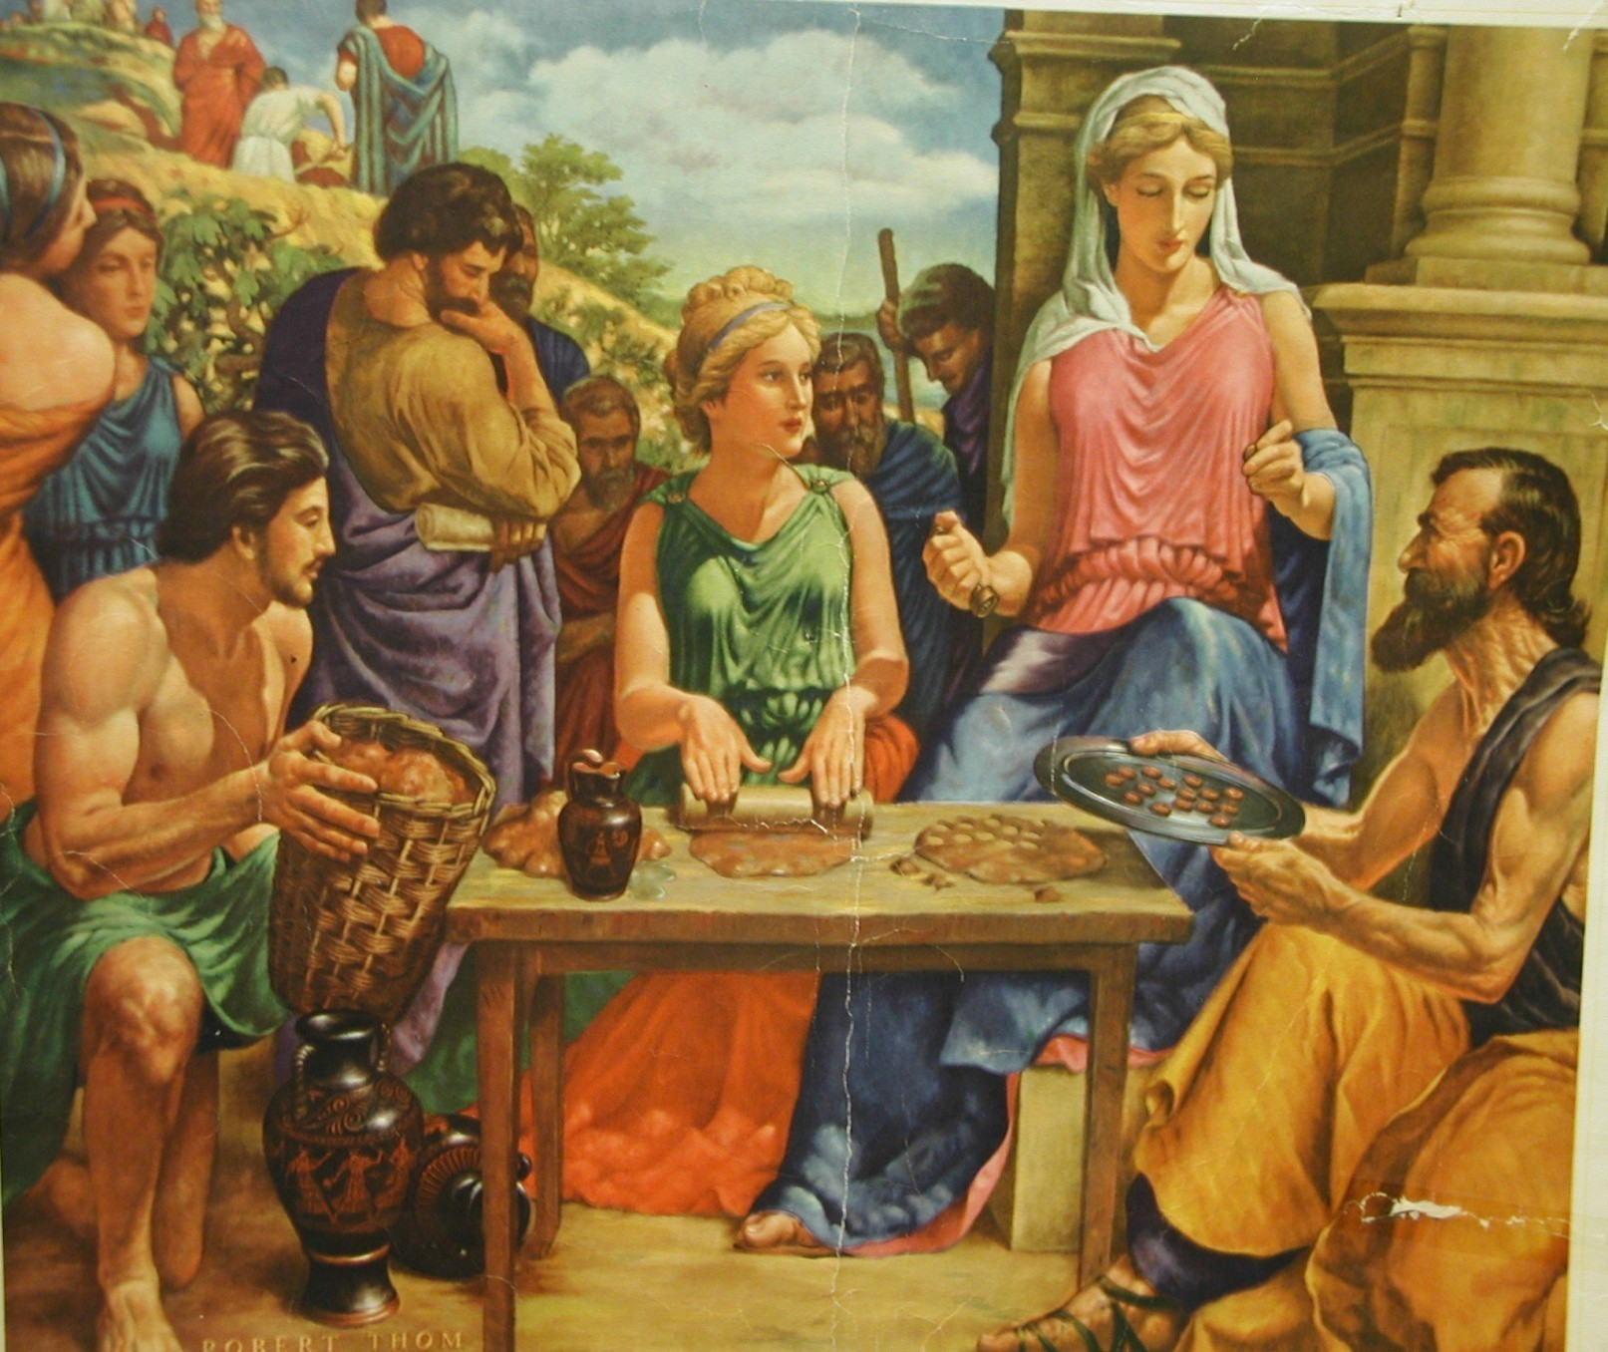
Terra Sigillata Early “Trademarked” Drug 500 B.C.

Slide 88
Terra Sigillata (sealed earth) 500 B.C.
Combination of greasy clay, silica, aluminum, magnesium and calcium salts, plus iron oxide
Antidote for poisons, treat dysentery, ulcers, hemorrhages, fevers, infections, animal & insect bites
Still used today – Kao-Pectate, antacids
Elaborate ritual was performed, with dignitaries, to commemorate the creation of terra sigillata. The stamped pastilles were distributed around the known world.
How important is the trademark?
Notes:
Terra Sigillata (Sacred Sealed Earth) & Hiera Pica (Holy Bitter) = 2 other great remedies used by ancient Greco-Roman physicians.
Survived for 2000 years.
Once harvested from the hillside, clay is washed, dried, rolled to proper thickness, cut into lozenges, and then impressed with an official seal by a
priestess.
Trademark on this: first trademarked drug that was sold commercially. Mark ensured patients were buying an authentic product from an established producer.
Today, how does a trademark affect a consumer’s view of a product? Is brand name product better?

Slide 89
Hiera Picra (Holy Bitter)
HIERA PICRA – an electuary employed in the temple of Aesclepius. The Asclepiads brought to Rome as they came in to the city claiming a “temple formula”.
Principle ingredients- aloe and canella bark.
99% had aloe, with a complement of other ingredients, changed through centuries and by maker. A panacea that cured everything -Always called Hiera….
Major ingredient is Aloe -Dioscorides is the first to identify aloe and record its “gentle purge” effect –Give ½ to 3 drachms (drachm is about 1/8 of an ounce) depending on degree of “laxation”.
Used for centuries, modified depending on maker and town.
Notes:
n Hiera-picra hī′e-ra-pik′ra a purgative drug from aloes and canella bark
Hiera-picra Also Hickery-pickery, Higry-pigry
Used as purgative.
Overpowering taste so mixed with honey to make palatable.
Included in the USP until 1870.

Slide 90
Dosage Forms of Ancient Greece
Confections – mix medicine powders with fruits or honey in mortar to form soft mass
Stored in clay pots or jars, doses removed when needed with spatula, rolled into ball and swallowed
Electuaries – form of confection, thinner, less congealed
Administered by licking dose from spoon or spatula or smeared onto licorice root to take
Notes:
Terms sometimes used interchangeably, causing confusion for the apothecary.

Slide 91
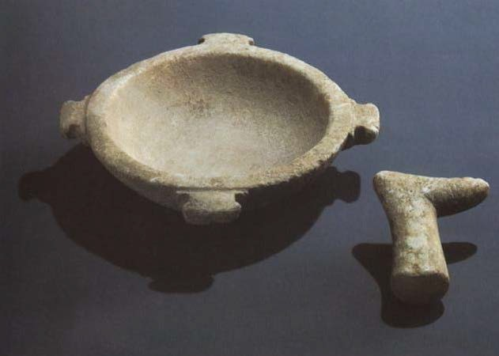
Greek Marble Mortar and Pestle, 1st Century AD

Slide 92
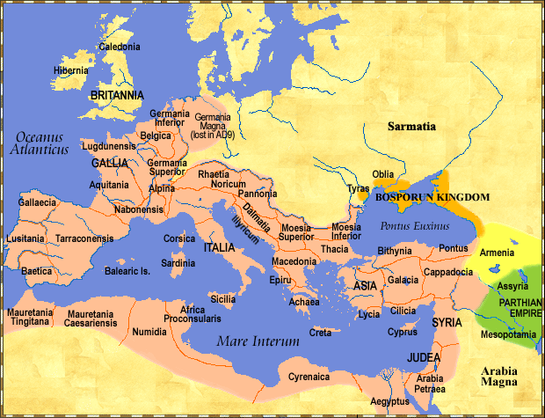
Roman Empire, about 100 A.D.
Huge army – became adept at surgery, applied medicine
Infrastructure, bridges, arches, architecture
Alleviated public health diseases-major advances water purification, sewage systems
Notes:
Romans excelled in the art of warfare, architecture, public health, and hygiene.
Water purification and sewage systems highly efficient (aqueducts) and most important at maintaining public health.

Slide 93
Roman Medicine
Head of the family, took care of sick members, slaves and livestock using folklore, herbs and incantations to fight disease. People knew their grapes and wines, cheeses and grains, weeds for tea, etc.
Relied on Gods and religious rituals to stop epidemics and sickness, had a God for every disease. Used Greek Gods such as Apollo, Asclepius, Hygeia, Panacea, all associated with healing power of the snake.
Greek physicians began drifting into Rome. Looked down upon physicians, used slaves and employed Greek physicians. Didn’t trust them (administered poison), low moral standards.
Notes:
Romans felt they could live without physicians. Taking care of the sick was considered uncultured and looked upon as a menial task.
They did not trust physicians. Eventually this attitude changed and Greek physicians were offered citizenship in Rome.
The Romans inherited Greek culture and medicine but felt that the practice of medicine was for uncultured men. They hired slaves to do the healing.

Slide 94
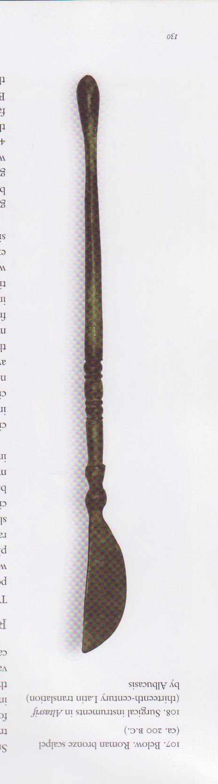
ROMAN SURGICAL TOOL, 100 A.D.

Slide 95
Greek Physicians in Rome
Asclepiads were physician/priests who practiced in Rome and practiced at the temple.
The temples led Romans to create public baths, part of the healing process.
Healers and quacks practiced anywhere including theatres and barber shops.
Rhizotomoi (Gr), pigmentarii, unguentarii, pharmakopolai (Gr), seplasiarri, all called apothecarius in Rome.
Medical practice was regulated in 230AD, when physicians were given tax privileges.
Julius Caesar eventually realized Greek physicians were of some value, offered citizenship.
Notes:
Around 117 AD the Romans had conquered most of Europe, the Middle East and the northern part of Africa (including Egypt).
Before Greek physicians arrived in Rome the Romans relied on gods to stop epidemics including religious processions. Romans had a god for every symptom or disease.
Combat Wounds. Romans mastered the tools and techniques of surgery since they had a large army. But for other medical problems they depended on Greek physicians. They began an elaborate system of training physicians.

Slide 96
2 Notable Scribe/Scientists-link from Greek Culture to the Romans (70AD)
Pliny, Roman General and natural historian, wrote “NATURALIS HISTORIA” encyclopedia of medicine and drugs, copied everything he could find and compiled (refers to 2000 books, now lost to antiquity).
Celsus, a Roman gentleman credited with meticulously translating Greek medical documents into Latin. De Medicina Octo Librii – classic texts on tx,surgery, therapy, pharmacology -also added his own opinions and ideas on medicine.
“Accurate diagnosis must precede treatment”.
Republished in 1478, by Pope Nicholas V, when no other medical text from antiquity was available.
Notes:
Pliny the Elder– books dealt with botany and medicinal use of plants.
“Introduced the “doctrine of signatures” maintaining plants exhibit characteristics in terms of color or form that were similar to the conditions they might be used to treat. Example: lungwort plant – lush leaves that resemble the lungs, so used to treat respiratory ailments.
“Magical healing qualities” – perpetuated folklore and myths about plants.
Celsus – Aulus Cornelius Celsus (25-50 AD)
Writings include:
history of medicine, general pathology, disease states, anatomy, pharmacy, surgery, & orthopedics
Weights & measures, compounding prescriptions, therapeutic use of drugs
Read more (Zebroski, Chpt 4, pg 57)

Slide 97
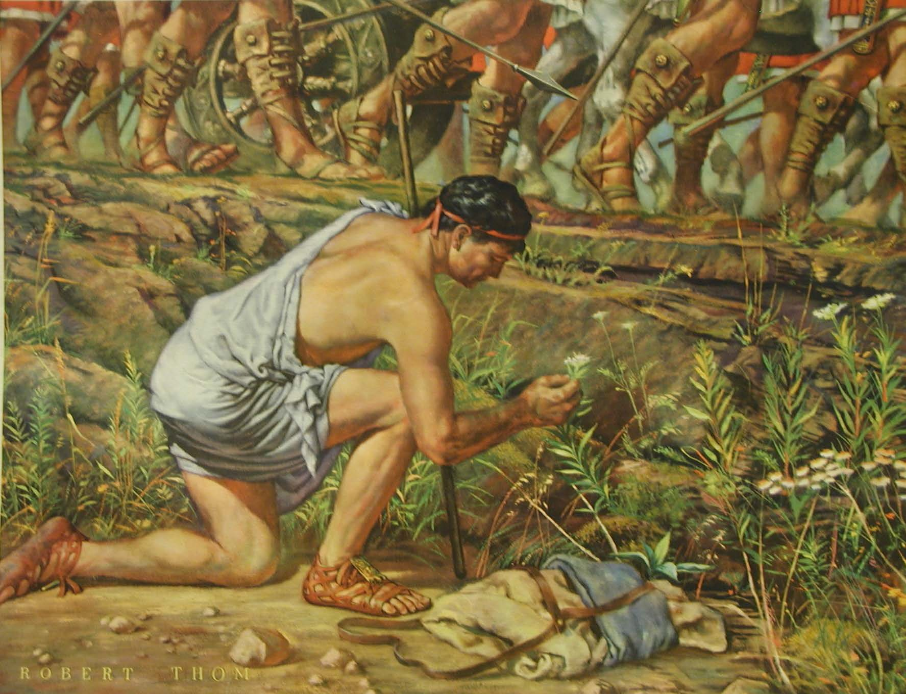
Dioscorides (100 A.D.) MATERIA MEDICA
Botanist and Plant Collector; categorized medicinal properties, animals, plants and minerals
Notes:
Dee-os-CORE-o-des (pronounce)
Serving as a surgeon to Roman legions, Dioscorides traveled widely and was able to collect, study, test and categorize plants.

Slide 98
Dioscorides
Materia Medica, a series of 5 books ,sum of all therapeutic knowledge, properties of any substance used for healing.
Well organized, medical uses. Storage and collection.
I- aromatics, oils, ointments, trees
II- living creatures, milk and dairy, cereals and sharp herbs
III- roots, juices, herbs
IV- herbs and roots
V- vines, wines and metallic ores
– Greek later translated to Latin, most important source of drug information used by the ancients and for centuries afterward
Described 600 plants, 90 of which were still used during WWI
Gives instructions for the detection of fake drugs, quite common especially with opium
Notes:
Dioscorides (100 AD). Contributed to the area of Medical Botany, Pharmacognosy and Materia Medica. He accompanied the Roman armies, collecting and later describing plant, animal and vegetable drugs. Described 600 plants, 90 of which were still in use during WW-I. He was a true natural scientist. The drugs were well organized in the books he wrote. Very scientific in his approach, ignoring the myths that were characteristic of many drugs used in his day. The medical uses of the drugs he collected were included in his writings. He wrote in Greek but later his books were translated into Latin (1554). His books “Herbarium de materia medica libri quinque” were considered the best source of information of drugs and were used continuously as the standard reference for plants, drugs and other substances with therapeutic properties.
Each herb had illustration with description.
“He discovered about 100 more plants than Theophrastus (Theo-FRAS- tuss) and knew about 450 more plants than Hippocrates did.” (Zebroski, Chapter 4, pg 56)

Slide 99
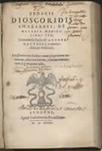
Dioscorides Materia Medica, 512 AD,
translated by Byzantine monk.
English translation -1655
Notes:
Materia Medica (medical material) is a Latin term for the body of collected knowledge about the therapeutic properties of any substance used for healing. Materia Medicas were used since antiquity through the early 20th century, but are no longer used.

Slide 100
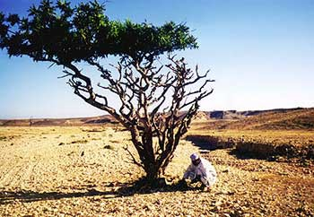
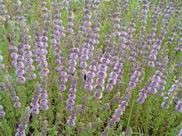
3 Notable Plants -Roman Empire:
Opium Poppy (opos)- common latex of the opium poppy, available in the marketplace – Romans would use for a painless death – its purgative and narcotic power well known
– heroin, morphine, codeine, papaverine
Frankincense (libanotos)- expensive, reserved the wealthy, used in ceremonies and as an antidote to hemlock poisoning
Pennyroyal (glechon)- used as a contraceptive tea, or burned in birthing chambers. Prostitutes and used pennyroyal to control all aspects of their menstrual cycles. Used as an emmenagogue, carminative and aromatic stimulant.
Notes:
Poppy (Papaverum Somniferum) Dioscorides distinguished 2 types of substances from the opium poppy: Opos from the growing poppy bud and the meconion – extract from the crushed leaves and head. Used as a purgative and narcotic in ancient civilizations, recorded used in Babylonian Era. Heroin, morphine and codeine are all derived from the opium poppy.
Frankincense was an expensive plant used in ceremonial rituals. It is the resin of the Boswellia tree, and has been used for over 5000 years.
Pennyroyal, (mentha pulegium) was used as a contraceptive tea, commonly employed by prostitutes of the era. It was long used as an emmenagogue, diaphoretic, carminative and aromatic stimulant. Greeks and Romans flavored wine with pennyroyal, and used it as a flavoring herb in cooking.
Emmenagogue = substance that stimulates of increases menstrual flow
Carminative = relieves flatulence
Diaphoretic = inducing perspiration

Slide 101
Beeswax and Honey
Honey was an excellent ingredient for wound dressings, due to its low pH (3.9), used for sweetening some drugs called electuaries -
medicinal paste compounded with honey or sugars to hide the taste
Added oils and fats along with honey would allow wound to dry out and reduce bacteria
Beeswax could easily be melted and applied, allowing adherence of plasters and poultices
Writing tablets that could easily be erased, jars and letters sealed
Notes:
Beeswax- served and important function during the Greco-Roman period of antiquity. Honey was an excellent ingredient for wound dressings, due to its high pH ( 3.9). By adding oils and fats along with honey, this would allow wounds to dry out and reduce bacteria. Beeswax could easily be melted and applied, allowing adherence of plasters and poultices. Beeswax was also used to seal jars and letters as well as create erasable writing tablets!

Slide 102
Mithridatum
The antidote ascribed to King Mithridates
Said to be effective against poisonous venom and other poisons like belladonna (atropine)
Composed of opium, myrhh, castor, ginger, cinnamon, saffron, duck blood, contained over 50 substances
After he was dispatched, his recipe was found. Eventually Andromachus (Nero’s physician) added vipers flesh- used for over 1000 years as a poison antidote and “cure-all” eventually became known as theriac or treacle (Br).
Notes:
MITHRADATUM is the name given to the antidote for poison that he developed. It was composed of opium, myrrh, castor, ginger, cinnamon, saffron, duck blood and 40 other substances, including poisonous material. Mithridatum was a cure-all, which would be reformulated throughout the centuries and eventually given the name Theriac. Used throughout the world, well into the late 1800’s.

Slide 103
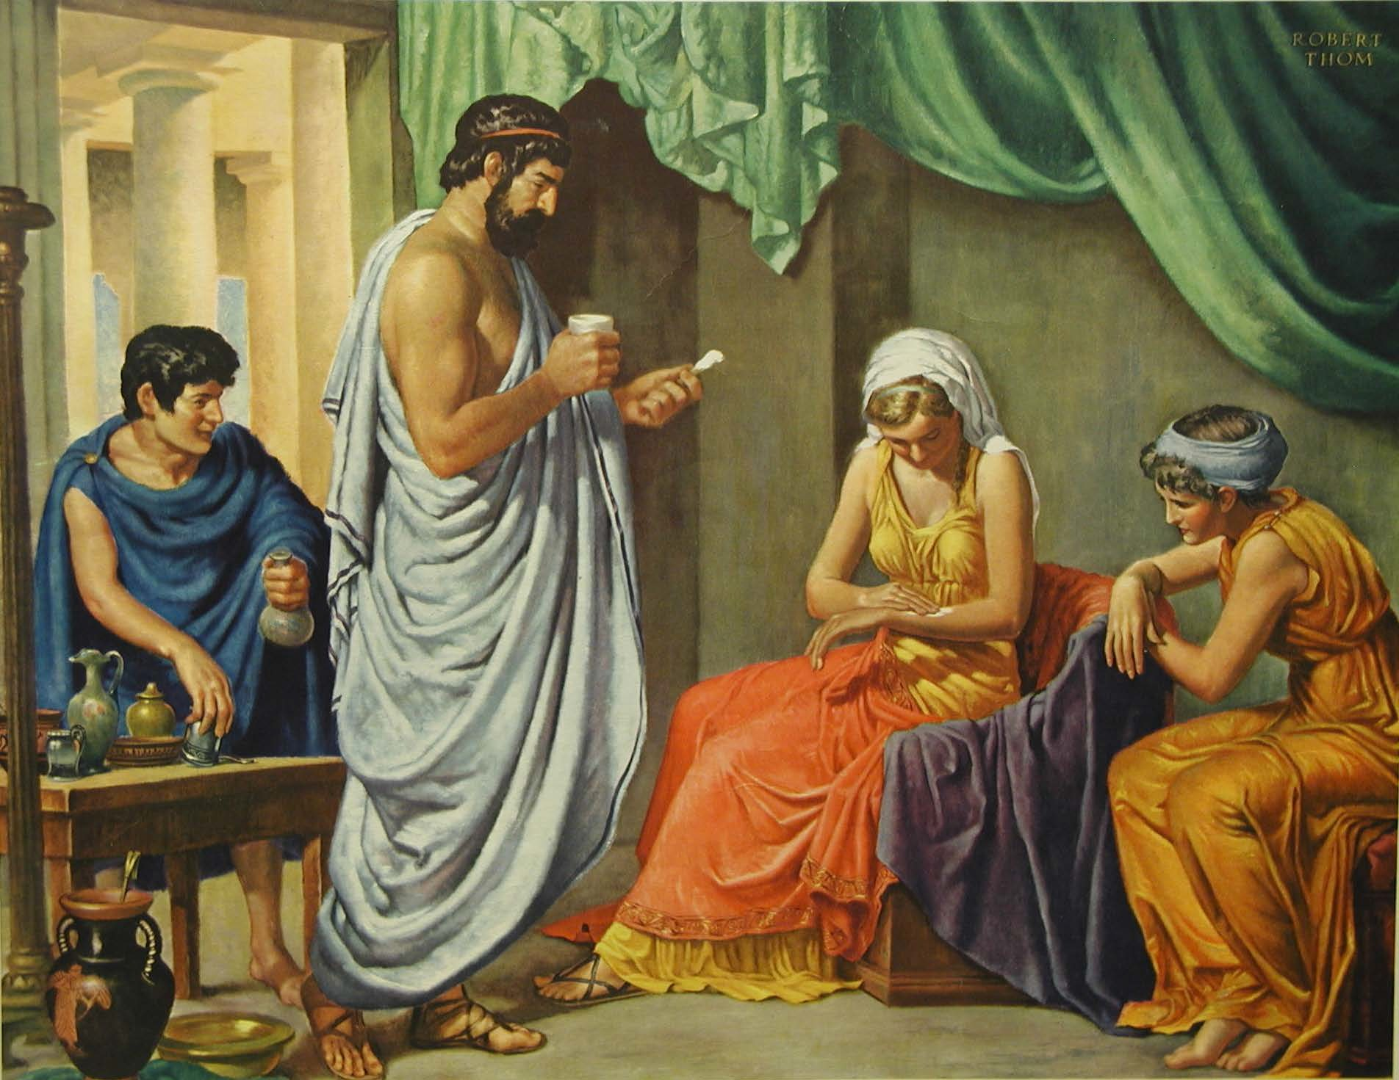
Galen A.D. 131-200 A.D., Physician to Emperors and Gladiators, Marks the End of Greek Medicine
Notes:
Claudius Galen

Slide 104
Galen’s Attributes
Excellent clinical observer , philosopher and teacher
  1st to take a pulse
  Wrote on blood, brain, nervous system, spine
Tried to systemize medical theories of the time (Dogmatism, Methodism, Empiricism, Pneumatism) in some of his over 1400 treatises, link between ancient Greek medicine and the Middle Ages
Criticized for fleeing Rome during a plague epidemic
First anatomic descriptions, of animals he dissected
  Extrapolated to humans
Addicted to polypharmacy, sometimes 25 drugs in one rx
  compounded rxs were henceforth called “galenics”
Used bleeding and evacuation
Theory of “laudable pus” meant wound is healing
Ruled medicine into the 17th century
Notes:
Claudius Galen. (130-200 AD). Physician. Born in Greek Pergamum (Now Turkey). Medical practitioner, lecturer and experimenter. He was the MD for the gladiators, and later to three Roman emperors. Galen traveled widely and was able to observe many different types of illnesses.
For 1500 years his concepts were the authority in the field of medicine in many lands.
Tried to systematize the medical theories of the time (mentioned previously). Tried to inject a scientific approach to the practice of medicine. He was an excellent clinical observer.
Dissected animals and extrapolated to humans, learned the function of the heart, liver, bladder, kidneys, and the circulatory system.
Personality: He was extremely dogmatic and could not interact with others. He denounced contemporary physicians especially the so-called "specialists." He was criticized for fleeing Rome during an epidemic.
Conclusions: Galen was unchallenged for almost 1500 years. He gave the impression that his medical beliefs were absolute and this attitude was welcomed during the middle Ages that followed.

Slide 105
Galen’s Humoral Theory
Modified the Humoral Theory of Hippocrates to treat disorders based on an individuals temperament (blood, phlegm, yellow bile, black bile) to include a temperament and season with each humor.
  Sanguine (passionate), spring
  Phlegmatic (sluggish & dull),winter
  Choleric (quick to anger) , summer
  Melancholic (depressed) , autumn
Notes:
He believed in a modification of the humoral theory of Hippocrates. He related each humor to a temperament or mood of the patient: Sanguine meant love. Phlegmatic aggressive. Choleric - melancholic. He was cautious in bleeding people but generally followed the other methods of Hippocrates.

Slide 106
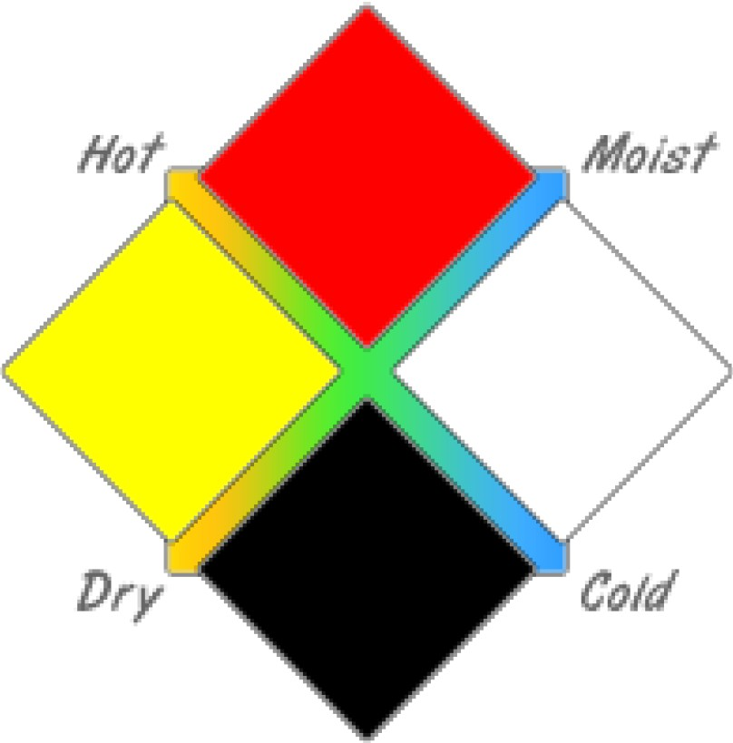
Sanguineus
BL00'D –AIR- SPRING
Cholericus
YELLOW BI LE -
FI RE – SUMMER
Phlegma ticus
PHLEGM - WATER -
WINTER
Melancholi cus
BLACK BILE – EARTH - AUTUMN
Notes:
See Figure 4.2 Diagram in Zebroski for another “like” version

Slide 107
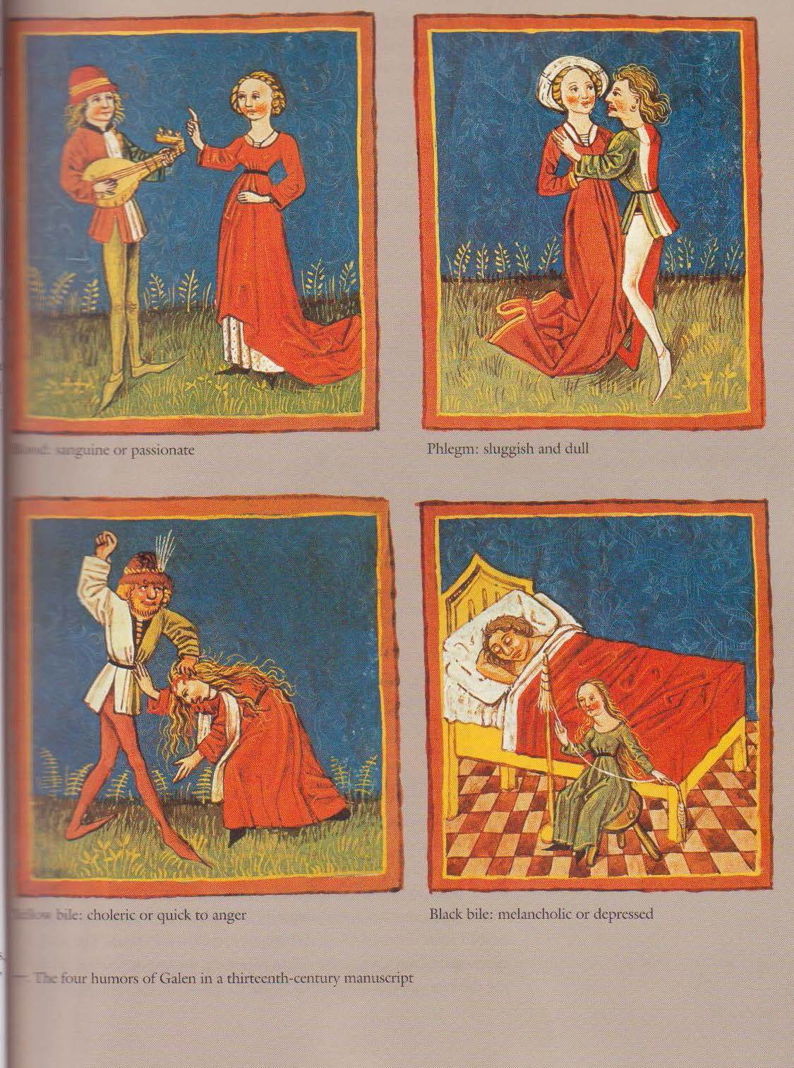
4 Humors of Galen, 13th century manuscript
Notes:
Sanguine (passionate), spring -Phlegmatic (sluggish & dull),winter
Choleric (quick to anger) , summer -Melancholic (depressed) , autumn

Slide 108
BLOODLETTING
Discovered by Egyptians
Central to Galen’s Four Humors Theory, excess blood caused a fever
Patients, in many cases, improved. Loss of blood induces vasopressin which in turn, reduces fever
Used until the mid 19th century

Slide 109
Galenicals
Important to pharmacy - Identified with compounding prescription dosage forms
  Classified herbs by healing properties
    Heating, cooling, drying or moistening
    Counteract lopsided humor
  Formulated the first cold cream (Unguentum Aqua Rosa) still used today
    Almond oil, rosewater and wax
Believed in polypharmacy
“The people want drugs”
Attempted to individualize doses using a scientific basis
Compounding Class - Galenicals
Notes:
Relation to Pharmacy.
Galen mixed, purified, and compounded dosage forms in a special area (iatreon) and administered them there. Drugs were stored in the (apotheca).
He is identified with compounding dosage forms and prescriptions. In the 30's and 40's US and Europe certain pharmacy school courses that involved compounding were titled Galenical Pharmacy I, II, etc.
Formulated Cold Cream (Unguentum Aqua Rosa - Rose Water Ointment). Remains basic ingredient in many cosmetics today. How many remember making this is compounding lab?
Galen prepared all medications on his own and was critical of other physicians who did not. Most followed his practices.
How did this affect pharmacy?

Slide 110
Theriac (Treacle)
Galen wrote an entire book about Theriac (theriaka) and gave it regularly to his patient, Emperor Marcus Aurelius
He continued to expand the formula of the original
mithridatum
– Added venom of vipers and other ingredients until it contained over 70 substances. Also recommended Terra Sigillata and Hiera Picra
Considered a universal antidote and a panacea, used until the 1880’s. Used for plague
Eaten in chunks or spread on the body, expensive
Many cities and towns compounded a theriac preparation with great pomp and circumstance, public ceremony
Theriac translates to opium is several languages
Idea of a universal antidote still elusive
Notes:
Galen believed in Polypharmacy. Was associated with Theriac (Wild Beast) which contained 64 ingredients and which was a modification of Mithridates (previously mentioned) which contained 54 drugs. Theriac was recommended by Galen as an antidote for snake bites and also used for Black Death (plague). Later it became a cure-all and was still in use in the 18th century.
Dispensed opium, hyoscyamus, colocynth, etc. which are still in use in certain parts of the world.

Slide 111
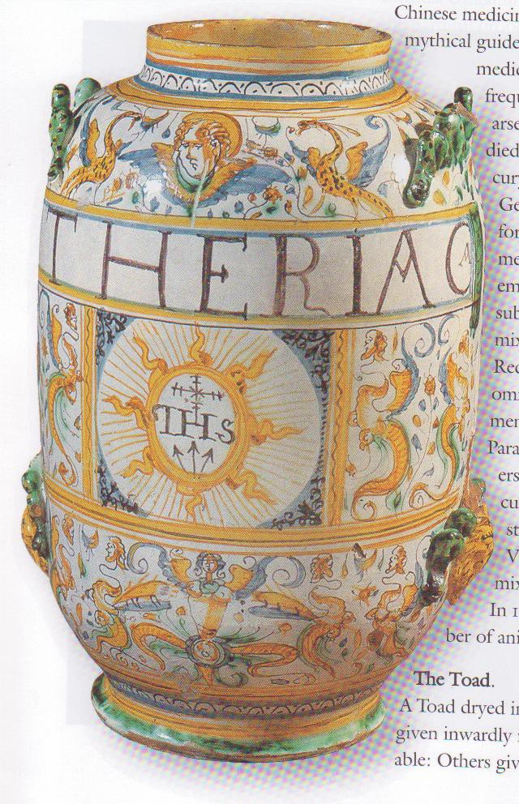
Theriac

Slide 112
Pharmacy in Ancient Rome
Dioscorides and Galen introduced apothecaries’ system of weights and measures in drug preparation
Most physicians prepared medications themselves
Writings indicate others preparing drugs, specializing:
Seplasia = a pharmacy
Selluarii = street stall, drug vendor shop
Medicina (drugs) prepared by medicamentarii, pharmacopoei, pharmacotritae, confectionarii
Medicamentarius = person who administers poison
Ungentarii = maker of ointments
Seplasarii = seller of ointments
Notes:
Those physicians purchasing drugs from others were criticized, especially if they did not check into the ingredients and how they were prepared.

Slide 113
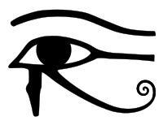


Symbol of Pharmacy RX – 2 Theories
Egyptian, Eye of Horus (Udjat), measure
Began during Emperor Nero’s reign
  R “Recipio” To take ( now Latin root recipere)
  Sign of Jupiter, allegiance to God Jupiter not Christianity-combined to form RX
Notes:
The Symbol of Pharmacy (Rx). It started during the reign of Emperor Nero in Rome. A doctor who ordered or prescribed drugs wrote the letter" R "on the prescriptions which was an abbreviation for "Recipio"--Take the following (drugs). To show the doctor's devotion to the pagan god and not to Christianity, he also placed the sign of Jupiter on the order. The two were later combined to form the Rx symbol
Recipere = Latin meaning to prepare

Slide 114
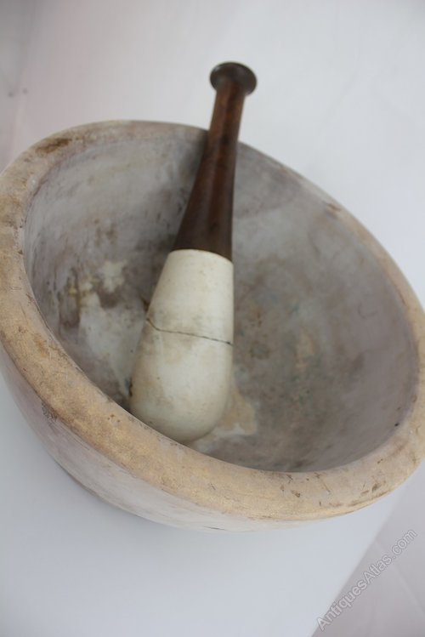
Mortar and Pestle
Date back to Egyptians, Romans named
Mortarium (Latin) -> Mortar (English) = receptacle for grinding
Pestillum (Latin) ->
Pestle (English)

Slide 115
Fall of Roman Empire
Germanic Tribes took over, malaria epidemic destabilized country, conquered Rome – some say lead vessels lead to decline, busy defending the empire in other countries
Catholic church saw the opportunity to translate Greek works into Latin
Church took over practice of medicine and plant cultivation for drugs
Church converted Roman Gods of Disease into Saints to pray to for particular diseases
As Roman Empire declined, so did progress in medicine and surgery and continued to decline through part of the Middle Ages

Slide 116
Roman Medical Authors of Note
Aulus Cornelius Celsus (1st century B.C.) – medical encyclopedist = De Medicina
Scribonius Largus (43 A.D.) – physician – wrote Compositiones (a dispensatory)
Pliny (1st century A.D.) - general/admiral/ diplomat – wrote Natural History
Paulos Aegineta (7th century A.D.) – lived during Arabian takeover/occupation – wrote Seven Books on Medicine
Notes:
NOT ON SLIDE:
Aulus Cornelius Celsus (1st century B.C.) – medical encyclopedist = De Medicina
Scribonius Largus (43 A.D.) – physician – wrote Compositiones (a dispensatory)
A dispensatory is a book or medicinal formulary containing a systematic description of the drugs and preparations used in medicine
Pliny (1st century A.D.) - general/admiral/ diplomat – wrote Natural History
Paulos Aegineta (7th century A.D.) – lived during Arabian takeover/occupation – wrote Seven Books on Medicine

Slide 117
Arabian Civilization
700 A.D. - 1200 A.D.
During the late 7th and early 8th centuries, the Muslim caliphate, established after Muhammad’s death, underwent a period of rapid expansion through war and conquest.
The Arabs (or Moors) conquered many older civilizations in their sweep across Northern Africa, Sicily and Spain.
Became a combination of Egyptian, Greek, Roman, Persian, Jewish and Spanish cultures.
Notes:
NEVER ON SLIDE:
Common language: Arabic
Common religion: Islam

Slide 118
Arabian Pharmacy Literature - Greatly Expanded
Four types of Arabic drug-oriented contributions:
  1) Formularies and compendiums – Theodoq, a court physician (709 A.D.)
  2) Books on herbals and the materia medica - Ibn Masawaih (857 A.D.) – physician & son of a pharmacist
  3) Toxicology treatises
  4) Diet and drug therapy in relation to human ecology

Slide 119
Arabian Pharmacy Literature - Greatly Expanded
Like the Romans, Arab writers tried to systematize medical knowledge and create encyclopedic works. Writer examples:
al-Razi – physician – scientific chemistry
Ali Ibn Abbas – the Royal Book - ethics
Ibn Sina – 5-part Canon – about 760 drugs
Abu-l-Qasim al-Zahrawi – medical encyclopedia w/ pharmaceutical concerns

Slide 120
Arabian Pharmacy
Drug armamentarium greatly enlarged.
New modes of drug therapy designed.
Pharmacy emerged as distinct calling from medical practitioners. Called “sayadilah” (mid-9th century A.D.) - examined and licensed by Muhtasib
Transferred Greco-Arabic medicine to western Europe via Sicily and Spain
Notes:
NEVER ON SLIDE:
The Arabian culture created a truly distinct and recognized profession of pharmacy during the 8th C. with: advances in drug armamentarium, pharmaceutical technique and government oversight.

Slide 121
Ancient Chinese Medicine
Theoretical basis found in
  Huang di nei jing (Huang di’ Inner Canon of Medicine)
  Zhang Zhongjing’s Shang han za bing lun (Essays on Cold and Miscellaneous Diseases)
System includes
  Yin-yang
  Five evolutionary channels
  Other theories including channel collaterals, viscera, pathogenesis, etiology, treating principles

Slide 122
Ancient Chinese Medicine
Yin-yang
  Two opposites in constant motion
  Disease is the result of yin or yang being in a state of excess or deficiency for an extended period of time
Five element theory (wuxing)
  Universe and everything in it, our health included, is controlled by the natural elements
    Wood: Associated with spring, the liver, and the gall bladder
    Fire: Associated with early summer, the heart, and the small intestines
    Earth: Associated with late summer, the stomach and spleen
    Metal: Associated with fall, the lungs and large intestine
    Water: Associated with winter, the kidneys and bladder
  Underscores belief that humans are interwoven with nature

Slide 123
Ancient Chinese Medicine
During end of Western Han dynasty, liquor was viewed as most significant medicine
Knives as stone needles, later evolved to using bronze to make needles
  Nine needle types for different types of treatments

Slide 124
Ancient Chinese Medicine
Bone and tortoise shell inscriptions show presence of:
  Headache
  Abdominal pain
  Dizziness
  Common cold
  Tinnitus, deafness
  Infectious diseases
Recognized relationship between seasons and occurrence of diseases

Slide 125
Ancient Chinese Medicine
Chinese Materia Medica
  Ancient term for herbal = ben cao
  Knowledge of properties such as taste, nature or property, channel affinity or tropism, toxicity, tendency toward tonification and reduction, compounded compatibility, indications, contraindications, dosage, methods of decoction, and administration
  Herbs derived from plants, animals, and minerals
Notes:
Knowledge obtained through clinical practice

Slide 126
Ayurveda Medicine
Indigenous living medical tradition on the Indian continent
Purpose is to “protect the health of the healthy and pacify the disease of the diseased”
The five elements (earth, water, fire, air, and space) are central to Ayurveda
Humans made of three pillars: imperishable self (atma), mind (sattva), and body (sarira)
Doctrine of three dosas or ‘vitiator’
  Vata (wind): regulates respiration, intestinal peristalsis, excretion
  Pitta (bile): responsible for digestion, metabolism, and psychic processes
  Kapha (phlegm): gives firmness to the body, regulates stabilizing functions, and refreshes the sense organs

Slide 127
Ayurveda Medicine
Eight disciplines
  Salyam (surgery)
  Salakyam (dealing with diseases above the clavicle)
  Kayacikitsa (medicine)
  Bhutavidya (science of dealing with spiritual possession)
  Kaumarabhrtyam (pediatrics)
  Agadatantram (toxicology)
  Rasayanam (preventive and strengthening measures)
  Vajikaranam (aphrodisiacs)

Slide 128
Unani Medicine
Entered India during Muslim invasions during the 1st half of the 6th century
Form of Greco-Islamic medicine

Slide 129
Shamanism
Thought to have existed since the Stone Age
Early form of polytheism with the following key beliefs:
  World is inhabited by spirits that can influence people
  Interconnections in nature that includes humans
  Humans are equal to other forms of life
  Human society is closely connected with the cosmos
  A human has the ability to acquire spiritual qualities and visit other worlds
  The aim of religious activity is to defend and make prosperous a small group of kinsmen
Illness contributed to evil spirits
  Illness is an expression of activities in the spiritual realm

Slide 130
Shamanism
Shaman
  One who connected directly with the spiritual world through a state of ecstasy
  Center of healing efforts
  May also be called a ‘medicine man’ but not all medicine men are shamans
  Two manners of healing
    Seeking up the fleeing soul
    Dislodging the disease object or spirit that has taken a person’s body in possession

